Slide 1





Sudan
A Profile of Malaria Control and Epidemiology
April 2016
Notes:
Background
The use of survey data, maps and epidemiological intelligence was a routine feature of control planning across most African countries during the Global Malaria Eradication Programme (GMEP), from the mid-1950s [Snow & Noor, 2015]. Data included epidemiological descriptions of transmission, vectors, topography and climate. There was a recognition, over 50 years ago, that one important source of planning data was infection prevalence among children aged 2-10 years (PfPR₂₋₁₀), used to define categories of endemic risk designed to guide and monitor progress toward malaria elimination targets.
The art and skills necessary to design malaria control, based on an understanding of the spatial epidemiology, was lost during the 1970s when the agenda for malaria control fell under a less specialized, integrated primary care mandate focused on managing fevers. In 1996, there was a renewed plea for better malaria cartography to guide malaria control in Africa [Snow et al., 1996] and over the last decade there has been a growth in spatial data on malaria and populations not available to malariologists or programme control managers 60 years ago. The growth in data has been accompanied by the development of statistical approaches to model and map risk and intervention access in space and in time using Model Based Geo-Statistics (MBG) [Diggle & Ribeiro, 2007].
At the launch of the Roll Back Malaria (RBM) initiative in 1999, calls for universal coverage of all available interventions was probably an appropriate response to the epidemic that affected most of sub-Saharan Africa during the mid-late 1990s [WHO, 2000; Snow et al., 2012]. Over a decade later, the international donor community is constrained by the global financial crisis, consequently accessing overseas development assistance (ODA) and using limited national domestic funding for malaria control now requires a much stronger evidence-based business case. These future business cases must be grounded in the best possible epidemiological evidence to predict the likely impact of future intervention, assess the impact of current investment and, equally important, demonstrate what might happen should funding and intervention coverage decline.
The Malaria Programme Review (MPR) undertaken in 2013 concluded that the FMoH should “Conduct risk mapping and burden estimation of malaria for stratification at the lowest possible administrative level using all available data including 2005, 2009 and 2012 Malaria Indicator Surveys (MIS) and routine data for strategy development” [NMCP, FMoH, 2013]
Action Points
Check for high resolution TIFFs for FMOH and NMCP logos
References
Diggle PJ & Ribeiro PJ (2007). Model-based geostatistics. New York: Springer
National Malaria Control Programme, Federal Ministry of Health (2013). Malaria Programme Review 2001-2012. Federal Ministry of Health, Republic of Sudan, Khartoum, December 2013.
Snow RW, Marsh K, le Sueur D (1996). The need for maps of transmission intensity to guide malaria control in Africa. Parasitology Today, 12: 455-457
Snow RW & Noor AM (2015). Malaria risk mapping in Africa: The historical context to the Information for Malaria (INFORM) project. Working Paper in support of the INFORM Project funded by the Department for International Development and the Wellcome Trust, Nairobi, Kenya June 2015; http://www.inform-malaria.org/wp-content/uploads/2015/07/History-of-Malaria-Risk-Mapping-Version-1.pdf
Snow RW, Amratia P, Kabaria CW, Noor AM, Marsh K (2012). The changing limits and incidence of malaria in Africa: 1939-2009. Advances in Parasitology, 78: 169-262
World Health Organization (2000). The Abuja Declaration and the Plan of Action. An extract from the African Summit on Roll Back Malaria, Abuja, 25 April 2000 (WHO/CDS/RBM/2000.17)

Slide 2
40 years ago…..
“.. but the fact remains that the basic epidemiology of the dynamics of malaria in the various provinces is still lacking. The malariometric surveys done in scattered areas of the country at one point of time, and the lack of reliable records on malaria morbidity and mortality from various health establishments, reflect the paucity of such basic knowledge”
MA Farid, WHO consultant to Sudan June-July, 1974

Slide 3
Topography: elevation, rivers & mountains
Elevation m.A.S.L
2917
0
Notes:
Background
Sudan was home to numerous ancient civilizations, including the Kingdom of Kush, Kerma, Nobatia, Alodia, Makuria and Meroë. By 3300 BC, Nubia and Nagadan Upper Egypt were joined under Pharaonic kingship. Because of its proximity to Egypt, the Sudan was influenced by Christianity by the 6th century and by Islam in the 15th century.
Sudan was divided in 2011 following the independence of South Sudan.
Sudan is a member of the United Nations, the African Union, the Arab League, the Organisation of Islamic Cooperation and the Non-Aligned Movement, and an observer in the World Trade Organization. Its capital is Khartoum.
Sudan is located in north eastern Africa, bordered by Egypt to the north, the Red Sea to the northeast (with an 853 km coastline), Eritrea and Ethiopia to the east, South Sudan to the south, the Central African Republic to the southwest, Chad to the west, and Libya to the northwest. Sudan is the third largest country in Africa. Sudan includes islands located in the Nile (including Aba Island, Badien Island, Sai Island, and, at the confluence of the Blue and White Nile, Tuti Island) and in the Red Sea (including the Suakin Archipelago).
The greatest part of Sudan is a vast plain traversed by the northward-flowing Nile River and its tributaries. The Nile River is formed near Khartoum by the confluence of the Blue Nile and White Nile. Flowing through the desert is the Nile Valley that provides habitable land within approximately 2 km either side and whose productivity depends on the annual flood. There are several dams on the Blue and White Niles, including the Sennar and Roseires Dams on the Blue Nile, and the Jebel Aulia Dam on the White Nile. To the east of the Nile lies the Nubian Desert and to the west, the Libyan Desert, in both deserts there is almost no rain and there are no Oases in the Nubian desert. Mountain chains and many hilly areas often reach altitudes of more than 2,000 m. In the west the Deriba Caldera (3,042 m), located in the Marrah Mountains, is the highest point in Sudan. The northern area is mainly desert, and the western sandy regions lead to the eastern Red Sea Hills. There are natural harbours at Port Sudan and Suakin on the Red Sea.
In the large areas of West Darfur and Kordofan regions, the absence of perennial streams means people and animals must remain within reach of permanent wells and hence the population is sparse and unevenly distributed. The plains of Western Darfur are dominated by the volcanic massif of Jabal Marrah (900 m) where the drainage supports a more settled population. Northern and eastern Darfur are semi-desert with water from only wadis or wells. The southern region of western Sudan is known as the qoz, of sand dunes that in the rainy season becomes grass and has more reliable sources of water with its bore holes and hafri. Here is also the Nuba mountain range. The area eastward from the Nuba Mountains to the Ethiopian frontier, broken only by the Ingessana Hills, and from Khartoum in the north to the far reaches of southern Sudan. Between the Dindar and the Rahad rivers, a low ridge slopes down from the Ethiopian highlands. Furthermore, in this heartland lies the jazirah, the land between the Blue Nile and the White Nile where the great Gezira Scheme was developed. This project grows cotton for export and has traditionally produced more than half of Sudan's revenue and export earnings.
Northeast of the central clay plains lies eastern Sudan, which is divided between desert and semi-desert and includes Al Butanah, the Qash Delta, the Red Sea Hills, and the coastal plain. Al Butanah, between Khartoum and Kassala, provides good grazing for cattle, sheep, and goats. East of Al Butanah is a peculiar geological formation known as the Qash Delta, created by the Qash River, enabling grasslands, trees and bushes which form grazing for the camels from the north, food crops and cotton.
Disputed boundaries
The border, towns and grazing lands between Sudan and South Sudan, following the referendum in 2011, remain contested [Craze, 2013]. During Sudan’s 2005 Comprehensive Peace Agreement (CPA) a Technical Border Committee (TBC) was established [International Crisis Group, 2007]. Of particular note is the Abyei region, because of oil reserves and fertile lands, this region has been the most contested [Salman, 2013]. Other areas which remain in dispute between Sudan and South Sudan include a) the Kafia Kingi Enclave (Western Bahr el Ghazal/South Darfur), known for its timber, grazing pasture, and rare mineral resources; b) the 14-Mile Area (Northern Bahr el Ghazal/East Darfur) which is grazing land just south of the River Kiir is vital for both the pastoralist Rizeigat the Malual Dinka of Northern Bahr el Ghazal. Following extensive Dinka complaints, in 1924, the Munro–Wheatley line was devised, running 14 miles south of the River Kiir; c) Jebel Megeinis (Upper Nile/South Kordofan): The area around the mountain of Jebel Megeinis in the north-west corner of Manyo County, is being cultivated by the Seleim, a Northern pastoralist people; d) Kaka Town (Upper Nile/South Kordofan): An important port on the Nile, Kaka town was transferred to what is now South Kordofan in 1923, in order to give Nuba populations access to supplies transported along the river. In 2012, the Government of Sudan extended its claim over the territory surrounding Kaka by 80 km, pushing into Upper Nile; e) Renk County (Upper Nile/White Nile), disputed area is just a few kilometres of valuable agricultural land, where the Abialang Dinka, have made protests over ownership.
Disputed territories also exits in the North, the Hala’ib Triangle and Bir Tawil Region between Sudan and Egypt. The Anglo-Egyptian Agreement of 1899 established the boundary between Egypt and the Sudan as the parallel of 22° north. Article 1 of that agreement stated that "The word 'Soudan' in this Agreement means all the territories south of the 22nd parallel of latitude. However, in 1902, for its own convenience, the United Kingdom drew a separate administrative boundary [GBIR, 1962; Guo, 2006]. This new boundary created two separate regions: the Hala’ib Triangle, the larger region which runs along the border’s eastern edge, and Bir Tawil, the smaller region immediately to its west. Sudan claims the Hala’ib Triangle but Egypt de facto administers security and economic development of Hala’ib region north of the 22nd parallel boundary; Egypt no longer shows its administration of the Bir Tawil trapezoid in Sudan on its map.
The rivers were downloaded from Global Lakes and Wetlands Database and complimented by other rivers digitized from a North Sudan map from Maps of World Database. The Digital Elevation model, DEM derived from 30m ASTER DEM: www.asterweb.jpl.nasa.gov/gdem
References
Craze J (2013). Dividing lines : Grazing and conflict along the Sudan – South Sudan border. Geneva, Switzerland. Retrieved from http://www.smallarmssurveysudan.org/
Geographer Bureau of Intelligence and Research (GBIR) (1962). International Boundary Study: Sudan – Egypt ( United Arab Republic ) Boundary. Accessed April 8th 2016 http://archive.law.fsu.edu/library/collection/LimitsinSeas/numericalibs-template.html
Global Lakes and Wetlands Database: http://www.worldwildlife.org/pages/global-lakes-and-wetlands-database
Guo R (2006). Territorial disputes and resource management: A Global Handbook. Nova Publishers.
International Crisis Group (2007). Sudan : Breaking the Abyei Deadlock. Africa Briefing No. 47. Nairobi/Brussels. Retrieved from http://www.crisisgroup.org/en/regions/africa/horn-of-africa/sudan/B047-sudan-breaking-the-abyei-deadlock.aspx
Maps of World Database: http://www.mapsofworld.com/
Ministry of Economy, Trade, and Industry (METI) of Japan and the United States National Aeronautics and Space Administration (NASA), ASTER Global Digital Elevation Model (ASTER GDEM) available at http://gdem.ersdac.jspacesystems.or.jp/index.jsp
Salman SMA (2013). The Abyei Territorial dispute between North and South Sudan: Why has its resolution proven difficult? In Land and post‐conflict peacebuilding, ed. J. Unruh and R. C. Williams. London: Earthscan. Accessed June 29, 2015 at [http://tinyurl.com/ngpwfvg]
U.S. Energy Information Administration. (2014). Country Analysis Brief: Sudan and South Sudan. Retrieved from https://www.eia.gov/

Slide 4
Administrative States (18)
Notes:
Context
Sudan operates a decentralized health system. The Federal Ministry of Health (FMoH) and the 18 States Ministries of Health (SMoH) are jointly mandated to ensure the health of the Sudanese population. The FMoH is responsible for setting of national policies and legislations, intersectoral collaboration, overall supervision and evaluation of the health system, international relations, management of skilled cadres, and quarantine and control of epidemics that are beyond the capacity of state or those of nationwide threat. In each state, the SMoH is responsible for administration and financing of the health system and management of hospitals. Within each State, there are a number of localities that are responsible for the management of family health centres and family health units. Local councils are also responsible for water and sanitation services. In addition to Ministry of Health structure, some health facilities are managed by the private sector and other ministries and agencies of government such as the Ministries of Higher Education, Interior, Defence, and the National Health Insurance Fund. The private sector, which is growing at a rapid pace, is concentrated in major cities and focuses on curative care [WHO, 2014].
State Level Malaria Control Programmes operationalize control down to Locality where there should, in theory, be a Locality Malaria Control Department and/or Malaria Focal Person [NMCP, FMoH 2013].
Localities shown in next slide
Data sources and cleaning
A shapefile of Sudan administrative levels was provided by Dr. Aliaa Ali M. Bilal, WHO malaria coordinator for Sudan (bilala@sud.emro.who.int) to Dr Hoda Youssef Atta (attah@who.int), WHO regional Director for Malaria, Cairo, with permission from The Republic of Sudan’s General Directorate of Planning and International Health (Letter dated 11th June 2015). The shapefile’s metadata reports that State and locality boundaries were as per Presidential Decree in July 2013. This official boundary file was based on the Census 2009, State Government consultations in Eastern Sudan in 2009, 2010 & 2011 and Bureau of Local Government consultations in Darfur. This also represents a federal decision on boundaries in Darfur (boundary between West-Central and South-East states) and Kordofan (boundary between West-South and West-North).
The Shapefile contained delineation of 18 administrative states and 172 localities
Sliver polygons were found in both the states and the localities boundaries after performing quality checks on the data. The sliver polygons were eliminated for states boundaries first, then for the localities boundaries by doing away with multiple boundaries and maintaining just one boundary between two polygons. State boundaries were given preference as they appear more authoritative than the localities boundaries. In total, 190 sliver polygons were detected in the State boundaries and 975 sliver polygons in the localities boundaries, which were removed to provide a final cleaned administrative level boundaries shown above. A final shapefile is provided with this report
Sliver polygons are polygons that result when two lines are digitized twice along the same boundary and don't exactly coincide (digitizing inaccuracies), that is same line being captured separately on two different occasions [ESRI, 2014].
Data update: A new shapefile assembled in Sudan and containing 189 localities in 18 states was provided by Ghasem Zamani of WHO (zamanig@who.int) on 10/11/16 from in-country partners who assisted in developing the revised shapefile from documented evidence of boundary changes (Mujahid Abdin, Abd Alla Ibrahim, Khalid Elmerdi and Asma Tohami). These were carefully compared and matched to the previous shapefile described above and boundary differences noted especially in West and South Kordofan states. The boundaries were aligned to the new shapefile and 17 new localities added to bring the total to 189. The 18 state boundaries remain the same.
Acknowledgements
Dr Elfatih Malik fatihmmalik@gmail.com Ministry of Health, Wad Madani, Gezera State, Republic of Sudan
Dr Imadeldin A M Ismail, Director General, Planning & International Health, Republic of Sudan
Dr Gashem Zamani, Head, Malaria Programme, EMRO, WHO, Cairo
References
ESRI Tutorial (2014). Eliminate Sliver Polygons (Data Management). ArcGIS Resource Center. 2014. Accessed June 29, 2015 at [http://tinyurl.com/njseg9h]
National Malaria Control Programme, Federal Ministry of Health (2013). Malaria Programme Review 2001-2012. Federal Ministry of Health, Republic of Sudan, Khartoum, December 2013
World Health Organization (2014). Country Cooperation Strategy for WHO and Sudan, Brief. Accessed June 29, 2015 at [http://tinyurl.com/qeulxjg

Slide 5
Administrative boundaries: 18 States and 189 localities
Notes:
Lists of localities and their numbering per state are in accompanying excel

Slide 6
Modelled Population distribution
Notes:
Context
The population of Sudan is a combination of indigenous inhabitants of the Nile Valley, and descendants of migrants from the Arabian Peninsula. Sudanese Arabs are by far the largest ethnic group in Sudan accounting for 70% of the population with the rest of the population drawn from Nubian, Beja, Fur, Nuba and Fallata ethnic communities. Sudanese Arab tribes predominantly occupy the states of Khartoum, Gezira, Sehnar, White Nile and Blue Nile in the southern region, while Nubians in this region occupy South Kordufan. The eastern States of Sudan (Red Sea, Kassala and Gedaref) are inhabited mainly by the Beja ethnic community. In the north, the Northern and River Nile States are inhabited by ethnic communities of both Nubian (Halfaween, Sukkot, Mahas and Danagla tribes) and populations of Arab descent (Shayqeih, Jaalyeen, Robatab and Manasir tribes). In the Darfur region, prominent African tribes are the Fur, Zaghawa and Massalit and the Fur, after whom the region was named, being the largest. There are many other smaller groups in Darfur including the Berta, Dago, Turjum, Fallatah, Bodaya, Tama, Maba, Bagirmi, Bande, and Nuba-Nubian tribes [Izady, 2012].
Sudan’s population is predominantly Muslim with most residents speaking Sudanese Arabic.
The first population census in Sudan was conducted under British colonial rule between 1955/1956. Conducting accurate population censuses have been challenging due to decades of conflicts. The exclusion of war-torn rural areas and weak logistics during population census have raised concerns about the accuracy of results of previous census in 1973, 1983 and 1993. The 2008 (5th) National Population and Housing Census is considered to be the most comprehensive and was implemented jointly by the Central Bureau of Statistics (CBS) in Sudan and the Southern Sudan Centre for Census, Statistics and Evaluation (SSCCSE) in the South with support from the international donor community. Over 7 million households were enumerated across 39,770 enumeration areas [Ahmed, 2008; CBS & SSCCSE, 2009]. It is projected from the last census that there were 38.4 million people living in the Sudan in 2015 and it is predicted that the population of Sudan will increase to over 40 million people by 2020 [CBS, 2010; CBS, 2013].
Data Assembly and modelling
The settlement of population in Sudan is largely defined by the ecology of the landscape, where communities have with time settled in agriculturally fertile areas of the Nile and its irrigated flood plains, or have not settled in exceptionally arid inhospitable areas. It is crucial in malaria risk mapping to ensure a congruence with predicted malaria risk and where people live. To improve our understanding of human settlement patterns, spatial modelling techniques have been developed to reallocate populations within census units to finer gridded surfaces [Linard et al., 2012; www.worldpop.org.uk]. In brief, a dasymetric modeling technique [Mennis, 2009] was used to redistribute population counts within the 86 spatial units used during the 2008 national census and land cover data sets derived from satellite imagery. A different population weight was assigned to each land cover class in order to shift populations away from unlikely populated areas, for example game reserves or arid deserts and concentrate populations in built-up areas. The net result was a gridded dataset of population distribution (counts) at 0.1 x 0.1 km resolution. The population distribution datasets were projected to years used to predict malaria risk and ITN coverage (see later) using UN national rural and urban growth rates [UN, 2014] and made to match the total national population estimates provided by the UN Population Division [UN, 2014] for these years.
Action Points
The surface shown is a poor reflection of the high resolution human settlement in Sudan. This is because only 86 actual population units were used to distribute population counts across vast spaces using a single algorithm. Settlement mapping would be improved with higher spatial resolution input data, for example enumeration areas, or at the very least population counts based on old 172 localities, and ways to train models based on geo-located settlement databases (next slide). Efforts should be made to connect with the Sudan CBS and access higher res 2008 census data and/or settlement databases.
At the very least we need population counts for 2008 census BY EACH LOCALITY.
We are limited here without a high resolution population map for Sudan, both in terms of defining the margins of risk and also the population-weighted attributes by locality. Presently this cannot be done because of imprecision in the denominators by locality
References
Ahmed AH (2008). The Fifth population census in Sudan: A census with a full coverage and a high accuracy. Neelain University. http://unstats.un.org/unsd/demographic/default.htm. Accessed 03/03/2016
Central Bureau of Statistics (CBS) & Southern Sudan Centre for Census, Statistics & Evaluation (SSCCSE) (2009). 5th Sudan Population and Housing Census 2008, Priority Results.
Central Bureau of Statistics (CBS) (2010). Sudan National Baseline Household Survey 2009. Sudan Central Bureau of Statistics, Khartoum. www.cbs.gov.sd/en/files.php. Accessed 03/03/2016
Central Bureau of Statistics (CBS) (2013). Sub-national Population Projections of Sudan and Age-Sex Composition. www.cbs.gov.sd/en/files.php. Accessed 03/03/2016
Izady M (2012). Ethnic groups in Republic of Sudan (North). The Gulf/2000 project. http://gulf2000.columbia.edu/maps. Accessed March 2016.
Linard C, Gilbert M, Snow RW, Noor AM, Tatem AJ (2012). Population distribution, settlement patterns and accessibility across Africa in 2010. PLoS One, 7: e31743
Mennis J (2009). Dasymetric mapping for estimating population in small areas. Geography Compass, 3: 727-745
United Nations (2014). World Urbanization Prospects: The 2014 Revision, New York: Department of Economic and Social Affairs, Population Division: United Nations. http://esa.un.org/unpd/wup/CD-ROM/

Slide 7
Population Settlement mapping OCHA
Notes:
Source: Information Management Working Group (IMWG)
Contributor: OCHA Sudan
Date of Dataset: 01/08/2011
Date Accessed: 16/08/2016
This data is the updated and cleaned version of former ‘Sudan Settlements 22 Aug 2011’ dataset with structured p-coded attributes, however positional verification is still as of 2011 [HDX, 2016]. This shapefile was downloaded from OCHA’s Humanitarian Data Exchange portal [http://tinyurl.com/jxrb38f].
The point shapefile had a total of 12,002 settlements with other variables including type of settlement (village, secondary town, capital town, administrative centre etc), and whether the location was derived from GPS (approximately 50%) or other sources and OCHA PCodes. Given the localities are points they do not show the extents of each settlement, note Khartoum, which have been digitized in next slide, and importantly none come with any population density estimates.

Slide 8
Urban extents
Notes:
Context
The majority of Sudan's population is rural, with about a third of Sudanese presently living in urban areas. However, the wider metropolitan area of Khartoum (including Omdurman) has a combined population of circa 5 million people, almost 15% of the total population [CBS & SSCCSE, 2009]. With an urban growth rate ranging between 2.5-3%, it is estimated more that over 15.6 million people will live in urban areas in Sudan by 2020 [CBS, 2010; CBS, 2013; UN, 2014]. According to the Central Bureau of Statistics, an urban areas is defined as localities of administrative and/or commercial importance with population of more than 5000 inhabitants [UN, 2014].
The NMCP, FMoH, have historically used urban extents in their stratification of malaria ecologies for targeted control – See slides 17-18 – the specific nature of larval control featured prominently in the Khartoum Malaria Free Initiative, but its less clear what is done in other urban centres. Nevertheless, this strata is an important one to map reliably and tied to specific intervention in Sudan.
Data assembly
We have used the listings of major settlements provided by the online digital gazetteer Geonames (www.geonames.nga.mil/gns/) in combination with population density metrics provided under the WorldPop model (www.worldpop.org.uk) (see Slide 6), to identify areas with population density greater than 1000 per km² and polygons with a total population greater than 30,000 people covering an area greater than 5 km². This combined approach identified 51 significant urban extents and shown above. The spatial extent of each urban centre was digitized using Google Earth imagery and ARCGIS. An excel of the 51 extents accompanies slides and a shapefile of mapped extents.
Action Points
We need the FMoH and partners to define what urban extents they would likely target specific malaria interventions to. It is unlikely it will be all 51 shown above and if we are to map these effectively it needs some participatory discussion
References
Central Bureau of Statistics (CBS) & Southern Sudan Centre for Census, Statistics & Evaluation (SSCCSE) (2009). 5th Sudan Population and Housing Census 2008, Priority Results.
Central Bureau of Statistics (CBS) (2010). Sudan National Baseline Household Survey 2009. Sudan Central Bureau of Statistics, Khartoum. www.cbs.gov.sd/en/files.php. Accessed 03/03/2016
Central Bureau of Statistics (CBS) (2013). Sub-national Population Projections of Sudan and Age-Sex Composition. www.cbs.gov.sd/en/files.php. Accessed 03/03/2016

Slide 9
IDP (Green) and Refugee (Red) camps
Notes:
Context
Over 3.1 million people were recorded as internally displaced persons (IDPs) in 2016 [UNOCHA, 2015; 2016]. The UN estimates over 2.6 million (IDPs) in the Darfur Region alone. Sudan also hosts just over 0.7 million refugees displaced from neighbouring countries of South Sudan in the south and Eritrea to the west [UNHCR, 2015]. Refugees and displaced populations living in humanitarian camps represent special health needs and organization of services to meet these needs, often provided by UN and NGO aid agencies. For malaria, the Ministry of Health has long recognized the significance of defining the location of refugees for targeted malaria needs (see slides 17-18).
The map shows the distribution of main Refugee camps (n=34) as well as location of smaller IDP camps (n=70) [UNOCHA, 2015]. These are listed in accompanying Excel.
Action Points
These are fluid but if FMOH wants to target resources and specific recommendations to the IDPs and Refugees it would probably be better to define how this would be operationalized and use the attached excel to list the various principal partners to be engaged at each location in the delivery of services.
In addition, IDPs often get excluded from national household sample surveys. If this were thought to be a significant omission, to effectively plan services in these communities, it should be possible to construct a special survey of IDPs off-line from the main MIS in 2016-17 and arrange for various NGOs in partnership with FMoH to undertake a parallel set of survey activities.
References
UNHCR (2015). UNHCR historical Refugee Data. United Nations High Commissioner for Refugees. http://data.unhcr.org/. Accessed 15/03/2016.
UNHCR (2015). UNHCR Global Appeal 2015 update: Sudan. United Nations High Commissioner for Refugees. http://www.unhcr.org/. Accessed 15/03/2016
UNOCHA (2015). Sudan: Humanitarian Snapshot December 2015. UN Office for the Coordination of Humanitarian Affairs. www.unocha.org/sudan. Accessed 15/03/2016.
UNOCHA (2016). Darfur Humanitarian Overview March 2016. UN Office for the Coordination of Humanitarian Affairs. www.unocha.org/sudan. Accessed 15/03/2016.

Slide 10
Health facility mapping
Notes:
Context
Health Facilities Services Provision specifications
Basic Health Units: It’s the first point of contact to the health services and provides comprehensive basic health services, serving 5000 people within 5 Km radius or 30 minutes walking time
Rural Health Centre: It’s the first referral point, serving 20,000 people surrounded by basic health units and administratively responsible for supervising it.
Rural Hospital: Defined as a capacity of 40 beds, covering a population of 100,000 -250,000
General Urban Hospital (Locality Hospital): A secondary care delivery level with 200-250 beds covering a population of 500,000
States Specialized Hospital: Provides distinguished specialized services for at least one of the medical fields, is the state Referral and teaching Hospital with at least 100 beds, depending on the need to the service and national policy
Urban Health Centre: This is distinguished by virtue of its urban nature and should be the first point of contact for health services, including referral, in these areas, serving 50,000 people and surrounded by rural health centres and basic health units.
General State Hospital: The State referral hospital has a capacity of 300 beds for the State
Federal Specialized Hospital: It provides distinguished specialized services for at least one of the medical fields, is the national Referral and teaching Hospital with 150-200 beds
Federal General Hospital: A General referral hospital with 300 beds capacity, and serves the state population
It is stated that there are 6,183 public health facilities, out of which 765 are non-functioning. These are sub-grouped into 408 general hospitals, 2,020 health centres, and 3,755 health units including dispensaries. In addition, there are 159 private, 18 police and 12 military hospitals. Only 24% of the Primary Health Care (PHC) facilities provide the full PHC essential service package, while the other 76% provide services that are missing at least one of the components of PHC essential service package.
About 14% of population has no access to health facilities (defined as living within 5 Km from the nearest functioning health facility) with huge variation between states. Among health care providers, the country has 2,716 medical doctors, 1,507 medical assistances and 945 nurses [NMCP, FMoH, 2014]
Health Service mapping
As Sudan begins to reach elimination in several states, as per stated strategic ambitions, the use of community based infection prevalence becomes increasingly less sensitive and increasingly costly to measure with precision. Metrics for estimating risk must then include actual malaria case incidence by locality and then finally by facility and village.
In 2007, the FMOH stated that “The HMIS performance is weak, unreliable and fragmented. This was a result of poor administrations of the systems, under funding and inharmonious actions of different players in the health arena. Recognizing these facts, the FMOH has developed a plan to strengthen the Health Management Information System which will be financed through the Health Metrics Network (HMN). The strategy will further expand on this work and provide a Framework for future development.”
In 2013, the MPR concluded that “There is a general consensus among stakeholders that the malaria burden is decreasing and malaria programme is on track to reach the main objective of the national strategy however it is difficult to conclude the exact magnitude of the reduction particularly at subnational level from the available data, mainly from Health Management Information System (HMIS), due to its incompleteness and inaccuracy” [NMCP, FMoH, 2013]. The average reporting rate 2007-2012 was between 16% and 29%.
Pilots of DHIS began in 2008, under the National Health Information Centre (NHIC) of the Directorate of Planning & Policies. However, multiple disease surveillance systems were in operation and no definitive plan emerged to integrate these into a single system [Al Said, 2010].
For a situation analysis of various information systems in Sudan see thesis by Al Said (2010)
Action Points
We need to establish what was provided under GF support for Health Systems strengthening to Sudan and how this was used.
We don’t have a geo-coded Health Facility Master list, its not clear whether this exists or not or whether used or not. For example, a collaboration between us, INED/University of Khartoum and Lab Services/State Khartoum MoH is mapping with GPS a provisional list of centres that provide diagnostics, so assume a national geo-coded list doesn’t exist.
In four States slated for elimination (Khartoum, River Nile, Northern and Red Sea) – it would be imperative to begin the process of detail facility mapping, linked to case reporting in a more systematic data review way. We’ve started this in Khartoum but needs some extension and funding in Khartoum and other 3 States. Aim would be to define finer resolution case incidence.
References
Al Said SSE (2010). The Health Information System in Sudan: The Disease and outbreaks Surveillance System at the National Level and the State Capital: A Descriptive Study. Thesis submitted as a part of the Master of Philosophy Degree in International Community Health, Department of General Practice and Community Medicine, Institute of Health & Society, Faculty of Medicine, University of Oslo, July 2010
Federal Ministry of Health (2007). Five Year Health Sector Strategic: Investing in Health Achieving the MDGs.
National Malaria Control Programme, Federal Ministry of Health (2013). Malaria Programme Review 2001-2012. Federal Ministry of Health, Republic of Sudan, Khartoum, December 2013.
National Malaria Control Programme, Federal Ministry of Health (2014). National Malaria Strategic Plan: 2014-2016. Federal Ministry of Health, Republic of Sudan, Khartoum, January 2014

Slide 11
Climate and ecology
Notes:
Context
Climate plays a significant role in defining the natural extents and intensity of malaria transmission. Most notable in Sudan is the presence and seasonal abundance of water for vectors to develop. The following slides outline some of these climatic factors, some of which have been used in defining the limits of malaria transmission in historical maps (slides 16 and 17), albeit without the current ability to use remotely sensed data, and some are used as covariates in predicting the intensity of malaria in Sudan (slides 19 and 27).
Although Sudan lies within the tropics, the climate ranges from hyper-arid in the north to tropical wet-and-dry in the far southwest. Temperatures do not vary greatly with the season at any location; the most significant climatic variables are rainfall and the length of the dry season. Variations in the length of the dry season depend on which of two air flows predominates, dry north-easterly winds from the Arabian Peninsula or moist south-westerly winds from the Congo River basin.
From January to March, the country is under the influence of the dry north easterlies, continental trade winds. There is practically no rainfall countrywide except for a small area in north-western Sudan in where the winds have passed over the Mediterranean bringing occasional light rains. By early April, the moist south westerlies have reached southern Sudan, bringing heavy rains and thunderstorms. By July the moist air has reached Khartoum, and in August it extends to its usual northern limits around Abu Hamad. In September the dry north easterlies begin to strengthen and to push south and by the end of December they cover the entire country. Khartoum has a three-month rainy season (July–September) with an annual average rainfall of 161 mm.
In some years, the arrival of the south westerlies and their rain in central Sudan can be delayed, or they may not come at all. If that happens, drought and famine follow. The decades of the 1970s and 1980s saw the south westerlies frequently fail, with disastrous results for the Sudanese people and economy.
Temperatures are highest at the end of the dry season. In Khartoum, the warmest months are May and June, when average highs are 41.9°C and temperatures can even reach 48°C. Northern Sudan, with its short rainy season, has very high daytime temperatures year round, except for winter months in the northwest where there is precipitation from the Mediterranean in January and February. Lows in Khartoum average 15°C in January and have dropped as low as 6°C after the passing of a cool front in winter.
The haboob, a violent dust storm, can occur in central Sudan when the moist southwesterly flow first arrives (May through July). The moist, unstable air forms thunderstorms in the heat of the afternoon. The initial downflow of air from an approaching storm produces a huge yellow wall of sand and clay that can temporarily reduce visibility to zero.
Desert regions in central and northern Sudan are among the driest and the sunniest places on Earth. Areas around Wadi Halfa can pass years or decades without rainfall and are among the hottest places during their summertime.

Slide 12
Proximates for long-term climate conditions
Temperature Suitability Index (TSI)
Enhanced Vegetation Index (EVI)
Precipitation Worldclim
Notes:
Temperature Suitability Index (TSI): As a metric for the effect of temperature on malaria transmission, a temperature suitability index (TSI) has been developed at a spatial resolution of 1×1 km [Gething et al., 2011]. The TSI model uses a biological framework based on survival of vectors and the fluctuating monthly ambient temperature effects on the duration of sporogony that must be completed within the lifetime of a single generation of Anophelines and constructed using monthly temperature time series [Hijmans et al., 2005]. On a scale of increasing transmission suitability, TSI ranges from 0 (unsuitable) to 1 (most suitable).
There are no areas with TSI Zero in Sudan
Enhanced Vegetation Index (EVI): For vegetation, Fourier–processed EVI, derived from the MODerate‐resolution Imaging Spectroradiometer (MODIS) sensor imagery and available at approx. 1×1 km spatial resolution [Scharlemann et al., 2008] was used to develop an annual mean EVI surface. EVI is an index of intensity of photosynthetic activity and ranges from 0 (no vegetation) to 1 (complete vegetation).
Precipitation: Rainfall is one of the determinants of vector abundance. Monthly rainfall surfaces exists that are produced from global weather station records gathered from a various sources (1950‐2000) and interpolated using thin‐plate smoothing spline algorithm to produce a continuous global surface [Hijmans et al., 2005] and monthly average rainfall raster surfaces at 1×1 km resolution available from the WorldClim website. Precipitation is shown in mm monthly averages this period of time (1950-2000).
References
Hijmans R, Cameron S, Parra J, Jones P, Jarvis A (2005). Very high resolution interpolated climate surfaces for global land areas. International Journal of Climatology, 25: 1965‐1978
Gething PW, Van Boeckel, Smith DL, Guerra CA, Patil AP, Snow RW, Hay SI (2011). Modelling the global constraints of temperature on transmission of Plasmodium falciparum and P. vivax. Parasites & Vectors, 4: 92
MODIS Data repository: http://modis.gsfc.nasa.gov/data/dataprod/mod13.php
Scharlemann JPW, Benz D, Hay SI, Purse BV, Tatem AJ, Wint GR, Rogers DJ (2008). Global data for ecology and epidemiology: A novel algorithm for Temporal Fourier Processing MODIS data. PLoS One, 1: e1408
WorldClim website : http://www.worldclim.org/

Slide 13
Aridity
Hyper Arid
Arid
Semi Arid
Dry Sub Humid
Notes:
One of the largest drivers of both malaria transmission potential and human settlement is aridity.
Global mean Aridity Index from 1950-2000 at 30’ spatial resolution has been developed [Trabucco et al,. 2009]. Aridity Index (AI) = Mean Annual Precipitation / Mean Annual Potential Evapo-Transpiration. The Aridity index values increase for more humid conditions, and decrease with more arid conditions. Mean annual precipitation (MAP) values were obtained from the WorldClim Global Climate Data [Hijmans et al. 2005], for years 1950-2000. The Global Potential Evapo-Transpiration (PET) layers estimated on a monthly average basis were used to generate/aggregate mean annual values (MAE).
PET is a measure of the ability of the atmosphere to remove water through Evapo-Transpiration process. PET is calculated as PET = 0.0023 • RA • (Tmean + 17.8) • TD0.5 (mm / day) where Tmean is mean monthly temperature, TD is mean monthly temperature range and RA is the mean monthly extra-terrestrial radiation. The Hargreaves method has been used , monthly average temperature has been sourced from WorldClim database, and monthly extra-terrestrial radiation, calculated using a methodology presented by Allen et al. (1998). Temperature range (TD) is a proxy to describe the effect of cloud cover on the quantity of extra-terrestrial radiation reaching the land surface.
Using the United Nations Environment Programme (UNEP) classification : values of <0.03 are Hyper arid, 0.03–0.2 Arid, 0.2–0.5 Semi-arid, 0.5–0.65 dry sub-humid and >0.65 humid (for which there are none in Sudan). The hyper arid areas are shown in dark brown, and correspond to historical limits of malaria transmission (slide 16)
References
Hijmans RJ, Cameron SE, Parra JL, Jones PG, Jarvis A (2005). Very high resolution interpolated climate surfaces for global land areas. International journal of climatology, 25:1965-78.
Trabucco A & Zomer RJ (2009). Global potential evapo-transpiration (Global-PET) and global aridity index (Global-Aridity) geo-database. CGIAR Consortium for Spatial Information. Available online from the CGIAR-CSI GeoPortal at: http://www. csi. cgiar. org.
UNEP (United Nations Environment Programme). 1997. World atlas of desertification 2ED. UNEP, London

Slide 14
Previous Malaria Risk Mapping

Slide 15
Previous mapping of malaria risk in Sudan: The Wernsdorfer Brothers 1961-1963
Notes:
The earliest attempt to develop an empirical risk map of the Sudan was undertaken by the Wernsdorfer brothers as part of a WHO supported national pre-eradication survey [Wernsdorfer & Wernsdorfer, 1967]. The survey was undertaken from 1961 to 1963 and included spleen and parasite rates among over 24,000 children aged 2-10 years, detailed descriptions of seasonality, vectors, topography, and assembled health centre morbidity and mortality reports. This survey, during the GMEP, arguably provided a richer set of epidemiological data compared with most contemporary malaria indicator surveys. This would have been a unique data set to examine the historical extent of malaria in Sudan, however, despite repeated attempts to locate the sampled village-level data from this 1960s survey at archives across the Sudan these raw data appear to have been lost or might be located outside of the country in Austria.
Figure on the left is original map. This has been re-digitized and data used in figure on Right to represent PfPR among 2-9 year olds scaled proportionately to the lowest recorded value in Khartoum State (0.03%). Colours represent proportions of all infections by species according to legend; in Kordofan and Darfur provinces, there was only 1 case of Po (0.1% and 0.14% of all species respectively)
References
Wernsdorfer G & Wernsdorfer W (1967). Malaria in the middle Nile basin and its bordering regions. Z Tropenmed Parasitol, 18: 17-44

Slide 16
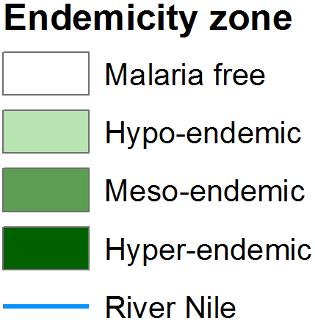
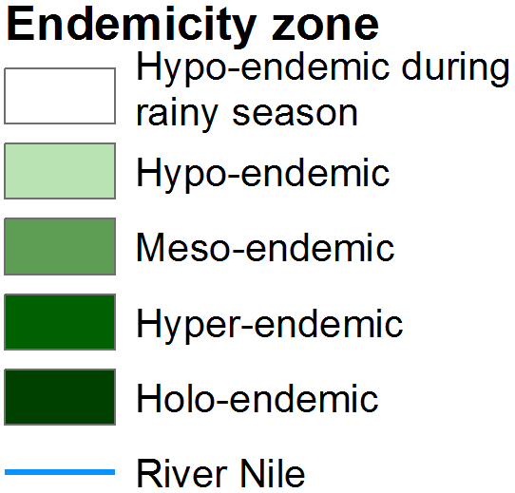
Previous mapping of malaria risk in Sudan (Re-digitized)
Nasr (1968)
El Gaddal (1986)
Notes:
During the late 1960s the widely held impression of malaria’s distribution and intensity is captured in the map developed by Nasr (1968), the precise information used to generate this map isn’t clear or available and likely to be based on expert opinion and experience of WHO consultants and national malaria control staff. This map suggests that there were no areas of holoendemicity but malaria intensity increased to meso-endemic levels further south, and its extent did not reach the Red Sea Coast or the Egyptian border. The map generated 20 years later by El Gaddal (1986) in a presentation of the extent and intensity of malaria transmission to USAID, did identify small areas close to what is now South Sudan’s border where holendemic transmission might occur and that the natural extent of transmission probably did reach the Red Sea Coast but did not reach as close to the Egyptian border, along the Nile, as was suggested 20 years earlier by Nasr. Again, the 1986 map’s information base isn’t clear and probably based on expert opinion.
Both maps have been re-digitized from original copies using on-screen using ARCGIS 10.1 and overlaid on current national Sate boundaries to allow for direct comparisons.
References
Nasr AH (1968). Preparations for future malaria eradication programme in the Republic of the Sudan. Al Hakeem, University of Khartoum, Faculty of Medicine, Journal of the Medical students Association, 7: 178-190
El Gaddal AA (1986). Malaria in the Sudan. In Proceedings of the conference on malaria in Africa: Practical considerations on malaria vaccines and clinical trials. Ed. AA Buck for USAID and AIBS, Washington DC, USA, December 1-4, 1986. Page 157

Slide 17
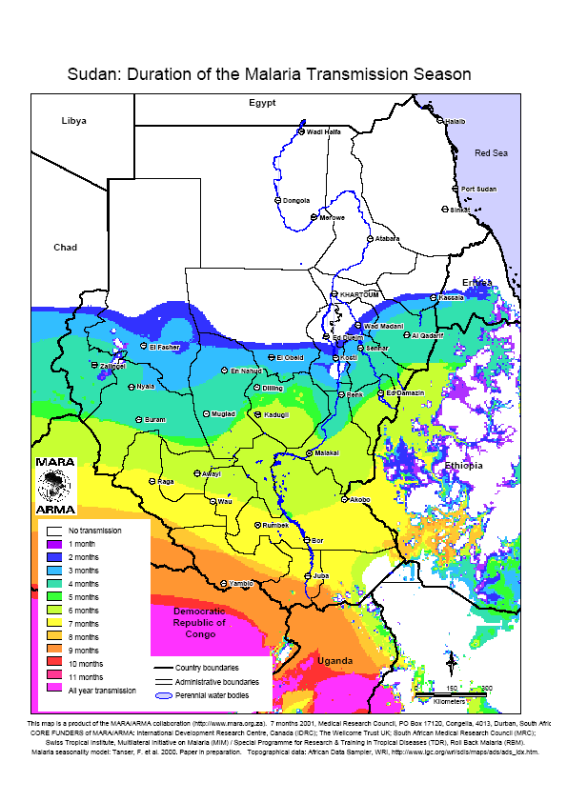
Contemporary Malaria risk maps used by NMCP
MARA map used in NMSP 2007-2012 and 2011-2015
Malaria stratification used in NMSP 2011-2015 and other documents
Notes:
More recent maps have included those used in the National Malaria Strategic Plan (NMSP) 2007-2012 [NMCP, FMoH, 2006] where climate modelled malaria seasons developed by the Mapping Malaria Risk in Africa (MARA) initiative were used to depict the longer duration of malaria transmission the further south in the country and the absence of malaria in the deserts of the north. This map was also shown in the NMSP developed for the period 2011-2015 [NMCP, FMoH, 2010].
The NMSP 2011-2015, was one of the first within Africa to lay out the foundations of sub-national stratification for control based on ecology, human settlement and malaria transmission. The strategy identified six strata (next slide) and mapped these – as shown above – where mixtures of interventions were provisionally targeted to mean the diversity of malaria within the national borders. This stratification and maps were also presented in the Malaria Programme Review in 2013 [NMCP, FMoH, 2013] and as part of the Insecticide Resistance Management Strategy 2016-2021 [FMoH, 2015]
Among specific human settlement strata were those living in Urban settlements (see slide 8 for more detail) and IDPs/Refugees (see slide 9 for more details).
References
Federal Ministry of Health (2015). Sudan insecticide resistance monitoring and management strategic plan: 2016-2020. Federal Ministry of Health, Republic of Sudan, Khartoum, August 2015.
National Malaria Control Programme, Federal Ministry of Health (2006). National Strategic Plan for RBM: 2007-2012. Federal Ministry of Health, Republic of Sudan, Khartoum, June 2006.
National Malaria Control Programme, Federal Ministry of Health (2010). Five years Strategic Plan for The National Malaria Control Programme, Sudan: 2011-2015. Federal Ministry of Health, Republic of Sudan, Khartoum, 2010.
National Malaria Control Programme, Federal Ministry of Health (2013). Malaria Programme Review 2001-2012. Federal Ministry of Health, Republic of Sudan, Khartoum, December 2013.

Slide 18
Six malaria Strata used to define intervention needs from 2011
Strata | Pop. | Areas | Main Technical Interventions
Desert fringe No transmission/ malaria free | 723,579 | Desert fringe area in the north above Latitude 15⁰ except cities, Riverine areas, irrigated scheme in River Nile State and delta Tokar in Red Sea | Case management, entomological/ parasitological surveillance and LLINs/IRS (where risk of infection is relatively high like areas around oases)
Riverine areas north of Khartoum Seasonal epidemics, related to floods & dams | 1,742,597 | Area about 20 Km on both sides of River Nile above Latitude of 15⁰ | Epidemic Early warning, early detection and rapid response. Case management, entomological monitoring, larviciding as appropriate And belt of protective ITN/IRS around free areas to be considered
Low malaria risk in urban extents | 10,455,583 | Khartoum and all large cities e.g. Port Sudan, Wad Medani…. | Case management, environmental management, larviciding and Epidemic Early warning, early detection and rapid response, LLINs in per-urban areas
Low-to moderate malaria risk 6-9 months of the year in irrigated agricultural schemes | 4,054,573 | All large- scale irrigated schemes (Gezira, Elrahad, Kinana, Asalia, West Sinnar, New Halafa & Elzidab,Suki,Khashm (Elgerba) | Case management, IPT, IRS and LLINs, larval source management, EPR
Low to moderate malaria risk | 14,540,340 | Rural areas other than irrigated schemes in Greater Darfour, Kordofan, Blue Nile, White Nile, Sinnar, Gezira, Gedarif, Kassala and Khartoum | Case management, LLINs, larval source management and EPR
Emergency and complex situation among IDPs and refugees | 5,000,000 | IDP and refuges (the number is as per 2007 and is subject to change) | Case management, LLINs, space spraying where appropriate
Notes:
It is important to recognise that the FMoH, and its partners in Sudan, identify with these strata and any future risk mapping must reflect these criteria. The country has an exceptionally diverse malaria transmission suitability, governed by latitude, agriculture and thus proximity to the Nile and Blue and White Niles, the huge urban concentration in large cities and the internal conflict that has led to displaced populations. The aim therefore is to use these criteria but improve upon their mapped extents using empirical data and a better articulation of what to-date has been referred to as “low” or “moderate” risk using empirical data from parasite surveys undertaken across the country (see slide 22).
In part this was attempted in 2012 (next slide).
Slide above adapted from two NMSP sources 2011-2015 and 2014-2016
References
National Malaria Control Programme, Federal Ministry of Health (2010). Five years Strategic Plan for The National Malaria Control Programme, Sudan: 2011-2015. Federal Ministry of Health, Republic of Sudan, Khartoum, 2010.
National Malaria Control Programme, Federal Ministry of Health (2014). National Malaria Strategic Plan: 2014-2016. Federal Ministry of Health, Republic of Sudan, Khartoum, January 2014

Slide 19
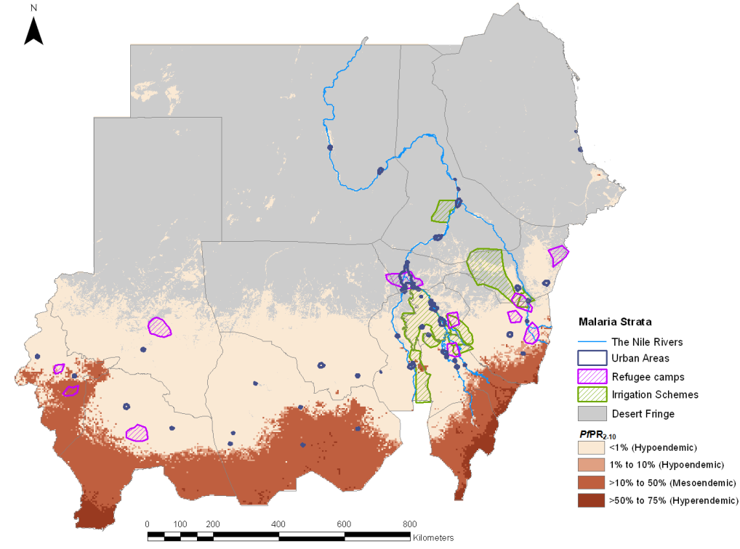
Malaria infection prevalence prediction model with other attributes for 2010 [Noor et al., 2012]
Notes:
In 2011, the KEMRI-Wellcome Trust programme/INFORM project in Nairobi worked with the Federal NMCP to use available malaria prevalence information and locations of urban settings and refugees to produce a more evidenced based malaria risk map for the country. In this exercise, a total of 2,604 community PfPR survey clusters from 913 unique locations were used covering the period 2000–2010 within a Bayesian space-time geo-statistical model framework to predict at un-sampled 5x5 km grid locations to the year 2010 [Noor et al., 2012]. The model included covariates (urbanization, precipitation and EVI). The final product used as a mask an aridity surface which did not quite capture the limits of transmission.
The image shown above was not used to describe malaria strata for control, other than showing epidemic risk, in the Malaria Programme Review in 2013 [NMCP, FMoH, 2013], and nor this was included in the final draft national malaria strategy in 2014-2016 [NMCP, FMoH, 2014]. The work was undertaken in close collaboration with the FMoH and attempted to reflect their needs of additional risk classes, but it remains the case that this map has not received much traction within the country for malaria planning.
References
National Malaria Control Programme, Federal Ministry of Health (2013). Malaria Programme Review 2001-2012. Federal Ministry of Health, Republic of Sudan, Khartoum, December 2013
National Malaria Control Programme, Federal Ministry of Health (2014). National Malaria Strategic Plan: 2014-2016. Federal Ministry of Health, Republic of Sudan, Khartoum, January 2014
Noor AM, Elmardi KA, Tarig A, Patil AP, Amine AAA, Bakhite S, Mukhtar M, Snow RW (2012). Malaria risk mapping for control in the Republic of Sudan. American Journal of Tropical Medicine & Hygiene, 87: 1012-1021

Slide 20
Revised Malaria Risk Mapping

Slide 21
Historical limits of transmission
Health Districts
Malaria Free
Transmission Limits
Notes:
There has been a historical context to the margins of malaria transmission in Sudan, based largely on the arid nature of the north within the potential for transmission along the Nile. These have been previously described by various authors beginning with the Sudan Medical Service in the 1930s [Sudan Medical Service, 1931; Nasr, 1968; Lysenko & Semashko, 1968; El Gaddal, 1986], examples of these are shown in Slide 16 [Nasr, 1968; El Gaddal, 1986]. Most descriptions and maps suggest that malaria does not exist above the 18th parallel except along the River Nile and its flood plains.
Provisionally, we have slightly adapted the 18th parallel rule to include areas of the North Eastern Red Sea border, including Port Sudan, where local transmission has been recorded [Hashim, 1998]. These margins approximately correspond with the borders between hyper-aridity that cover the two deserts in the North (Slide 13)
The “invasion” into Egypt and epidemics of malaria in Wadi Halfa region in the late 1940s, led to a significant investment by Egypt in the containment of malaria in the northern reaches of the Nile of Sudan as it borders Egypt [Shousha, 1948].
Action points
We do need the updated data from Wadi Halfa Gambiae Project to confirm zero transmission. For example we need to be able to say “Since xxxx and the survey of xxxx people in xxx villages from point x no malaria infection detected and no cases reported. The current upper boundary of transmission in Sudan therefore stops at xxxxx” – this needs confirmation and email sent to Houmouda on 19th April 2016 cc EMRO to set up confirmatory status
In addition, we have previously contacted Sidiqi Ismail, vector control specialist, FMoH for an update on sampled villages in Gambiae Project of Wadi Halfa area for years 2011, 2012, 2013, 2014 and 2015 – important if all zeros to attenuate risk in this bend of Nile (last 311015/241115)
In equal measure we need to confirm height of extents on Red Sea Littoral – and some better clarification of malaria at Port Sudan/Saukin – here colonial reports state clearly that malaria only imported and we need to interrogate this further
Precise risks within city limits of Khartoum needs more investigation and is part of work planned between State MoH Lab Directorate and INED.
All part of making sure the margins of risk right for future shrinking of the map as part of four State Elimination ambitions as stated in NMS
References
Hashim A (1998). Five years plan of action in malaria control in Red Sea State 1998-2002; Blue Nile Research and Training Institute, Giezera
El Gaddal AA (1986). Malaria in the Sudan. In Proceedings of the conference on malaria in Africa: Practical considerations on malaria vaccines and clinical trials. Ed. AA Buck for USAID and AIBS, Washington DC, USA, December 1-4, 1986. Page 157
Lysenko AJ & Semashko IN (1968). Geography of malaria. A medico-geographic profile of an ancient disease. In: Lebedew AW, ed. Itogi Nauki: Medicinskaja Geografija. Moscow, USSR: Academy of Sciences, pp 25–146
Nasr AH (1968). Preparations for future malaria eradication programme in the Republic of the Sudan. University of Khartoum Faculty of Medicine. Journal of Medical Students Association, 7: 178–195
Shousha AT (1948). The eradication of A. gambiae from Upper Egypt, 1942-1945. Bulletin of World Health Organization, 1: 309-348
Sudan Medical Service (1930-1959). Reports on medical & health work in The Sudan for the Years 1930-1959; published Mcorquodake & co. (Sudan) Limited, Khartoum; NPHL-Wellcome Library, Nairobi

Slide 22
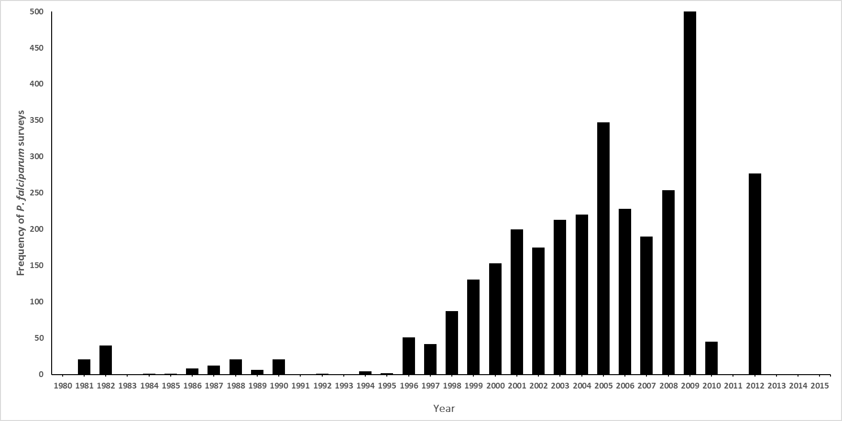
Malaria parasite prevalence surveys by year 1981-2012
Notes:
Given the lack of reliable HMIS data on malaria case incidence across much of the country and the likely stable transmission conditions that prevail in large areas south of the 18th Parallel, the use of parasite prevalence data is the default measure of risk. Parasite prevalence, and categories of prevalence, have been used for decades to define the appropriateness of interventions, pre-elimination states and a means by which to track impact of control. Surveys are often undertaken among complete or random samples of communities of all ages, school children, or among selected age groups within villages. The Sudan has a long history of survey work on malaria infection prevalence by research groups, student thesis projects, routine monitoring exercises in special areas (e.g Khartoum, Wadi Halfa and Giezera) and most recently through national household surveys.
Community-based surveys of malaria parasite prevalence have been assembled from a variety of sources including peer-reviewed journals, international and national ministry of health and academic archives, personal correspondence and more recent national household and school sample surveys. Methods used to identify, extract and geo-code survey reports are presented elsewhere [Snow et al., 2015].
Of the assembled data, we restricted inclusion of all surveys undertaken from 1980, five survey sites could not be geo-located and 24 had sample sizes less than 10 individuals. The earliest sample was in August 1981, it has not been possible to locate any community-based surveys of malaria prevalence since 2012.
Remaining series included in analysis was 3284 surveys at 1319 unique locations, more than previously used by Noor et al. (2012) (Slide x).
This assembly of survey data includes a) national household survey data covering individuals of all ages sampled during the October 2005, October 2009 and December 2012 malaria indicator surveys; b) repeat annual village surveys undertaken as part of the Blue Nile Health project and Giezera State surveillance between 1998 and 2009, when these surveys stopped [Mirghani et al. 2010], Khartoum between 20000 and 2009 [Nourein et al. 2011] and villages surround the Wadi Halfa, as part of the Gambiae project 1996 to 2010 [NMCP, unpublished data].
Of the 3284 time-space survey data points, 576 used RDTs for parasite detection (First Response Combo) during the 2009 national MIS and during the 2012 national MIS (Carestart Pf+Pan combo), the remaining surveys used microscopy.
At 1043 survey/time specific sites between 1981 and 2012, 195,843 individuals were examined using microscopy and P. vivax and P. falciparum were uniquely defined per examined slide. Among those surveyed there were 3527 (1.8%) P. falciparum infections and 141 (0.07%) infections with P. vivax.
All data assembled is provided to the NMCP accompanying this report, for future use and updating
Action Points
Data will exist from the Gambiae project 2013-2016 and the MIS for 2016 is planned to generate much more data – see previous slide
References
Mirghani ES, Nour BYM, Bushra SM, Hassan El I, Snow RW, Noor AM (2010). The spatial-temporal clustering of Plasmodium falciparum infection over eleven years in Gezira State, The Sudan. Malaria Journal, 9: e172
National Malaria Control Programme (NMCP) [Sudan] (2005). Malaria prevalence and coverage indicators survey, Sudan October 2005. Final Report – December 2005, National Malaria Control Program, Federal Ministry of Health, Khartoum
National Malaria Control Programme (NMCP) [Sudan] (2010). National Malaria Indicator Survey in the northern states of the Sudan 2009. Organization, Eastern Mediterranean Regional Office, Cairo, Egypt, March 2010
National Malaria Control Programme (NMCP) [Sudan] (2013). Malaria Indicator Survey Republic of Sudan – December 2012. National Malaria Control Programmme, Federal Ministry of Health, Republic of Sudan, Khartoum, September 2013
Noor AM, Elmardi KA, Tarig A, Patil AP, Amine AAA, Bakhite S, Mukhtar M, Snow RW (2012). Malaria risk mapping for control in the Republic of Sudan. American Journal of Tropical Medicine & Hygiene, 87: 1012-1021
Nourein AB, Abass MA, Abdel Nugud AD, El Hassan I, Snow RW, Noor AM (2011). Identifying residual foci of Plasmodium falciparum infections for malaria elimination: the urban context of Khartoum, Sudan. PLoS One, 6: e16948
Snow RW, Amratia P, Mundia CW, Alegana VA, Kirui VC, Kabaria CW, Noor AM (2015). Assembling a geo-coded repository of malaria infection prevalence survey data in Africa 1900-2014. INFORM Working Paper, developed with support from the Department of International Development and Wellcome Trust, UK, June 2015; http://www.inform-malaria.org/wp-content/uploads/2015/07/Assembly-of-Parasite-Rate-Data-Version-1.pdf

Slide 23
Location of 3284 age-corrected parasite prevalence data (PfPR₂₋₁₀) between 1981-2012; Highest value on top
Notes:
To make meaningful comparisons in time and space, a single standardized age range is required. Correction to a standard age for P. falciparum was done using adapted catalytic conversion Muench models, into static equations in R-script that uses the lower and upper range of the sample and the overall prevalence to transform into a predicted estimate in children aged 2-10 years, PfPR₂₋₁₀ [Smith et al., 2007]
References
Smith DL, Guerra CA, Snow RW, Hay SI (2007). Standardizing estimates of malaria prevalence. Malaria Journal, 6: 131

Slide 24
Location of 3284 age-corrected parasite prevalence data (PfPR₂₋₁₀) between 1981-2012; Lowest value on top
Notes:
Previous slide shows the highest value of PfPR shown on top, however sites surveyed multiple times and therefore this slide shows the lowest value on top.

Slide 25
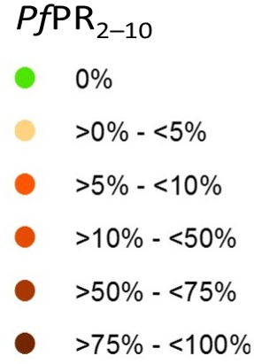
Location of 2134 age-corrected parasite prevalence data (PfPR₂₋₁₀) between 1998-2012 in 14 control states; Highest value on top (Left), Lowest Value on top (Right)
Notes:
For the purposes of modelling we have elected to use only survey data within the malaria transmission margins of all states (14) not targeted for malaria elimination. This constrains model predictions over shorter spaces (increasing likelihood of spatial structure). In addition, we have selected only data from 1998, thus reducing the temporal cube of data used in predicting malaria risk to the latest period where most data derive, 2012 (Slide 22). The distribution of these data are shown in the above slide, representing 2134 surveys at 739 unique clusters.

Slide 26
Summary data of those examined and positive and clusters by Control State from 1998-2012 (all data) and 2005-2012
State | Clusters 1998-2012 (clusters Pos) | Pos/Examined 1998-2012 (%) | Clusters 2005-2012 (Clusters Pos) | Pos/Examined 2005-2012 (%)
Al Gezira | 1614 (984) | 4265/166749 (2.6) | 783 (400) | 1251/76972 (1.6)
Blue Nile | 23 (19) | 198/2293 (8.6) | 21 (17) | 183/1737 (10.5)
Central Darfur | 26 (18) | 85/2293 (3.7) | 26 (18) | 85/2293 (3.7)
East Darfur | 11 (4) | 5/1034 (0.5) | 11 (4) | 5/1034 (0.5)
Gedaref | 52 (32) | 922/7549 (12.2) | 39 (22) | 149/3322 (4.5)
Kassala | 54 (27) | 89/5191 (1.7) | 52 (25) | 74/4996 (1.5)
North Darfur | 40 (18) | 46/3101 (1.5) | 40 (18) | 46/3101 (1.5)
North Kordofan | 49 (31) | 95/4965 (1.9) | 48 (30) | 84/4665 (1.8)
Sennar | 43 (28) | 277/6847 (4.1) | 39 (24) | 147/3427 (4.3)
South Darfur | 62 (43) | 195/5741 (3.4) | 62 (43) | 195/5741 (3.4)
South Kordofan | 49 (36) | 154/4588 (3.4) | 47 (34) | 127/4163 (3.1)
West Darfur | 27 (24) | 82/2093 (3.9) | 27 (24) | 82/2093 (3.9)
West Kordofan | 37 (26) | 156/3104 (5.0) | 36 (25) | 148/2904 (5.1)
White Nile | 47 (31) | 142/4165 (3.4) | 44 (28) | 95/4015 (2.4)
Notes:
This represents a very simple summary of the data, it takes no account of multiple sampling at the same locations, nor any spatial structure in the data and would be valid if the survey data were true random samples of each State, which they are not. However, if provides a comparison with subsequent modelled approaches for purposes of triangulation and fro powering subsequent national MIS around parasite prevalence.

Slide 27
Model-based Geostatistics: Tobler’s law
Space-time Kriging P. falciparum data in Bayesian framework
Time
Latitude
Longitude
Notes:
Geo statistical methods were developed to interpolate from data at sampled locations in space and time to provide predictions of quantities at locations and times where data do not exist. These statistical methods operate under Tobler’s First Law of Geography, which states that things that are closer in space and time are more similar than those more spatially and temporally distal [Tobler, 1970]. When applied within a Bayesian inference framework, these methods are referred to as model-based geostatistical (MBG) methods. Bayesian inference allows for better use of sparse data and through the application of prior knowledge of an outcome in an iterative process and also allows for robust estimation of uncertainties around the estimates of the outcome.
Ecological and climatic heterogeneity affect the development and survival of the Plasmodium parasite and the malaria-transmitting Anopheles vectors. Environmental covariates are therefore commonly used to improve the precision of malaria risk modelling and traditionally include measures of aridity, vegetation, rainfall, temperature, proximity to water bodies and urbanization (See earlier slides). These covariates were used within a total sets analysis based on a generalized linear regression model and implemented in bestglm package in R [Miller, 2002; Lumley, 2010] with PfPR₂₋₁₀ as the dependent variable. The best combination of covariates (Slides 8 and 12), those with the lowest value of the Bayesian Information Criteria (BIC) statistic, were selected, and proved to be Temperature Suitability (P=0.01), EVI (P=0.001), Precipitation (P<0.0003) and urbanization (P=0.01).
The procedures used to model and validate the transformation of empirical P. falciparum parasite prevalence data to continuous predictions of age-corrected mean prevalence in children aged 2-10 years (PfPR₂₋₁₀) are provided elsewhere [Noor et al., 2014]. In brief, we have used information from available age-corrected survey data (sample size and numbers positive) at known locations (longitude and latitude) and times (year) all data assembled 1998-2012 with the minimal set of conservative, long-term covariates (TSI, EVI, precipitation and urbanization) within a Bayesian hierarchical space-time model, implemented through an adapted Stochastic Partial Differential Equations (SPDE) approach using Integrated Nested Laplace Approximations (INLA) for inference [R-INLA, 2013; Rue et al., 2009] to produce continuous maps of PfPR₂₋₁₀ for a time when the peak of the most recent survey data exist - 2012 - at 1 x 1 spatial resolutions. The INLA mesh size used was 11,085.
References
Lumley T (2010). Leaps: regression subset selection (R package) Version 2.7.
Miller A (2002). Subset Selection in Regression. Boca Raton, FL: Chapman & Hall
Noor AM, Kinyoki DK, Mundia CW, Kabaria CW, Wambua JM, Alegana VA, Fall IS, Snow RW (2014). The changing risk of Plasmodium falciparum malaria infection in Africa: 2000 to 2010. Lancet, 383: 1739-1747
R-INLA project. http://www.r-inla.org/. Accessed 10 April 2012
Rue H, Martino S, Chopin N (2009). Approximate Bayesian inference for latent Gaussian models by using integrated nested Laplace approximations. Journal of the Royal Statistical Society Series B, 71: 319–392
Tobler W (1970). A computer movie simulating urban growth in the Detroit region. Economic Geography, 46: 234-240

Slide 28
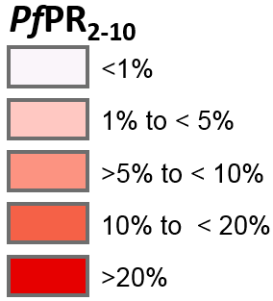
Binned mean per 1x1km pixel of model predictions of PfPR₂₋₁₀ in 2012
Notes:
For each year shown in panels above a posterior prediction was made with a distribution around the mean at 1x1km resolutions. These were then grouped into categories of risk as shown in the bottom right panel.

Slide 29
Binned mean per 1x1km pixel of model predictions of PfPR₂₋₁₀ in 2012
Notes:
For each year shown in panels above a posterior prediction was made with a distribution around the mean at 1x1km resolutions. These were then grouped into categories of risk as shown in the bottom right panel.

Slide 30
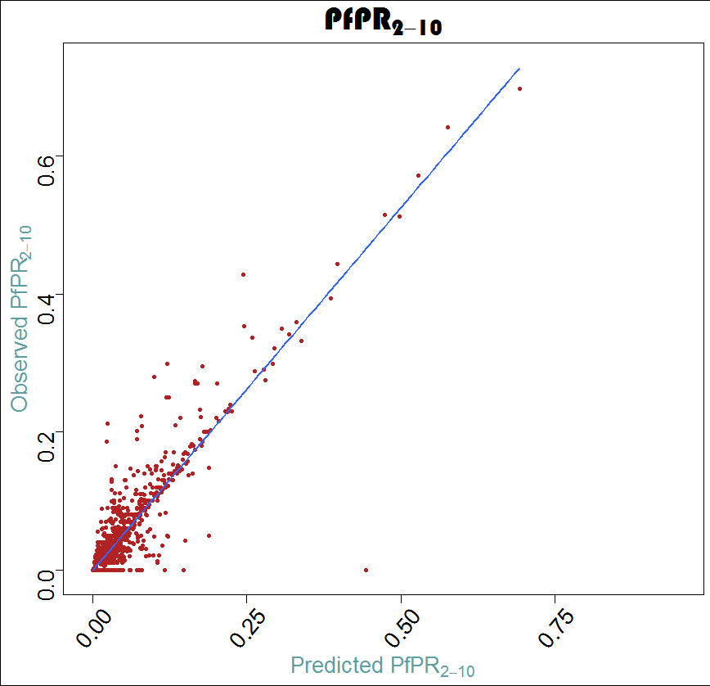
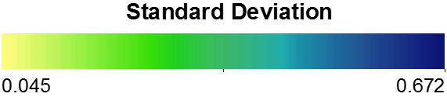
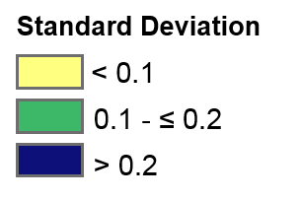
Validation statistics
Notes:
To assess the predictive performance of the model, the predicted prevalence of malaria in the surveyed locations was extracted and matched with the actual prevalence in surveyed data at the corresponding locations and time in a randomly sampled 10% holdout validation dataset using a sampling algorithm which de-clusters over space and time.
Four performance indices were chosen to evaluate predictive performance and model fit: root-mean-square error (RMSE), mean prediction error (MPE), mean absolute prediction error (MAPE), and the correlation coefficient between the predicted and the observed values. The RMSE is simply the square-root of the mean of the squared difference between the posterior predicted mean and observed value and it is used to measure the accuracy of the model. The MPE provides a measure of the bias of the predictor, the MAPE provides a measure of the mean accuracy of individual predictions, and the correlation coefficient provides a measure of association between the observed data and prediction sets [Magalhaes & Clements, 2011]. The correlation between the observed and predicted data was visualized in a scatter plot with a least-squares best fitting line and histograms (see above left hand image).
Overall there is a tendency for the model to over-predict very low prevalence but under predict higher prevalence. Overall the validation statistics were the RMSE was 0.026; MPE 3.7%; MAPE 1.3% and the correlation coefficient 0.904
Despite a good overall model fit, as per the testing of observed and predicted hold-out data, the model does not perform equally well everywhere and is largely a combined result of data paucity in space or large variance in data within small geographical areas, notably when prevalence declines to very low levels.
The Standard Deviation (SD) map shows the SD around the posterior predicted mean as a continuous variable (top right panel) and binned to show areas more clearly where, for example, SD is above 0.2. These areas are largely located in the most southerly and easterly areas of the control States.
Action Points
Although not a guarantee it would help to have more survey data in the space occupied by >0.2 SD shown in the bottom right panel above during the 2016 MIS.
References
Magalhaes RJS & Clements ACA (2011). Mapping the risk of anaemia in preschool-age children: The contribution of malnutrition, malaria, and helminth infections in West Africa. PLoS Medicine, 8: e1000438

Slide 31
Provisional malaria risk map V1 for Sudan in 2012
Notes:
This is a provisional risk map. It is not possible for reasons described earlier to develop a map of population weighted infection risk by locality. Presently risk is shown only to the localities where we have a GIS shape file and this needs updating with revised shape files. Because we cannot make a population weighted mean per locality, a simplified approach has been used to attribute localities to “majority area” endemicity class.
Malaria Free: Here the assumption is that the margins of likely transmission extend up to Port Sudan in the East and are constrained by arid deserts either side of the Nile down to the 18th Parallel where topography gives way to arid conditions from hyper-aridity.
Maintenance: With confirmation, it seems reasonable to assume that there has been at least 5 years without any local transmission from the border with Egypt to xxxxx (the actual lower extent needs confirmation). The Gambiae Project therefore has maintained this area in a Maintenance Free status (Dark Green)
Elimination/Attack: During the previous national malaria strategic plan, four States were identified as being prepared for elimination – Red Sea, River Nile, Northern and Khartoum. These areas are of exceptionally low, focal transmission (Green Areas). A strategic decision to increase investment in elimination in these Sates as part of the next NMS, means that these ecologically unique States should be defined separately. Here parasite prevalence is not a useful metric to define malaria risk. These States must migrate to much enhanced disease surveillance and the future of malaria elimination will depend on combinations of active and passive case detection linked to targeted vector control, larviciding and out-break/hotspot management.
Low endemic areas: The continuous posterior predicted risk maps shown in slide 28 are the best that can be done with the data available. Models are not perfect, notably when many samples are zero infection prevalence, and over small distances a few positive samples are recorded. Data have never been sampled to provide precision at locality levels. Other modelling approaches attempted (Small Area Estimation, Exceedence Probability etc) all share similar problems of the input data not being perfect. Nevertheless, the map in slide 28 is the best approximation of malaria risk in 2012. Here we have simply attributed localities to the very low risk class (PfPR₂₋₁₀ <1%) to identify where LLIN might be selectively distributed to areas of epidemic outbreaks or known focal transmission areas. These areas, as might be expected are largely located in between the malaria free/elimination localities and the more southerly higher endemicty classes.
Intermediary endemic areas: It is tempting to call out small “hotspots” or areas along borders that are “high” risk (Slide 28), however it should be noted that these small nuggets of apparent high risk are likely a result of very small variance in input data over short distances, i.e. one or two unusually high survey points, or as is the case along the borders not because of any data driving the model but only covariates. As such it is a more conservative and reasoned to assume that all localities where risks are above 1% are best classified as above 1% and likely below 5%. Across this entire space one would promote sustained, universal LLIN coverage as part of an integrated vector control strategy. Other criteria for selecting alternate approaches to vector control are shown in the next slide.
Comments: A useful monitoring metric in the 14 control states would be parasite prevalence, however alternatives to the current MIS strategy to sample infection prevalence is required. The 2016 MIS will not generate adequate information to provide precision at the locality level, simpler, cheaper and more rapid approaches to power sampling to locality levels are required. By 2020, with considerably more data it should be possible to re-map risk in the 14 control states and examine how many localities have migrated from >= 1% (dark pink) to <1% (light pink). In should be emphasised that there needs to be a transition, with time, to using more routine data on fever test positivity rates (TPR) at health facilities and mapped according to location. This is not possible at present for a number of reasons discussed above, notably there is no geo-coded master health facility database, no DHIS2 system of digital data and no quality assured checking of malaria data from routine systems. One major ambition of the next strategic plan must be to strengthen the main pillar of surveillance & TTT as an intervention and M&E package. Finally, within the four elimination states, the central theme will be surveillance and across the spaces shown above enhanced facility mapping, data assembly and data quality audits are urgently required.

Slide 32
Provisional malaria risk map V2 for Sudan in 2012
Notes:
This version shows the other population and agricultural attributes used for over a decade in planning malaria control in Sudan. The map is restricted in its presentation to dominant locations, for example only xx urban extents where populations are in excess of 100,000 (where urban malaria control might be started under special initiatives), major refugee settlements (rather than the multitude of smaller IDP camps) where partner collaboration is required for control of malaria in thee marginalized communities with regular risks of imported infections, and irrigation areas (digitized from satellite images) in the control states where combinations of LLIN universal coverage and IRS are likely to be applied.

Slide 33
Plasmodium vivax and other parasite species
Notes:
During the 1960s, P. vivax and P. malariae were described across most States in present day Sudan, P. ovale was very rare [Wernsdorfer & Wernsdorfer, 1967] (Slide 15).
It is not possible to generate a contemporary map the distribution of P. vivax reliably, not all surveys using microscopy reported vivax infections, it is an often ignored parasite and more sensitive methods of detection (e.g. PCR) would be necessary to generate a more reliable mapped distribution of this parasite across Sudan.
However, at 1043 survey/time specific sites between 1981 and 2012, 195,843 individuals were examined using microscopy and P. vivax and P. falciparum were uniquely defined per examined slide. Among those surveyed there were 3527 (1.8%) P. falciparum infections and 141 (0.07%) infections with P. vivax. Of all persons infected during these community surveys 3.8% were found to have P. vivax.
Clearly, P. falciparum is the most ubiquitous and common parasite, however the presence of P. vivax cannot be ignored. There are reports of P. vivax prevalence increasing in the Eastern areas that border Ethiopia and Eritrea because of human movement across these borders (e.g. at Kasala, Gedaref and New Halfa) [Himeidan et al., 2005; Mahgoub et al., 2012; Abdallah et al., 2012; Tahla et al., 2014; Tahla et al., 2015]. The Kassala region also had high relative numbers of P. vivax infections during the national surveys of 1961-1963 [Wernsdorfer & Wernsdorfer, 1967] (Slide 15). PCR investigations of clinical infections in Wadi Medani has also shown circa 2-3% P. vivax [Tahla et al., 2014]. Recent PCR studies of infections among febrile patients attending health facilities in Sherganile Locality, Khartoum State have shown that at least 18% of positive cases had evidence of P. vivax infection [Abobakar, 2015], supporting earlier observations of circa 5% of infections being P. vivax I other areas of Khartoum [Ali et al., 2009]. Finally, among the migrant labour force in SW Saudi Arabia, many cases of imported P. vivax are reported each year among Sudanese returning from their native country [Ali Sharani & Tagader, 2016, unpublished data].
There are no provisions in national guidelines for the treatment of vivax malaria.
Among survey data 1981-2012 assembled for the P. falciparum mapping where other species on microscopy were recorded, P. malariae had been reported during 23 community based surveys largely in the Kordofan area. P. ovale has only been described among people surveyed in the Port Sudan area and its not clear if these were imported infections [Hashim, 1998].
Action Points
The distribution and significance of P. vivax should be investigated further from a wider series of clinical samples and more detailed PCR investigations of filter papers, this might be done as a sub-sample from household members during the 2016 MIS or more efficiently from facility-based surveys of fevers presenting to clinic, which increases the likelihood of detection and provides a more tangible presentation of “risk” to guide treatment policy. INED are able to provide PCR capacity for this work as required and could be built around contracts with MIS and separate studies in the four elimination states.
References
Abdallah TM, Abdeen MT, Ahmed IS, Hamdan HZ, Magzoub M, Adam I (2012). Severe Plasmodium falciparum and Plasmodium vivax malaria among adults at Kassala Hospital, eastern Sudan. Malaria Journal, 12: 148
Abobakar SHO (2015). Prevalence of Plasmodium vivax among patients in Shergalnile locality in Khartoum State by using Polymerase Chain Reaction. Thesis submitted in partial fulfilment of MSC degree in Medical Laboratory Sciences (Parasitology & Entomology). Faculty of Graduate Studies, Al-Zaiem Alazhri University, May 2015.
Ali MO, Homeida MMA, Bennett JL, Okasha H, Hamid KA, Elkhatim H, Mokhtar K (2009). Recurrent malaria infection in Khartoum State, Sudan. Sudan Medical Journal, 45: 34-39
Hashim A (1998). Five years plan of action in malaria control in Red Sea State 1998-2002. Blue Nile Research and Training Institute, unpublished report
Himeidan YE, Elbashir MI, El-Rayah el A, Adam I (2005). Epidemiology of malaria in New Halfa, an irrigated area in eastern Sudan. Eastern Mediterranean Health Journal, 11: 499-504
Mahgoub H et al. (2012). Severe Plasmodium vivax malaria among Sudanese children at New Halfa Hospital, Eastern Sudan. Parasites & Vectors, 5: 154
Talha AA, Pirahmadi S, Elgaily EM, Zakeri S, Nour BYM (2014). Low Prevalence of Plasmodium vivax - Plasmodium falciparum Mixed-Infection in Patients from Central and Eastern Part of Sudan: Implication for Case Management in Sudan. International Journal of Tropical Disease & Health, 4: 887-895
Talha AA, Pirahmadi S, Mehrizi AA, Djadid ND, Nour BYM, Zakeri S (2015). Molecular genetic analysis of Plasmodium vivax isolates from Eastern and Central Sudan using pvcsp and pvmsp-3a genes as molecular markers. Infection, Genetics & Evolution, 32: 12-22
Wernsdorfer G & Wernsdorfer W (1967). Malaria in the middle Nile basin and its bordering regions. Z Tropenmed Parasitol, 18: 17-44

Slide 34
Malaria Vector Mapping

Slide 35
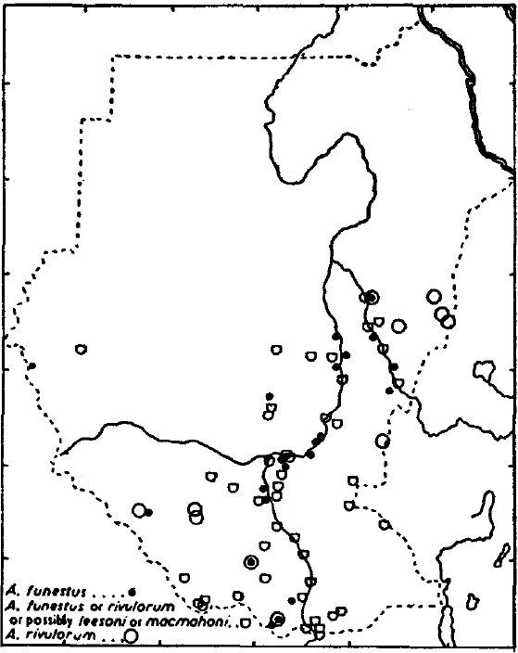
Historical mapping of malaria vectors in 1950s-1960s
Lewis (1956)
Wernsdorfer & Wernsdorfer (1967)
Notes:
Background
As with many malaria endemic countries during the GMEP era, detailed mapped inventories of Anopheline vector species were developed. The first in Sudan were maps of An. gambiae, An. funestus, An. pharoensis and other anophelines assembled by Lewis in 1956, based on reviews of published and unpublished entomological surveys undertaken by government entomologists and academics since 1900. Additionally, the Wernsdorfer brothers, while mounting a massive national survey of malaria infection, conducted malaria vector species investigations and assemblies at each of their sample sites. For many decades, these served as the only systematic reviews of malaria vectors across the country.
References
Lewis DJ (1956). The anopheline mosquitoes of Sudan. Bulletin of Entomological Research, 47: 475-494
Wernsdorfer G & Wernsdorfer W (1967). Malaria in the middle Nile basin and its bordering regions. Z Tropenmed Parasitol, 18: 17-44

Slide 36
Location of mosquito sampling sites for 516 surveys undertaken between 1903 and 2014
Notes:
Historical archives and published sources, increased the documentation of potential secondary vectors and sourced more recent unpublished data from scientists and control agencies working in Sudan have been used to develop a repository of data on malaria vectors. Full details of the data assembly, geo-coding methods and classifications of species according to their role in malaria transmission are provided elsewhere [Snow et al., 2015]. The database has been arranged as a site-specific, referenced inventory to capture details of species identification recorded since the earliest surveys in 1903 through to the latest records in 2014. The full digital PDF library, database and bibliography accompanies this report.
From each identified report, data extraction included whether a species was identified at a given site, methods used to capture adults or larvae and methods used to speciate each anopheline collection. “Y” was recorded if species was identified and “N” was only recorded when the true absence of the species was reported. The database is therefore one of species presence, not absence and nor proportional presence of various vectors.
The final database contained 516 site/time specific reports of anopheline vectors in Sudan occurrence between 1903 and 2014 for which we were able to geo-locate the survey site. We were unable to geo-locate 24 (4.4%) of the survey sites
The database includes the extensive mosquito survey data assemblies compiled by Lewis during the 1940s and 1950s [Lewis, 1945; 1956] as part of wider national reconnaissance when the two Sudan’s were united under one Federal Government and the 1974-1987 survey data on species distributions by Petrarca [Petrarca et al., 2000].
We have not assembled, geo-coded information related to vector resistance, these data have been carefully curated, validated and mapped by the IRBase initiative [IRBase; Knox et al., 2014] and described in the malaria milestone narrative section.
References
IRBase: http://www.irmapper.com
Knox TB, Juma EO, Ochomo EO, Pates Jamet H, Ndungo L, Chege P, Bayoh NM, N’Guessan R, Christian RN, Hunt RH, Coetzee M (2014). An online tool for mapping insecticide resistance in major Anopheles vectors of human malaria parasites and review of resistance status for the Afrotropical region. Parasites & Vectors, 7: 76
Lewis DJ (1945). Observations on the distribution and taxonomy of Culicidae (Diptera) in the Sudan. Transactions of the Royal Entomological Society of London, 95: 1-26
Lewis DJ (1956). The anopheline mosquitoes of Sudan. Bulletin of Entomological Research, 47: 475-494
Petrarca V, Nugud AD, Ahmed MA, Haridi AM, Di Deco MA, Coluzzi M (2000). Cytogenetics of the Anopheles gambiae complex in Sudan, with special reference to An. arabiensis: relationships with East and West African populations. Medical & Veterinary Entomology, 14: 149-164
Snow RW, Kyalo D, Amratia P, Kabaria CW, Noor AM. Developing a geo-coded repository of malaria vector species occurrence for Africa: methods and data summaries 1900-2014. Working Paper 2: Report prepared in support of the INFORM Project funded by the Department for International Development and the Wellcome Trust, April 2015; http://www.inform-malaria.org/wp-content/uploads/2015/07/Assembly-of-Vector-Data-Version-1.pdf

Slide 37
Location of mosquito sampling sites for 167 surveys undertaken since 2005
Notes:
Far fewer studies undertaken over the last 10 years however there is a reasonable geographic spread of information across the States.
Action points
Apparently 64 sentinel sites in 17 states for vector surveillance we don't have any of these data and if species documented using PCR this might help with a clearer picture of An. gambiae s.s. distributions.
The data from sentinel sites would be valuable to include in the single geo-coded repository. Contacts with those responsible for the vector surveillance should be made and the assembled database from 1903-2014 shared with them to be updated.

Slide 38
Recorded species identifications across all surveys by State
Notes:
The presence of the An. gambiae complex and the An. funestus group are sympatric in the southern States. An. funestus has not been described in Khartoum. There is an unpublished report of An funestus larvae in Port Sudan [Huda, 2011], and this is the furthest north tis vector has been described (see next slide).
Among the An. gambiae complex, An. arabiensis has been described in all the States, while An. gambiae ss has been recorded in only one locality in Sennar town [Petrarca et al., 2000]. As expected the salt water breeding members of the An. gambiae complex have never been described in Sudan.
An. rivulorum, a member of An. funestus group, has been described in the south-eastern regions and the northern parts of the country, though sparsely. In Sudan, “An. funestus ss and An. rivulorum are suspected to play role in malaria transmission” [Makhawi et al., 2015]
An. pharoensis has been recorded in all the states except Central and South Darfur, while an important vector in Egypt, it is not clear whether this vector plays a role in malaria transmission in Sudan. An. nili is found mostly in the southern States especially the White Nile State but probably not considered to play any role in malaria transmission in Sudan.
An. multicolor has been recorded in only three localities: in Kassala near Eritrea border, in Port Sudan along the Red Sed and in Wadi Halfa near Lake Nasser on the border with Egypt. It has not been implicated in transmission of malaria in the Sudan.
An. moucheti and An. hancocki have never been described in Sudan.
References
Huda JE (2011). Identification and distribution of mosquitoes species in Portsudan city, Eastern Sudan. A thesis submitted for the degree of Master in Medical Laboratory Sciences, faculty of Medical laboratory, University of Sudan, Sudan
Petrarca V, Nugud AD, Ahmed MA, Haridi AM, Di Deco MA, Coluzzi M (2000). Cytogenetics of the Anopheles gambiae complex in Sudan, with special reference to An. arabiensis: relationships with East and West African populations. Medical & Veterinary Entomology, 14: 149-164
Makhawi AM, Aboud MA, El Raba’a FM, Osman OF, Elnaiem D-EA (2015). Identification of Anopheles species of the funestus Group and their role in malaria transmission in Sudan. Journal of Applied & Industrial Sciences, 3: 58-62

Slide 39
Recorded locations of An. arabiensis, An. funestus and An. pharoensis

Slide 40
Records of other anopheline species, either non-vectors or considered incidental vectors of malaria since 1903
An. caspius, An. cinereus, An. coustani, An. d'thali,
An. leesoni, An. macmahoni, An. maculipalpis,
An. marshalli, An. paludis, An. pretoriensis,
An. rhodesiensis, An. rufipes, An. rupicolus, An. squamosus, An. turkhudi, An. wellcomei and An. ziemanni

Slide 41
Malaria vector control mapping

Slide 42
IRS
Localities
Notes:
Context
History of IRS in Sudan goes back to its first reported use in Khartoum, in 1946. During the 1950s DDT was used throughout urban settlements of the country. From 1951, Dieldrin IRS was introduced into Fung District (Blue Nile Province), Kordofan, and Darfur Provinces and the Giezera Irrigation Scheme. Overtime Dieldrin was replaced by Gammaxene. However, Dieldrin was used in the WHO pilot eradication project of Blue Nile and Sennar though to early 1960s. A return to DDT occurred in 1968, following the detection of Dieldrin resistance. DDT was used throughout the Gambiae Control programme in the North. In the Giezera area Malathion was used until resistance emerged and then replaced with Fenitrothion in 1977 until 1989 when IRS stopped. During the early 2000s IRS was re-introduced into agricultural schemes including Gezira, Elrahad, New Halfa, Suki, Zeidab, Kenana and Sugar cane projects using carbamates and/or pyrethroids. From 2006 only Bendiocarb used for annual IRS in irrigation scheme areas [Noor et al., 2012; NMCP, FMoH, 2013].
32 localities have reported IRS activities since 2012, these are shown in above map where localities have been constrained to only areas of malaria risk as per slide 21. These localities are Wadi Halfa [1], Dalgo [2], Elburgag [3], Abo Hamad [4], Barbar [5], Atbara [6], Elmtama [7], Eldamar [8], Shandi [9], Nahar Atbara [10], Aldelta North [11], Reifi Aroma [12], Halfa Elgidida [13], Reifi Egerba [14], East Elgezira [15], Um Elgora [16], Alfaw [17], Wad Madni [18], Elkamlin [19], Elheshesa [20], South Elgezira [21], East Sinnar [22], El dinder [23], El Gbleen [24], Elmnagil [25], Rabak [26], Sinnar [27], El Gbleen [28], Eldali and Elmzmoom [29], Singa [30], Abu Hogar [31] and El Soki [32].
Action Points
Localities are too large for representation of spatial areas covered by IRS, if more detail provided could use Google Earth to delineate the exact extents of each IRS community, based on irrigated areas etc.
More detail is required of villages with localities targeted, rounds of spraying with which insecticides and how many people and households protected. These process data can be mapped and are all should be available within the FMoH. As has proven to be the case in so many MIS’s across Africa, household reports of IRS are often poor and do not capture the level of detail necessary and only available from process data.
References
National Malaria Control Programme, Federal Ministry of Health (2013). Malaria Programme Review 2001-2012. Federal Ministry of Health, Republic of Sudan, Khartoum, December 2013.
Noor AM, ElMardi KA, Abdelgader TM, Patil AP, Amine AAA, Bakhiet S, Mukhtar MM, Snow RW (2012). Malaria Risk Mapping for Control in the Republic of Sudan. The American Society of Tropical Medicine and Hygiene, 87: 1012–1021

Slide 43
ITN coverage from survey data in 2009
Proportion of population sleeping under ITN
Proportion of households with at least one ITN for every two persons
Notes:
Typically, national household surveys are designed to be precise at national and regional levels and rarely at lower levels such as districts. Therefore, simply aggregating survey data to provide district level estimates of an outcome of interest will lead to values of low precision. SAE methods handle the problem of making reliable estimates of a variable at these areal units under conditions where the information available for the variable, on its own, is not sufficient to make valid estimates [Rao et al., 2003; BIAS 2007]. We have used the geo-coded household data from the 2009 and 2012 national MIS sample surveys to provide information coverage and reported LLIN use for each of the 189 localities using Small Area Estimation (SAE) methods. Here we have used hierarchical Bayesian spatial and temporal SAE techniques using a geo-additive regression approach [Banerjee et al., 2004; Best et al., 2005]. This method uses survey data from a locality and neighborhood information from adjacent localities to smooth values at the locality. Importantly we have elected to predict quantities among all age groups, as this now represents the important indicator for universal coverage and necessary when computing likely impacts on malaria transmission [Smith et al., 2009; Griffin et al. 2010]. In addition, WHO recommended targets for universal coverage have been defined as at least 2 people per LLIN per household and shown for the 2009 survey year (above) and 2012 (following slide).
Note modelling for 2009 MIS based on 300 clusters, 5,979 households and 30,504 respondents.
References
Banerjee S, Carlin BP, Gelfand AE (2004). Hierarchical Modeling and Analysis for Spatial Data. Chapman & Hall, New York.
Best N, Richardson S, Thomson A (2005). A comparison of Bayesian spatial models for disease mapping. Statistical Methods in Medical Research, 14: 35-59
BIAS (2007). Introduction to Bayesian Small Area Estimation, January 2007. http://www.bias-project.org.uk/software/SAE.pdf
Griffin JT, Hollingsworth D, Okell LC et al. (2010). Reducing Plasmodium falciparum malaria transmission in Africa: a model based evaluation of intervention strategies. PLoS Medicine, 7: e1000324
National Malaria Control Programme (NMCP) [Sudan] (2010). National Malaria Indicator Survey in the northern states of the Sudan 2009. Organization, Eastern Mediterranean Regional Office, Cairo, Egypt, March 2010
National Malaria Control Programme (NMCP) [Sudan] (2013). Malaria Indicator Survey Republic of Sudan – December 2012. National Malaria Control Programmme, Federal Ministry of Health, Republic of Sudan, Khartoum, September 2013
Rao JNK (2003). Small Area Estimation. John Wiley & Sons, Inc., Hoboken, New Jersey, 2003
Smith DL, Noor AM, Hay SI, Snow RW (2009). Predicting changing malaria risk following expanded insecticide treated net coverage in Africa. Trends in Parasitology, 25: 511-516

Slide 44
ITN coverage from survey data in 2012
Proportion of population sleeping under ITN
Proportion of households with at least one ITN for every two persons
Notes:
Note modelling for 2012 MIS based on 291 clusters, 5,510 households and 26,844 respondents.
Action Points
While the MIS data provide us with some indication of “use” they are invariably time-limited in their value. Mass distributions often occur following an MIS, reports of net ownership in the household doesn’t always mean use and it is often the case that the date at which the LLIN was issued isn’t accurate enough to know whether it is still “effective”. What is required to make the interpretation of MIS reports is the process data on distribution dates, volumes and all by locality. These data should be available somewhere in FMoH and should be assembled from 2014 (when last likely to be “effective”). Data by State is of too poor a spatial resolution to examine gaps.
Reference
National Malaria Control Programme (NMCP) [Sudan] (2013). Malaria Indicator Survey Republic of Sudan – December 2012. National Malaria Control Programmme, Federal Ministry of Health, Republic of Sudan, Khartoum, September 2013

Slide 45
Observations

Slide 46
Acknowledgements
We acknowledge all those who have generously provided unpublished parasite and vectors data, helped locate information or the geo-coordinates of data necessary to complete the analysis of malaria risk across Sudan:
Mohamed Abbas, Alnazear Abdalla, Tareg Abdelgader, Mujahid Abdin, Nasruddin Abdul-Hadi, Abdalla Ahmed, Mubashar Ahmed, Dalin Abdelkareem Altahir, Ahmed Alnazear Amine, Sahar Bakhite, Mustafa Dukeen, Khalid Elmerdi, Tayseer Elamin El Faki, Asma Hsahim El Hassan, Ibrahim El Hassan, Limya El Yamani, Khalid Elmardi, Salah Elbin Elmubark, Homooda Totoa Kafy, Abd Alla Ibrahim, Fatih Malik, Jaffar Mirghani, Alaa Moawia, Tasneem Moawia, Abdullah Sayied Mohammed, Maowia Mukhtar, Fazza Munim, Samia Seif Murghan, Ali Elamin Nasir, Bakari Nour, Abdelhameed Elbirdiri Nugad, A. Omer, Abdala Sayaid, Jihad Eltaher Sulieman, Mohamad Tarig, Asma Tohami, Randa Youssef
FMoH: xxxxxxx
EMRO (Cairo): Ghasem Zamani, Caroline Barwa & Hoda Atta
INFORM (Nairobi): Bob Snow, Lukio Olweny, Paul Ouma, Peter Macharia, Joseph Maina, Stephen Oloo, Ezekiel Gogo, David Kyalo, Damaris Kinyoki
LINK (London): Ngozi Erondu, Caroline Lynch, David Schellenberg
Notes:
Action Points
The main contributors from the FMoH should be listed and advice on this should be sought

