Slide 1
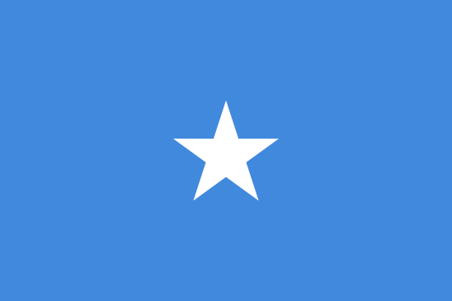
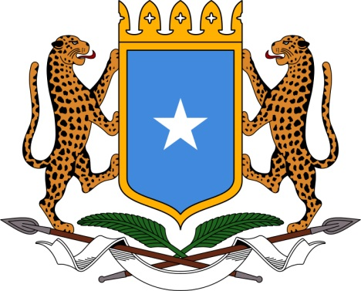



Somalia
A Profile of Malaria Control and Epidemiology
June 2016

Slide 2
Context
Notes:
Political and economic context
Somalia, officially the Republic of Somalia, formerly known as the Somali Democratic Republic, forms the largest part of the Horn of Africa (637,540 km²). It is bordered by Djibouti to the northwest, Kenya to the southwest, Ethiopia to the west and the Gulf of Aden which separates Somalia from Yemen to the north. The Indian Ocean forms its eastern seaboard.
Somalia has not functioned as a unitary state since 1991, when the overthrow of the Siad Barre regime led to a long phase of instability, from which the country has yet to recover. Within the context if this fragile state Somalia has managed to support malaria control through partnerships with development agencies and NGOs.
The state has effectively fragmented into three distinct zonal blocks, Somaliland, Puntland and the Central Southern Zone (CSZ). Attempts have been made since 2000 to unite various factions through the development of a parliament which has appointed successive Transitional Governments. The Transitional Federal Government (TFG) was put in place in 2004, and was to be installed in Southern Somalia. In 2012, the TFG was replaced by the Somali Federal Government (SFG), based in Mogadishu. The SFG has limited control over the CSZ and a power struggle continues with Al-Shabab causing instability across large parts of the southern part of the country.
The Republic of Somaliland in the Northwest of Somalia declared independence in 1991. Somaliland remains unrecognised by the international community but has maintained its own political institutions, judiciary, police, armed forces and currency. The Puntland State of Somalia declared autonomy in 1998 but contests control over parts of two further regions, Sool and Sanaag on its western side with neighbouring Somaliland. Puntland formally endorses the federal processes, but has its own constitution, political institutions and armed forces, and conducts its own foreign and trade policies. The Reconstruction and Development Programme (RDP) 2008-2013 recognised the different stages at which Somaliland, Puntland and South Central Somalia were in the process of state building and that there is no ‘one size fits all’ formula for development in Somalia.
Economy
Somalia remains a fragile state and is classified as a Low Income Country with an estimated US$ 190 GNI per capita. The GDP of Somalia was estimated at close to US$ 5.8 billion in 2010, with a per capita GDP of US$ 600. Livestock accounts for about 40% of GDP and more than 50% of export earnings. Other main products include fish, charcoal and bananas, sugar, sorghum and corn. According to the Central Bank of Somalia, aggregate imports of goods average about US$460 million per year, which stand above the level prior to the start of the civil war in 1991. Exports of about US$ 270 million annually have also surpassed pre-1991 aggregate export levels, but still result in a trade account deficit of about US$ 190 million per year.
The extensive Somali Diaspora, estimated to be 1-1.5 million people, has injected a significant inflow of funds through a somewhat sophisticated banking system. Remittances alone are estimated at about US$1-2 billion per year.
Poverty & Security
Educational attainment is low with a high proportion of women in Somalia receiving no formal education. The adult literacy rate is 31.8% and it is expected that adults ages 25 years or above will receive on average 4.82 years of schooling. Poverty remains widespread throughout the country and many communities are living in precarious security situations that impacts on their livelihoods which exacerbates ill-health and malnutrition.
The Multidimensional Poverty Index (MPI) ranked Somalia as 94 out of 104 countries, and among Arab League States Somalia has the highest MPI value. CSZ has the highest proportion of people experiencing multidimensional poverty at 89%, followed by Puntland (75%) and Somaliland (72%). Nomadic and rural areas have extreme MPI values [HDR, 2012].
Somalia currently performs poorly against the United Nations’ definition of ‘human security’, the multiple ways in which poor security has manifested itself across all spheres of society renders Somalia the most insecure nation included in the Human Security Index (ranked 232 out of 232) [UNDP, 1994]
References
Gross National Income measurement by The World Bank according to the Atlas method classification. Somalia ranks as 197th in the global classification list based on 1990 estimates. http://data.worldbank.org/country/somalia
Human Development Report (HDR) (2012). http://hdr.undp.org/sites/default/files/reports/242/somalia_report_2012.pdf
Somalia, Country Brief 2013-2015; OREB Department, African Development Bank Group, March 2013
Somalia Household Survey 2010; World Bank International Comparison Program 2010 (PPP 2008 US$)
United Nations Development Programme (UNDP) (1994). New dimensions of Human Security. Human Development Report 1994, UNDP. [internet]. New York. 22–46

Slide 3
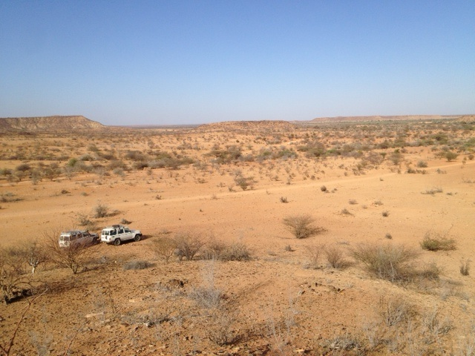
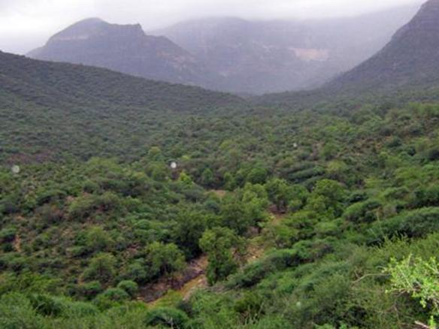
Topography and location
Bahale
Shimbris Mountains
Notes:
Context
In the North of Somalia, a low-lying coastline borders the Gulf of Aden, beyond which, running parallel to the Coast, a series of dry hills, the Haud, at 500 to 2,000 meters above sea level (mASL), form a skeletal framework for the country: they descend thereafter to the south-east as they join the Ethiopian Ogaden. In the East and the South, the plateau ends in arid steppes, from under 200 mASL down to the Indian Ocean. The plains drain into the Juba River in the south and Shabelle River in the centre, which disappears into a swamp before reaching the coast. The Shimbris Mountains lie at 2,414 mASL in Sanaag region and it’s the highest peak in Somalia. Karkaar Mountains extend east to west in the far north Bari region rising as high as 2,071 mASL and Gacab Libaax lie at 2,008 mASL in Togdheer.
The Sa'ad ad-Din Islands and known as the Zeila Archipelago are group of islands off the northern coast and situated near the ancient city of Zeila. The inhabitants of the archipelago are Somalis from the Gadabuursi sub-clan, a sub-division of the larger Dir clan, who have established reef fishing communities on the islands [McClanahan, 2000].
The Bajuni Islands are an archipelago in the Indian Ocean, on the southern coast of Somalia, from Kismayu to Ras Kiyemboni (not to be confused with Ras Kamboni). They lie at the northern end of a string of reefs which also include Zanzibar and Pemba. There are 6 main islands: Chandra, Chovaye, Chula, Koyama, Darakasi and Ngumi. Chula with the village of Ndowa is the only island with a significant population. Koyama Island is the largest island in the group with two villages, Koyama and Koyamani with very small populations. The other islands have only migratory fishermen as their "populations". The Bajuni are a small independent ethnic community of circa 3,000-4,000 [RDC, 2009].
Other islands of minor importance are: Kandha Iwu, Fuma, Ilisi and the island of Kisimayu (actual Kisimayu harbor) attached to the coast in 1961 during the construction of Kismayu Port.
Disputed territories
Among the three disputed areas which are not under Somalia’s direct control today, the Ogaden (comprised in the Somali Regional State, one of Ethiopia’s administrative divisions) and the Haud represent the most difficult issues as a result of British diplomacy, the inability of Ethiopia to gain full control of the area and the presence of pasturelands that are of vital importance to Somali herdsmen [Kornprobst, 2002; Zoppi, 2015].
Ethiopia argues that its dispute with Somalia centres only on the demarcation of the borders of former Italian Somaliland and Ethiopia. The northern portion -i.e. the Ethiopia-British Somaliland border, it says, has already been demarcated [Kendie, 2007].
Data used
Aeronautics and Space Administration (NASA) and the Ministry of Economy, Trade, and Industry (METI) of Japan. It is available at 30m spatial resolution and can be obtained by the public through their website (https://asterweb.jpl.nasa.gov/gdem.asp)
Rovers shown from DIVA GIS portal: http://www.diva-gis.org/datadown where only major river systems shown (throughout profile)
References
Kendie D (2007). Towards Resolving the Ethiopia-Somalia Disputes. International Conference on African Development Archives. Paper 104.
Kornprobst M (2002). The management of border disputes in African regional subsystems: Comparing West Africa and the Horn of Africa. Journal of Modern African Studies, 40: 369-393
McClanahan TR, Sheppard CRC, Obura DO (2000). Coral Reefs of the Indian Ocean: Their Ecology and Conservation. Oxford University Press, 2000. ISBN 0-195-35217-3
Refugee Documentation Center (2009). Information regarding the treatment of the Bajuni clan in Somalia.
Zoppi M (2015). Greater Somalia, the never-ending dream? Contested Somali borders: the power of tradition vs. the tradition of power. Journal of African History, Politics and Society, 1: 43-64
Pictures
Dry landscape https://morealtitude.files.wordpress.com/2013/01/bahale.jpg
Shimbris Mountains https://www.google.co.ke/search?q=shimbiris+mountain&biw=1366&bih=644&source=lnms&tbm=isch&sa=X&ved=0ahUKEwiM-_fRmJnNAhWJK8AKHRgmA8MQ_AUIBigB#imgrc=O1kvJnFvtGHQcM%3A

Slide 4
Regions, Population & Settlement

Slide 5
Health administration
Notes:
Somalia operates as a semi-federal state system with three principal political regions (or Zones): Central South (CSZ), Somaliland and Puntland. The administration, including the health sector, collapsed following the start of the civil war in 1991. During the decade form 2000, partners have helped the various State led health delivery, including agencies such as the Somali Aid Coordinating Body (SACB) for The Global Fund.
Across the three autonomous states there are 18 regions (gobollada) (Above figure left). According to the UN’s second-level administration mapping system there are 74 districts (degmooyin) across the 18 regions [GAUL, 2008]. For the purposes of malaria risk mapping and intervention coverage analysis between 2007 and 2010, these boundaries formed the basis of the granular analysis of disease burden, receptive and current risks versus LLIN distributions [Noor et al., 2008; Noor et al., 2012; Snow et al., 2010]. These mapped representations of malaria have been used in national strategic plans, Global Fund applications and national programme reviews.
Since 2011, there has been constant changes to the administrative boundary units used by various agencies, including the new Federal Government of Somalia [WHO, 2011]. State-led health sector strategic plans were launched in all three states in 2013. Overall, it is proposed that there will be 120 districts across 20 regions of the three States. In practice only 109 districts that are “functional” and recognized across the original 18 regions. These boundaries are used by relief and UN agencies in Somalia to currently describe partner responses to humanitarian needs, food in-security and immunization coverage [e.g: FSAU, 2015; OCHA, 2015].
For the purposes of the current profiling work, and in line with the maps used by the NMCPs for the Global Fund, we use 18 regions and 109 districts
Data Sources
A shapefile of Somalia districts (n=109) as used by Somalia Ministry of Health for polio vaccination and OCHA was provided by Anthony Ajanga of WHO on 11th March 2014. The shapefile contains information on districts and their respective regions. A separate shapefile of the regions was extracted from the districts shapefile using the Split by Attribute tool in ArcMap software. The output polygons were then merged to obtain a new separate shapefile of Regions. The above figure (right) shows the map of the 109 health districts of Somalia.
Action points
While we have made every effort to delineate the agreed 109 district boundaries these are likely to change with time and negotiation to 120. In addition, partners use districts and regions inter-changeably for different approaches to resource and activity allocation. Early work developed by INFORM to support the Somali NMCPs has focused on the 18 regions. More recently, the predictions have been to the 109 districts, including all the information generated for mixes of interventions as shown in slides 25 and 26.
A detailed discussion with the NMCP is required to decide finally on whether lower resolution regions might be easier to use for stratified control planning. This would have the advantage of having greater malaria prevalence prediction accuracy, but loose resolutions necessary for shrinking the map for malaria elimination.
Our recommendation is to use regions for malaria prevalence mapping, thus increasing the precision required and also allowing the NMCP to track ambitions of reducing parasite prevalence in specified areas. In future, when HMIS and malaria case surveillance improves, districts should be used in the north of Somalia to track case-incidence prior to moving ultimately to case location and foci descriptions.
References
Attorney General's office of the State of Somaliland (AGOSS) (2014). Somaliland Republic Official Gazette. Year 3. Accessed July 1, 2015
Battera F (2000). Remarks on the 1998 Charter of Puntland State of Somalia
Food Security Analysis Unit (FSAU) - Somalia (2015). http://www.fsnau.org/in-focus/updated-somalia-livelihood-zones-map-april-2015 .
GAUL (2008): http://www.fao.org/geonetwork/srv/en/main.home: accessed 3rd July 2015.
Muse A (2012). Khaatumo 2 Conference Results in Further Balkanization. Accessed July 2, 2015 at [http://tinyurl.com/po6ufef].
Noor AM, Clements ACA, Gething PW, Moloney G, Borle M, Shewshuk T, Hay SI, Snow RW (2008). Spatial prediction of Plasmodium falciparum prevalence in Somalia. Malaria Journal, 7: 159
Noor AM, Alegana VA, Patil AP, Moloney G, Borle M, Ahmed F, Yousef F, Amran J, Snow RW (2012). Mapping the receptivity of malaria risk to plan the future of control in Somalia. British Medical Journal Open Access, 2: e001160
Office of coordination for humanitarian affairs (OCHA) (2015): http://www.unocha.org/somalia/; accessed 7th July 2015.
Snow RW, Alegana VA, Okiro EA, Gething PW, Patil P, Tatem AJ, Linard C, Moloney G, Borle M, Yusuf FE, Amran J, Noor AM (2010). Estimating the Plasmodium falciparum morbidity and mortality burden 2005 and 2009 in Somalia: Combining models of population distribution, time-space changes in malaria infection risk and the epidemiology of malaria disease burden. Report prepared for UNICEF-Somalia, March 2010
World Health Organization (2011). Country Cooperation Strategy for WHO and Somalia 2010–2014. Accessed July 1, 2015

Slide 6
Mapping vulnerability and partner assistance in Somalia
Notes:
Maps of partner responsibilities and activities have been an important feature of crisis management and coordinated responses for over a decade. The above shows the use of mapped presentations of refugee/IDP estimates (slide 8), vulnerability, livelihoods and risks based on FSANU composite data (left hand image above) and a map showing where different NGOs support varied development sectors, including health (right hand image above).
Action points
It would be valuable to have the actual district maps of partners or a list in excel per district of where partners work. The right hand image lists those working in each region and codes by colour the numbers of partners by district. It is not clear how much use the NMCP makes of this wider UN partner mapping and vulnerability mapping.
References
OCHA (2016a). Humanitarian Needs Overview: Somalia. http://reliefweb.int/report/somalia/somalia-humanitarian-needs-overview-2016
OCHA (2016b). Somalia: Operational Activities (3W) | April 2015. http://reliefweb.int/map/somalia/somalia-operational-activities-3w-april-2015

Slide 7
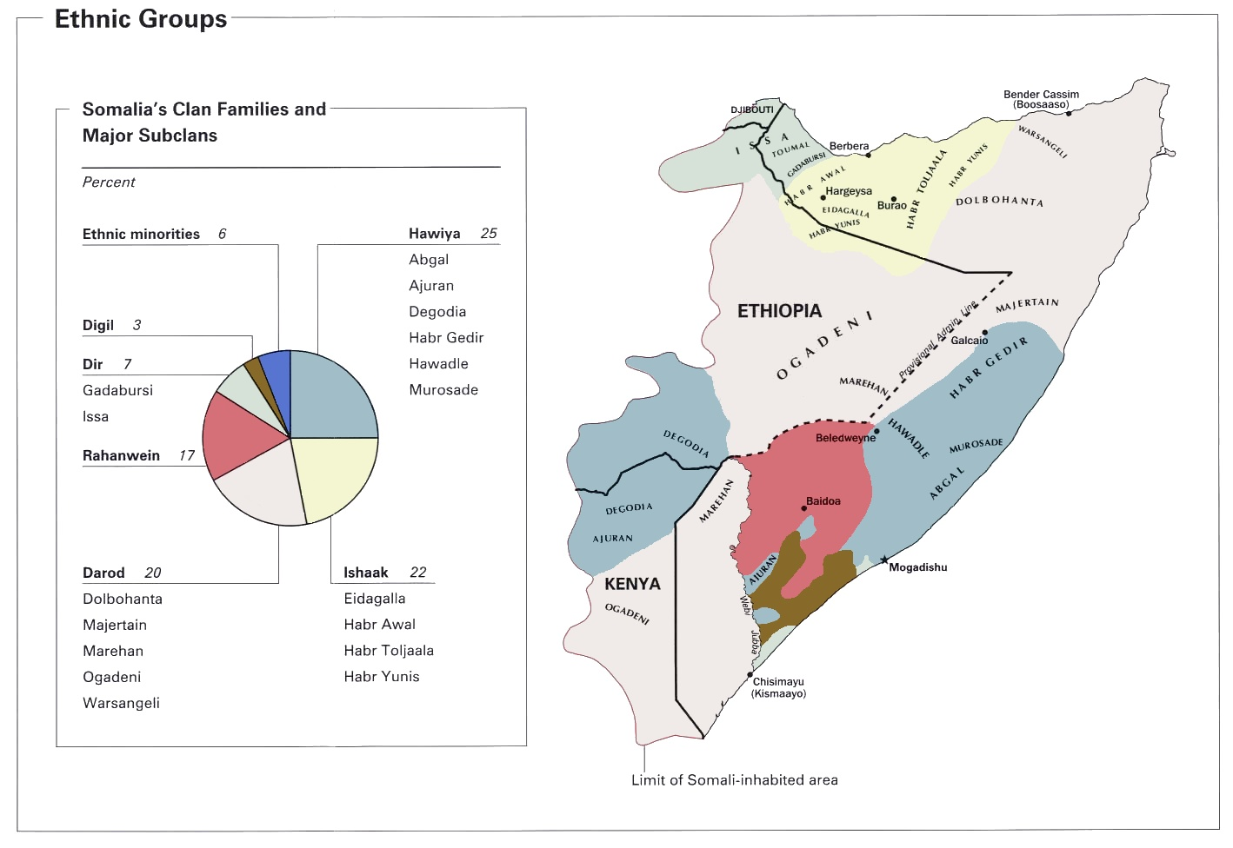
Clan distribution
Notes:
Clan structure in Somalia
In a report on IDPs one UN respondent stated “Do not underestimate the power of clan dynamics,…. If a clan disagrees with a humanitarian plan, the plan cannot move forward – period” [Drumtra, 2014]
The six major Somali clans are Darod, Dir, Hawiye and Issak forming the Samale group, and the Rahaweyn (Digile and Mrifle) known as the Sab group. Minority groups who fall outside major clan lineage divisions are often discriminated and marginalized in Somali society. Minorities are traditionally hunters or craftsmen. Bantu minority groups tend to be small scale farmers or laborers and live in the riverine areas. The six major clans form branches to numerous sub clans. The major clans include Darod, Dir, Hawiye and Issak collectively known as Samale group, and the Rahaweyn (Digile and Mrifle) community categorized as the Sab group.
The Somali clans are grouped into clan bonds or clan alliances formed to safe guard the mutual interest and protection of the members of the alliances though social contract or “xeer”. It is widely regarded that the social context of human development in Somalia cannot be understood without reference to clan affiliation. At the grassroots level, clan elders and other community leaders play a vital role in providing most of the day-to-day governance throughout Somalia, in the absence of effective state authority, and are often instrumental in maintaining local stability.
References
Map derived from: https://upload.wikimedia.org/wikipedia/commons/8/8b/Somalia_ethnic_grps_2002.jpg
Drumtra J (2014). Internal Displacement in Somalia. Brookings-LSE project on internal displacement. December, 2014

Slide 8
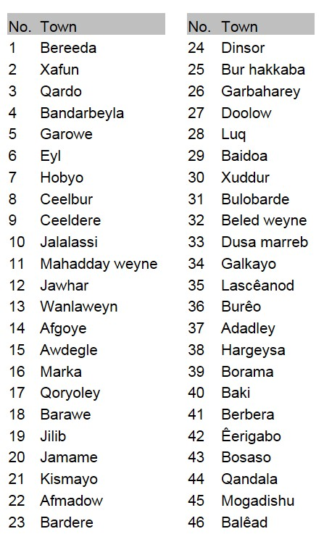
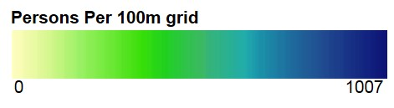
Population settlement
Notes:
Context
Clearly any approach that requires the use of modeled disease rates requires reasonable information on the resident population for the years one is intending to estimate risk. Where risks of disease are over-distributed in space, such as most vector borne diseases, population distributions and counts must be resolved to higher spatial levels than large regional estimates
Population estimates for Somalia are contentious. The last population census was conducted in 1975. Until recently the size of Somalia’s population had been highly disputed with estimates ranging from 8 to 10 million, a projected annual growth of 2.6% and relatively low density. However, the recent 2014 UN Population Estimates Survey (PESS) gives a national population figure of 12.4 million (2-3 million higher than earlier estimates). Population estimates for Somalia are currently derived from the 2014 country-wide Population Estimation Survey (PESS) that was conducted by The Ministry of Planning with facilitation by UNFPA. An extensive household sample survey (October 2013-March 2014) provided reliable and comprehensive population estimates and important demographic characteristics by the 18 pre-war regions.
The total population in 2014 is estimated to be 12.3 million people. The PESS indicated that the average household size in Somalia consisted of 6.5, 6.4, 5.8 and 3.7 persons in Nomadic, Urban, Rural and IDPs populations respectively. Out of the total population, 42% (5,216,392) were living in urban areas and 23% (2,806,787) were living in rural areas. The nomadic population constituted 26% (3,186,965) and the internally displaced persons made up 9% (1,106,751) of the population. The country has a youthful population with just under half (45.6%) being less than 15 years and 75% under 30 years.
Map construction of populated settlements
The above left-hand image shows the distribution of settlements in Somalia using by combining populated places database assembled by the National Geospatial-Intelligence Agency (NGA; http://geoengine.nga.mil/geospatial/SW_TOOLS/NIMAMUSE/webinter/rast_roam_help.html) and Place locations database assembled from the Open Street Map (OSM; http://extract.bbbike.org/). Although no specific date on when the last update was made, both datasets are reported to be updated on a weekly basis on their respective website. 20,085 settlement locations have been geo-coded.
We have also assembled “urban centres” in Somalia using the place name gazetteer of Somalia (www.geonames.nga.mil/gns/) and subsequently digitizing using Google Earth the 46 “urban” places where an estimated 10,000 inhabitants (shown in left hand table and numbered on left hand map).
Only permanent rivers confirmed using the Global Lakes & Wetlands Database (GLWD; www.worldwildlife.org/GLWD) were selected and shown in image above.
The road network (red lines in left hand image) for Somalia was that obtained from the Open Street Map (OSM).
Population distribution modelling – Linard et al. (2010)
Previous population settlement mapping was done with a downgraded set of settlement data assembled from various sources including UNDP, GTZ, KEMRI, FSAU. The dataset contained 11,413 points divided in 8 categories: district capital (57), IDP camp (535), National capital (1), part of town (186), regional capital (17), settlement (9852), temporary nomadic settlement (752) and town (13). These were then compressed to three classes a) towns = national capital + regional capitals + district capitals + towns + parts of towns; b) IDP camps and c) rural settlements. Population estimate data that available at the district level were based on 74 districts, giving an average spatial resolution of 93 km where the United Nations Development Programme (UNDP) provided population estimates for the year 2005. Population data were adjusted forward to estimated 2010 levels using UN growth rates.
Landcover classed from Africover (www.africover.org) were condensed from 99 individual classes to 22 aggregated classes. For urban extents the GeoTerraImage dataset depicting urban and settlement polygon outlines was used based on Landsat imagery between 2000 and 2005, generated through a combination of conventional on-screen photo-interpretation and hierarchical clustering techniques, often involving the use of area-specific geographic masks. Land cover class densities were used as weights to reallocate populations within districts. Per-pixel population densities were adjusted to the total population estimated by the UNDP (2005) in the administrative unit they belong to resulting in a gridded population distribution density per 100m resolution shown in right hand figure.
Action points
The left hand image has many more defined settlements and the openstreetdata roads network has improved since the Linard paper of 2010 (>20,000 compared to circa 11,000 in 2010 model). Most importantly the updated PES provides a much more reliable estimation of population census data across 109 (rather than 74) districts. It is therefore important to re-model population distributions and densities now this additional data is available. This is likely to make important differences to the population adjusted estimates of malaria infection prevalence.
Data have been assembled and provided to Afripop c/o Catherine Linard on 2nd June 2016 to use more up-to-date methods of random forest, dasymetric modelling [Linard et al., 2012; ; www.worldpop.org.uk]
References
Linard C, Alegana VA, Noor AM, Snow RW, Tatem AJ (2010). A high resolution spatial population database of Somalia for disease risk mapping. International Journal of Health Geographics, 9: e45
Linard C, Gilbert M, Snow RW, Noor AM, Tatem AJ (2012). Population distribution, settlement patterns and accessibility across Africa in 2010. PLoS One, 7: e31743
Population Estimation Survey 2014 for the 18 Pre-War Regions of Somalia, Data for a Better Tomorrow: PESS 2014 (October 2014), Federal Public of Somalia and UNFPA.

Slide 9
Displaced persons
Post Yemeni crisis migration 2016
Xingod IDP camp, Karkaar, Puntland
(N Pearson & S Khan, 2012)
UNHCR estimates of IDPs in February 2016
Notes:
Context
Somalia has the seventh-largest internally displaced population in the world. It is the scene of one of the world’s longest continuous humanitarian assistance operations, dating back to the late-1980s [Drumtra, 2016]
There remains over 1.1 million protracted displaced people in Somalia, who are vulnerable, under constant threat of eviction and abuse and not protected by clan structures. The recent crisis that began in 2015 in Yemen has resulted in an influx of circa 30,000 Yemeni refugees from the southern regions of Yemen to Somaliland and Puntland (see above right from UNHCR report 2016). In April 2016, the Kenyan government announced that it would close the Dadaab Refugee camp, forcing the return of long-term asylum seekers from Somalia to return to Somalia.
These populations are stated in the National Malaria Strategic Plan 2011-2015 and the Global Fund Concept note in 2014 as requiring special needs. As part of the National Malaria Strategic plan 2011-2015 it was stated that “There is a need to ensure that IDPs are correctly screened and treated after mass displacements in order to reduce morbidity among IDPs and the likelihood of transmission to host communities. The RBM taskforce will coordinate with agencies such as UNHCR as well as the Population Tracking Initiative to determine whether mass movements have taken place. Resources will be mobilised for implementing agencies on the ground to screen IDPs systematically in camp health facilities in order to detect and treat any parasite infections” [NMCP, 2009]. However, while a sensible strategy, there is no documentation that this actually happened at any IDP camps since 2010.
Action Points
It should be possible to assemble the data from OCHA on the >500 refugee/IDP camp locations and NGO supporters in Somalia. Given these are a special risk groups and constitute 9% of the population it would be useful to have these spatially mapped. Someone needs to contact OCHA offices for these data.
What interventions are proposed specifically for IDPs, other than being vulnerable, and how might this be mapped and operationally implemented.
References
Drumtra J (2014). Internal Displacement in Somalia. Brookings-LSE project on internal displacement. December, 2014
National Malaria Control Programmes (NMCP) (2009). Somalia National Strategic Plan for Malaria 2011-2015. Nairobi, Kenya; October 2009
UNHCR (2016). Map showing displaced populations by region. March 2016

Slide 10
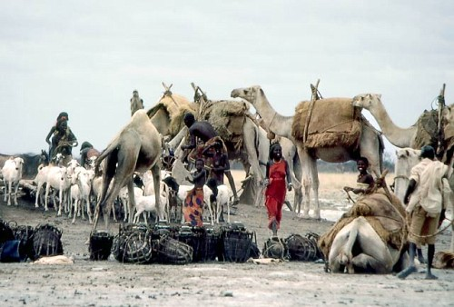
Nomadic pastoralists
Notes:
Context
Population mapping does not capture the nomadic pastoralists in any meaningful way
A large proportion of the Somali population are nomadic. These communities offer specific challenges to malaria control, recognised in the late 1950’s and 1960’s [Arena, 1965], notably in Somaliland where attempts made to protect nomadic housing structures using IRS as part of the Haud Malaria Control project which sprayed Aqals when nomads crossed into Somaliland from Ethiopia.
As mentioned fifty years ago, malaria control among nomadic groups is not one single country’s problem and is as much a special group issue as it is a cross-border issue. “Inter-country co-operation will, of course be needed for the parallel development of the operational phases of malaria eradication programmes in neighboring countries, since population movements across borders cannot be controlled in these vast, arid, roadless regions, where millions of people and animals are in ceaseless movement.” [Arena, 1965]
There are no specific recommendations for the control of malaria in nomadic groups in Somalia. This requires better data and more dialogue and resonates with recommendations by the WHO in 1960, when nomadic populations were 66% of total population, “Epidemiological study among nomads is urgently required”. A small study of 152 nomadic and semi-nomadic people was undertaken in September 1984 in the Lower Shabelle region and none were found to harbour malaria infection [Ilardi et al., 1987]. This is the only “recent” investigation of malaria among nomadic peoples in Somalia identified.
The Global Fund Concept note identified nomadic pastoralists as being a special vulnerable group, distal from formal health services that are concentrated in towns and cities and therefore hard to reach for prevention and disease management. However, these groups are not specifically identified for specialized malaria control activities.
Image: http://www.vulkaner.no/n/africa/somalia/somalinomad.jpg
Action Points
There is a need to better define the nomadic pastoralists as a group that are marginalized from the national strategic plans and also contribute to threats of imported malaria where malaria is eliminated.
References
Arena JM (1965). Malaria eradication among the Nomads of Somalia. WHO Chronicle, 19: 232-239
Ilardi I, Sebastiani A, Leone F, Madera A, Bile MK, Shiddo SC, Mohamed HH, Amiconi G (1987). Epidemiological study of parasitic infections in Somali nomads. Transactions of the Royal Society of Tropical Medicine & Hygiene, 81: 771-772

Slide 11
Health Service delivery & Information systems
Notes:
Context
Over the last two decades the health system has collapsed across many parts of the country and the combination of insecurity, drought and famine. Somalia continues to struggle to emerge from the decades of conflict and instability. Mulitlateral and bilateral agencies have jointly supported various development programmes aimed at engendering peace and governance. The main active donors in Somalia meet under the auspices of the Coordination of International Support to Somalia (CISS) which includes the Somalia Donor Group (SDG), the UN country team (UNCT) and the NGO Consortium. The UN and the World Bank funded Somali Reconstruction and Development Programme (RDP) was the first national development plan for all three Somali regions. The aims of the health sector component of the RDP were to: improve access, utilization and quality of health services; strengthen financial management; build human resources; ensure cost-effective availability of essential drugs and rehabilitate health care infrastructure.
The Health Sector Committee (HSC) coordinated implementation of the health sector component of the RDP with oversight from the CISS. The RDP was only partially implemented and came to an end in 2012. In the same year, the UN Joint Programme on Local Governance and Decentralized Service Delivery in Somalia (JPLG) was formed continue some key activities of the RDP and to strengthen governance. For health, the programme continued to implement the rehabilitation of health care infrastructure.
The Joint Health and Nutrition Programme (JHNP) was also formed in 2012 to improve the health and nutrition status of the Somali people, including a reduction of child and maternal mortality; and to improve capacity for health management and governance. The JHNP coordinated the development of the first health sector strategic plans (HSSPs) and work plans specific to the contexts in Somaliland, Puntland and South Central Zones. The HSSPs were launched on the 31st of March 2013. All three HSSPs note that malaria is one of the main public health problems to be tackled under health service delivery goal of improving overall maternal and child health. Each HSSP is underpinned by the WHO framework for a well-functioning health system and focuses on the following strategies; 1) Enhance, expand and increase utilisation of Essential Package of Health Services (EPHS) delivery, 2) Development of financial systems which increasingly depend more on national financing and local resources, whilst utilising external funding more efficiently through sector wide approaches, 3) Establish a skilled, well managed, motivated and equitably distributed workforce to provide EPHS, 4) Improve the availability, quality, safety and rational use of medicines and health products, 5) Improve decision-making through collecting and analysing comprehensive and accurate information on key health metrics, and 6) Strengthen leadership and governance to better manage the core functions of the MoH at all levels.The Malaria National Strategic Plan (2011-2015) was used as a reference document during the development of the HSSPs. While there is no specific budget for malaria control in the National Health Budgets; funding for malaria is integrated with within the primary care budgets.
Health services are almost entirely funded from donor support. The UK’s Department for International Development (DFID) currently has 44 active projects in Somalia at a total cost of US$100 million, a level of spending which was fixed through to 2015. The United States Agency for International Development (USAID) spent US$ 239 million in Somalia in 2010 alone. Both the UK and US focus their funding on projects to encourage the development of stable government over
humanitarian and health projects. Stripping inflation from the figures, total aid to Somalia rose significantly from $103 million in 2001 to $683 million in 2009, or $75 per Somali citizen, making Somalia amongst the top 10 largest recipients of aid [Ali et al., 2014]. With time, external donor assistance has declined [Devi, 2016], and now the Global Fund is one of the principal funders of the health sector and at times the only donor supporting malaria activities in Somalia. United Nations Children’s Fund (UNICEF) is the principal recipient (PR) of GFATM funds while WHO, local and international NGOs are sub-recipient implementing agencies. The GFATM through a health systems grant for malaria round six has supported the reintroduction of the health management information system (HMIS) and provides remuneration for various cadres of health workers.
References
Ali AM, Handuleh J, Patel P, Whitwell S, Harris K, Ali FR, Southgate RJ, Godman B, Al-Hadithy N, Gustafsson LL, Finlayson AE (2014). The most fragile state:
healthcare in Somalia. Medicine, Conflict & Survival, 30: 28-36
Devi S (2016). Somalia calls for greater coordination in health assistance. Lancet, 387: 1263-1264

Slide 12
Health facility mapping
Xingod Health Center, Karkaar, Puntland
(N Pearson & S Khan, 2012)
Notes:
Central to the reliable use of routine health information system data, or definitions of service access, is a complete geo-coded map and master list of all possible disease reporting sites. Over the years various attempts have been undertaken by the KEMRI-Wellcome Trust programme and partners in Somalia to create this database.
Public health care system
Public sector service delivery points are managed and financed by employees of international or national NGOs and community-based organizations, largely contracted by the United Nations programmes. The EHPS, implemented in a phased approach from 2012 has a four-tier system:
Primary health unit (PHU) formed from health posts and staffed by at least one trained Community Health Worker (CHW) to provide basic health prevention and promotion services; estimated number 594-625
Health Centre (HC) is the key service delivery unit providing maternal and child health services, a delivery unit and a six-bed observation unit. MCH/OPDs not meeting these criteria will become PHUs; estimated number 234-293
Referral Health Centres (RHC) and district hospitals provide the next level of services including comprehensive obstetric care; estimated number 19
Referral Hospitals: Provide 24 hour uninterrupted services with resident doctors and specialists; estimated number 24
Some private hospitals have been supported by Somalian professionals in-country in collaboration with local businesses or the diaspora. Some good health care facilities, albeit much smaller than what the country currently needs, have been established. These include general hospitals such as Al-Hayat, Arafat and SOS for Children, all situated in Mogadishu. Several health facilities have also been set up in Somaliland, chief among them being the modern and well equipped Edna Maternity Hospital which was constructed in Hargeisa.
Data Sources
The health facility database used and dated 08/02/12 is a combination of health facilities lists from different UN agencies working in Somalia. The database was cross-referenced with a list of 45 health facilities from a 2007 health facilities mapping project in 3 districts of Somalia [Noor, 2007; Noor & Rage, 2007; Noor, 2007]. All the 45 facilities were found to be in the main database and all had coordinates from GPS. The combined database has 830 public health facilities of which 47 have missing coordinates. The database was further improved by addition of 54 health facilities from digitizing a map of functioning health facilities of Somalia as of April – June 2013 by OCHA [OCHA, 2013]. From this map, we only digitized facilities that did not coincide spatially with the facilities in our database. These were 30 health posts and 24 health centers to bring the total number of public health facilities in the database to 884, of which 54 have no facility names. 837 facilities were then spatial joined with Somalia 109 districts. 47 facilities have no coordinates. The official number of public health facilities in 2008 was 922 [MOH, 2009; MOHDPS, 2011]. The excel database of health service provision sites accompanies this report.
Action points
A recently updated official list or database of Somali public health facilities is needed. The above figure shows a map of Somalia’s public health facilities.
There are differences between summary reports of numbers/types of facilities in the MPR and draft NMS 2016-2020. This is an ever changing, dynamic data but information on the precise location of facilities is fundamental to any nascent HMIS. It is therefore recommended that these data be validated again across each of the three regions. This should also form part of an audit of malaria diagnostic services available at each site and staffing levels. This basic health facility master-list/audit would benefit many sectors beyond malaria.
References
Ministry of Human Development and Public Services (2012). Health Sector Strategic Plan 2013 – 2016. Accessed December 18, 2015 at [http://tinyurl.com/qeq9hbu].
Ministry of Human Development and Public Services (2009). Somalia National Strategic Plan for Malaria 2011 – 2015. Accessed December 18, 2015 at [http://tinyurl.com/qeq9hbu].
Noor AM (2007). Baseline Mapping and Health Facility Audit Survey: Gebiley District. Report on trip to Somaliland. 28th March – 3rd April 2007 and 29th April – 2ndth May 2007. On behalf of WHO-RBM Somalia & UNICEF.
Noor AM & Rage IA (2007). Baseline Mapping and Health Facility Audit Survey: Merka District, Somalia. Report on Merka survey. 25th August -10th September 2007. On behalf of WHO-RBM Somalia & UNICEF.
Noor AM (2007). Baseline Mapping and Health Facility Audit Survey: Garowe and Burtinale Districts, Puntland, Somalia. Report on Garowe & Burtinle survey. 17th October - 17th November 2007. On behalf of WHO-RBM Somalia & UNICEF
OCHA (2013). Somalia - Functioning Health Facilities, April - June 2013. Accessed January 4, 2016 at [http://tinyurl.com/zsuvae2].
Pearson N & Khan S (2013). Review of the implementation of the essential package of health services in Sahil region of Somaliland, Kaarkar region of Puntland and Gedo region of South Central Somalia. Report commissioned by DFID & Somali Ministries of Health. Contracted by the Health Consortium for the Somali People. Work overseen by DFID Somalia Health Adviser, Katie Bigmore, November 2013

Slide 13
Joint Health and Nutrition Programme (JHNP) districts (Left); Location of 222 NMCP sentinel sites (Right)
Notes:
Joint Health and Nutrition Programme (JHNP) established, as a five year multi-donor health sector development program, to improve the health and nutrition status of the Somali people; managed by a partnership between UNICEF, WHO and UNFPA two to three targeted districts in 9 regions (3 in each zone) receiving the full complement of programs. By 2014, these hadn’t rolled out extensively in the CSZ owing to issues related to security. The districts covered by the JHNP by 2014 are shown in red above.
The UNICEF office is the administrative agent for a Joint Health and Nutrition programme which is resourced by: DfiD; SIDA; USAID (programmatic but not financial); AusAID and the Swiss Development Cooperation. UNICEF hosts the secretariat which is responsible for distributing funds toward the three agencies: WHO, UNICEF and UNFPA. The JHNP is a multi-sectoral programme which was developed with all the three health ministries which have a full leadership/convening role. The JHNP has a mandate from 2012-2016 with a likely extension to 2017 and has a required capitalization value of $236 million over five years.
Action Points
We need to establish what sorts of data the JHNP districts assemble routinely that might support M&E for the NMCPs.
In addition there is a need to map the sentinel sites so that these are reviewed for externality of ecologies.

Slide 14
Climate

Slide 15
Climate covariates used to help model predictions
Precipitation
Enhanced Vegetation Index
Temperature Suitability Index
Notes:
Climate context
Overall, Somalia is classified as having an arid to semi-arid climate. North and South movement of the inter-Tropical Convergence Zone (iTCZ) determines rainfall, the primary characteristic of climate in Somalia. The annual cycle of movement from the iTCZ provides great spatial variation in precipitation levels. Additionally, the iTCZ contributes to temporal variation in rainfall, which in most parts of the country results in two wet-seasons. The Gu occurs in the period between March and July and the Deyr from August to November. The months of highest rainfall within these seasons are generally from April-June and October-November respectively. Outside of the wet-seasons are two distinct dry periods which vary across the country in their onset, based on when the wet-seasons end. The principal dry season is the Jilaal, occurring between December-March, when the iTCZ is far to the south. The secondary dry season, the Haggai, occurs between the Gu and Deyr wet seasons. On average Somalia receives 500 mm of rainfall each year.
Across years, of all climatic parameters, rainfall offers the most variability and unpredictability. This can lead to droughts which can persist for years in more arid locations such as the northern coastline and inland areas of the north-eastern coast. Conversely, there can be intense downpours that lead to flash flooding which are a common occurrence along the intermittent wadis in the North of the country. Floods are also prevalent along the Juba and Shabelle alluvial plains. Historically, floods have affected riverine areas during the Deyr season (Principally between October to December), and less frequently during the Gu season. Rainfall is a key determinant of growing seasons and the types of agriculture practiced, directly influencing surface runoff, stream flow, and groundwater recharge. Years in which rainfall patterns are anomalous can result in food insecurity as well as increased seasonal malaria transmission and epidemic outbreaks.
Monthly rainfall surfaces exists that are produced from global weather station records gathered from a various sources (1950‐2000) and interpolated using thin‐plate smoothing spline algorithm to produce a continuous global surface [Hijmans et al., 2005] and monthly average rainfall raster surfaces at 1×1 km resolution available from the WorldClim website. Precipitation is shown in mm monthly averages this period of time (1950-2000). Rainfall determines vector abundance, but might not capture the variation in available surface water, this is often measured using an Enhanced Vegetation Index (EVI), that is a measure of vegetation, from Fourier–processed data from the MODerate‐resolution Imaging Spectroradiometer (MODIS) sensor imagery and available at approx. 1×1 km spatial resolution [Scharlemann et al., 2008]. Here used to develop an annual mean EVI surface. EVI is an index of intensity of photosynthetic activity and ranges from 0 (no vegetation) to 1 (complete vegetation).
Mean air temperatures are generally over 20°C for most part of the year throughout the country. However, like with rainfall, there is spatial and temporal variations throughout the year. In the south the temperature is highest inland, with Luuq in Gedo region near the border with Ethiopia and Kenya, having the highest mean temperature in Somalia of over 30°C. Temperatures along the southern coast are lower than those inland, due to the influence of cold ocean currents. Temperatures in the north at lower altitudes at the height of the dry season can reach 38°C. The relative thermal uniformity prevailing in the south is distorted by the effects of higher altitudes in the north, where temperature decreases with altitude, giving a larger mean daily lapse rate of about 6°C per 1000m, which can widen more in the dry season compared to that of the wet. Isotherms are more or less widely spaced in the south where the surface is more homogeneous, unlike in the north where they are relatively closer to each other, with a varied topographical coverage.
As a metric for the effect of temperature on malaria transmission, a temperature suitability index (TSI) has been developed at a spatial resolution of 1×1 km [Gething et al., 2011]. The TSI model uses a biological framework based on survival of vectors and the fluctuating monthly ambient temperature effects on the duration of sporogony that must be completed within the lifetime of a single generation of Anophelines and constructed using monthly temperature time series [Hijmans et al., 2005]. On a scale of increasing transmission suitability, TSI ranges from 0 (unsuitable) to 1 (most suitable).
References:
The Geology of Somalia: A Selected Bibliography of Somalian Geology, Geography and Earth Science (2007). Hadden, R.L., Engineer Research and Development Laboratories, Topographic Engineering Center.
Hijmans R, Cameron S, Parra J, Jones P, Jarvis A (2005). Very high resolution interpolated climate surfaces for global land areas. International Journal of Climatology, 25: 1965‐1978
Gething PW, Van Boeckel, Smith DL, Guerra CA, Patil AP, Snow RW, Hay SI (2011). Modelling the global constraints of temperature on transmission of Plasmodium falciparum and P. vivax. Parasites & Vectors, 4: 92
MODIS Data repository: http://modis.gsfc.nasa.gov/data/dataprod/mod13.php
Scharlemann JPW, Benz D, Hay SI, Purse BV, Tatem AJ, Wint GR, Rogers DJ (2008). Global data for ecology and epidemiology: A novel algorithm for Temporal Fourier Processing MODIS data. PLoS One, 1: e1408
WorldClim website : http://www.worldclim.org/

Slide 16
History of malaria risk mapping in Somalia
Notes:
Background
The use of survey data, maps and epidemiological intelligence was a routine feature of control planning across most African countries during the Global Malaria Eradication Programme (GMEP) era from the mid-1950s. Data included epidemiological descriptions of transmission, vectors, topography and climate. There was a recognition over 50 years ago that one important source of planning data was infection prevalence among children aged 2-10 years (PfPR₂₋₁₀), used to define categories of endemic risk designed to guide and monitor progress toward malaria elimination targets.
The art and skills necessary to design malaria control based on an understanding of the spatial epidemiology was lost during the 1970s when the agenda for malaria control fell under a less specialized, integrated primary care mandate focused on managing fevers. In 1996, there was a renewed plea for better malaria cartography to guide malaria control in Africa [Snow et al., 1996; Snow & Noor, 2015] and over the last decade there has been a growth in spatial data on malaria and populations not available to malariologists or programme control managers 60 years ago. The growth in data has been accompanied by the development of statistical approaches to model and map risk and intervention access in space and in time using Model Based Geo-Statistics (MBG) [Diggle & Ribeiro, 2007].
At the launch of the Roll Back Malaria (RBM) initiative, calls for universal coverage of all available interventions was probably an appropriate response to the epidemic that affected most of sub-Saharan Africa during the mid-late 1990s [WHO, 2000; Snow et al., 2012]. A decade on, the international donor community is constrained by the global financial crisis, accessing overseas development assistance (ODA) and using limited national domestic funding for malaria control now requires a much stronger evidence-based business case. These future business cases must be grounded in the best possible epidemiological evidence to predict the likely impact of future intervention, assess the impact of current investment and, equally important, demonstrate what might happen should funding and intervention coverage decline.
The Malaria Programme Review, completed in 2014 recommended that the NMCP “Update the current malaria risk and stratification map for the country using prevalence data collected in surveys from 2011 and document the current epidemiology and burden of P. vivax and other non-falciparum species” [NMCP, 2014]
This epidemiological profile attempts to assemble as much available data likely to improve the definition and measurement of malaria risk in Somalia, as well as ancillary data necessary to guide its future ambitions of re-elimination, most notably the development of a revised national strategic plan for 2016-2020
References
Diggle PJ & Ribeiro PJ (2007). Model-based geostatistics. New York: Springer
National Malaria Control Programme (2014). Somalia Malaria Performance Review. Ministries of Health of the Federal Government of Somalia, Puntland and Somaliland, March 2014
Snow RW, Marsh K, le Sueur D (1996). The need for maps of transmission intensity to guide malaria control in Africa. Parasitology Today, 12: 455-457
Snow RW & Noor AM (2015). Malaria risk mapping in Africa: The historical context to the Information for Malaria (INFORM) project. Working Paper in support of the INFORM Project funded by the Department for International Development and the Wellcome Trust, Nairobi, Kenya June 2015; http://www.inform-malaria.org/wp-content/uploads/2015/07/History-of-Malaria-Risk-Mapping-Version-1.pdf
Snow RW, Amratia P, Kabaria CW, Noor AM, Marsh K (2012). The changing limits and incidence of malaria in Africa: 1939-2009. Advances in Parasitology, 78: 169-262
World Health Organization (2000). The Abuja Declaration and the Plan of Action. An extract from the African Summit on Roll Back Malaria, Abuja, 25 April 2000 (WHO/CDS/RBM/2000.17)

Slide 17
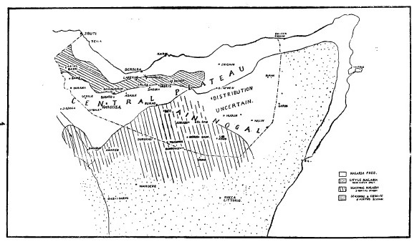
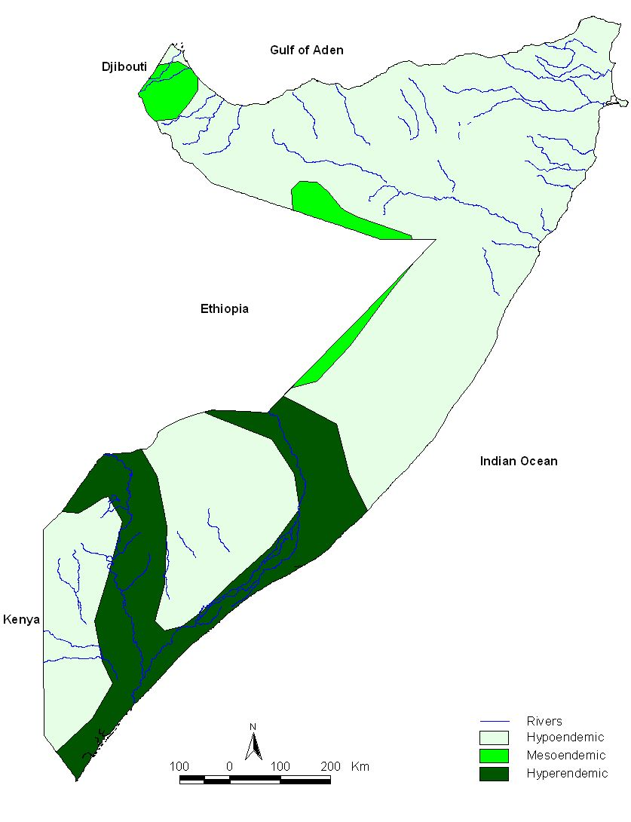
Historical malaria risk mapping
Wilson (1949)
Massa (1936)
Lysenko & Smesahko (1968)
Notes:
Background
Interestingly, there was a concerted effort over 50 years ago to assemble the epidemiological evidence necessary to define the diversity of risk that would require a tailored approach to control
In the Italian Somalia, Massa in 1936 concluded that the truly malarious areas were found closest to permanent water bodies (See above left and digitised version). He observed in the district of Juba that malaria notifications would rise particularly in the months of April after the heavy rains in March [Massa, 1936]. This is probably one of the earliest malaria risk maps developed in Africa.
As a further investigation for the British Army Malaria Services, Dr. Wilson conducted a malaria reconnaissance between May and June 1946 in British Somaliland. He stressed difficulty of malaria control due to a nomadic population and gave a topological overview of endemic areas in Somaliland (displayed in map, above top left). He concludes that epidemics may spread from small foci’s depending on seasonal rainfall and length of stay in by nomads in malarious areas. Wilson believed that the only truly endemic portion of British Somaliland consists of small foci around the sandy stream beds in the northern foothills. During a parasitological among 600 people were surveyed; 11.3% found to harbor P. falciparum, 1.3% P. malariae and 0.3% P. vivax [Wilson, 1949]. No surveys were done along the coastal plain, as this hot, windy and arid area generally felt not to be at risk of any malaria.
As part of a global mapping exercise, Lysenko & Semashko (1968) developed an approximate risk map for Somalia. Its course definition of risk is a result of almost no empirically driven descriptions of endemicity up to 1968 but nevertheless represents a reasonable “expert” opinion on the distribution of malaria risks ranging from hyperendemic around the two major river courses to pockets of mesoendemicity and large areas of hypoendemic transmission. According to the Lysenko map nowhere was classified as holoendemic and no area regarded at no risk.
References
Lysenko AJ & Semashko IN (1968) Geography of malaria. A medico-geographic profile of an ancient disease [in Russian]. in Itogi Nauki: Medicinskaja Geografija (ed. Lebedew, A.W.) 25-146 Academy of Sciences, USSR, Moscow.
Massa F (1936). Malaria Somalia. Giornale di Medicina Militaire, 14: 643 - 651
Wilson DB (1949). Malaria in British Somaliland. East African Medical Journal, 26: 283-291

Slide 18
Assembly of available malariometric data pre-1950 by Mosie [1951]
Parasite prevalence data 1932-1950
Location of malaria epidemics pre-1950
Notes:
Background continued from previous slide
Moise (1951), summarised all the avialable parasite prevalence data from various Italian malariologists who had undertaken surveys as part of reconnaissance between 1932 and 1950; this included spleen rates; these data were used to classify areas into endemicty classes as per the 1950 Kampala conference classifications. Hyper-endemic transmission was only located at the lower reaches of both the Juba and Shabelle rivers. Parasite rates were considerably lower in the northern parts of the country.
He also assembled the locations of documented epidemics during the same period (right hand figure). Imporantly, as natratives in the timelines indicate, epidemics have been documented in Somalia nationwide.
He concludes that to be able to control malaria in Somalia more epidemiological detail is required through special surveys.
Action points
This paper needs translating into English as it is a valuable resource of probably most detailed, earliest attempt to provide an epidemiolgical profile in advance of planned control and elimination
References
Moise R (1951). Il problema della malaria in Somalia e l'impostazione di una campagna di lotta. Rivista di Malariologia, 30: 229-256

Slide 19
Dr Gigioli’s report to WHO in 1955 describing the epidemiology of malaria in Somalia [EM/MAL/17; 1955]
Northern and central parts of Somaliland - low incidence of malaria generally, but epidemics occur during years of heavy rain
Endemic malaria associated with Juba and Shabelle riverine areas
Coastal areas are generally free from malaria
Wide arid tracts where only foci of endemicity restricted to permanent water collections such as springs, wells, etc
Transmission is seasonal everywhere
Holoendemic malaria is not found anywhere
Notes:
Rather than use a map the WHO consultant to Somalia in 1955 used a narrative to describe the principle epidemiological strata. He also commented on the fact that despite a basic classification the large nomadic population has never been surveyed and very little is known about them

Slide 20
Presumed malaria endemicity, based on expert opinion, WHO 1960
Notes:
As part of preparation for the malaria pre-eradication projects in Somalia plans of action available, but undated and not authored, are shown in above left image. This has been digitized on right hand images and reflects the general consensus of previous expert opinions that malaria was virtually absent from arid coastlines, was either free or focal in the north, low endemicity but prone to epidemics in the majority of Puntland and toward the Kenyan borders but stable endemic in the middle part of central south with higher endemicity along the lower reaches of the Juba and Shabelle Rivers.
WHO (1959/1960). Unpublished document in EMRO archives, headed Annex to plan of operation to pre-eradication survey in Somalia.

Slide 21
Stratified Malaria control in Somalia
Notes:
Background
The use of survey data, maps and epidemiological intelligence was a routine feature of control planning across most African countries during the Global Malaria Eradication Programme (GMEP) era from the mid-1950s. Data included epidemiological descriptions of transmission, vectors, topography and climate. There was a recognition over 50 years ago that one important source of planning data was infection prevalence among children aged 2-10 years (PfPR₂₋₁₀), used to define categories of endemic risk designed to guide and monitor progress toward malaria elimination targets.
The art and skills necessary to design malaria control based on an understanding of the spatial epidemiology was lost during the 1970s when the agenda for malaria control fell under a less specialized, integrated primary care mandate focused on managing fevers. In 1996, there was a renewed plea for better malaria cartography to guide malaria control in Africa [Snow et al., 1996; Snow & Noor, 2015] and over the last decade there has been a growth in spatial data on malaria and populations not available to malariologists or programme control managers 60 years ago. The growth in data has been accompanied by the development of statistical approaches to model and map risk and intervention access in space and in time using Model Based Geo-Statistics (MBG) [Diggle & Ribeiro, 2007].
At the launch of the Roll Back Malaria (RBM) initiative, calls for universal coverage of all available interventions was probably an appropriate response to the epidemic that affected most of sub-Saharan Africa during the mid-late 1990s [WHO, 2000; Snow et al., 2012]. A decade on, the international donor community is constrained by the global financial crisis, accessing overseas development assistance (ODA) and using limited national domestic funding for malaria control now requires a much stronger evidence-based business case. These future business cases must be grounded in the best possible epidemiological evidence to predict the likely impact of future intervention, assess the impact of current investment and, equally important, demonstrate what might happen should funding and intervention coverage decline.
The Malaria Programme Review, completed in 2014 recommended that the NMCP “Update the current malaria risk and stratification map for the country using prevalence data collected in surveys from 2011 and document the current epidemiology and burden of P. vivax and other non-falciparum species” [NMCP, 2014]
This epidemiological profile attempts to assemble as much available data likely to improve the definition and measurement of malaria risk in Somalia, as well as ancillary data necessary to guide its future ambitions of re-elimination. All assembled data, GIS shapefiles, images and bibliographic libraries are provided with this report
References
Diggle PJ & Ribeiro PJ (2007). Model-based geostatistics. New York: Springer
National Malaria Control Programme (2014). Somalia Malaria Performance Review. Ministries of Health of the Federal Government of Somalia, Puntland and Somaliland, March 2014
Snow RW, Marsh K, le Sueur D (1996). The need for maps of transmission intensity to guide malaria control in Africa. Parasitology Today, 12: 455-457
Snow RW & Noor AM (2015). Malaria risk mapping in Africa: The historical context to the Information for Malaria (INFORM) project. Working Paper in support of the INFORM Project funded by the Department for International Development and the Wellcome Trust, Nairobi, Kenya June 2015; http://www.inform-malaria.org/wp-content/uploads/2015/07/History-of-Malaria-Risk-Mapping-Version-1.pdf
Snow RW, Amratia P, Kabaria CW, Noor AM, Marsh K (2012). The changing limits and incidence of malaria in Africa: 1939-2009. Advances in Parasitology, 78: 169-262
World Health Organization (2000). The Abuja Declaration and the Plan of Action. An extract from the African Summit on Roll Back Malaria, Abuja, 25 April 2000 (WHO/CDS/RBM/2000.17)

Slide 22
WHO consultant recommendations for stratified response in 1997
To strengthen epidemiological expertise and logistics in northern Somalia to guide the operational implementation of larval control measures and to take responsibility of health information system including early warning and prediction and preparedness for epidemics
To develop control of malaria transmission in northern Somalia by anti-larval measures wherever anopheles breeding places are confined to artificial water storage reservoirs
Notes:
For decades malariologists have recognized the varied epidemiology of malaria in Somalia as requiring tailored approaches to its control. As such the notion of one size fits all has never really been recommended. 10 years before serious attempts to re-map the malaria epidemiology in Somalia, Dr Anatole Kassatsky, a WHO Consultant, was assigned to Somalia from July to November 1997 to develop a plan of action for Northern and Southern Somalia, separately, given the varied ecology from north to south. While in both areas enhanced community awareness, diagnosis and prompt access to treatment was recommended, in Northern Somalia greater emphasis was placed on epidemiological surveillance and larval control and in Southern Somalia’s recommendations included adoption of IPTp. The strategic inclusion of ITN was not made at this time.

Slide 23
WHO consultant recommendations for stratified ITN response in 2001
North-Western - increase the proportion of households, which own at least one ITN by 10% in urban areas, 5% in rural areas and 2% in nomadic areas
North-Eastern - pilot ITN in nomads and urban settings
Central-South - protect all vulnerable children and pregnant women
Notes:
The notion of a stratified response was again repeated by Dr Eliab Some, a WHO Consultant, assigned to Somalia in 2000 to develop a Roll Back Malaria Proposal for the three zones of Somalia. The proposals emphasised the regional differences in the malaria ecology, most notably for insecticide-treated nets, which were the first time they were promoted in a policy recommendation in Somalia.
At the onset of Global Fund support to Somalia, the nuanced recommendations for a stratified response were again emphasised through initial risk mapping by the KEMRI-Wellcome Trust programme, emphasizing the limited value of universal coverage of ITN in the northern parts of the country compared to promoting universal coverage in the south between the Juba and Shabelle rivers.
References
Some ES (2000). Assignment report on Roll Back Malaria in Somalia 29th June to 28th July 2000. EMRO, World Health Organisation, unpublished report, EM/MAL/276/E/R/12.01/20, September 2000

Slide 24
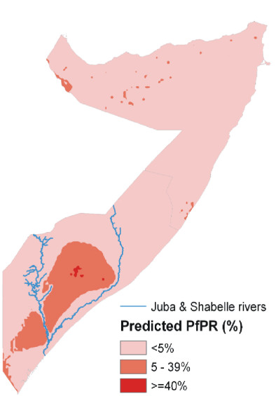
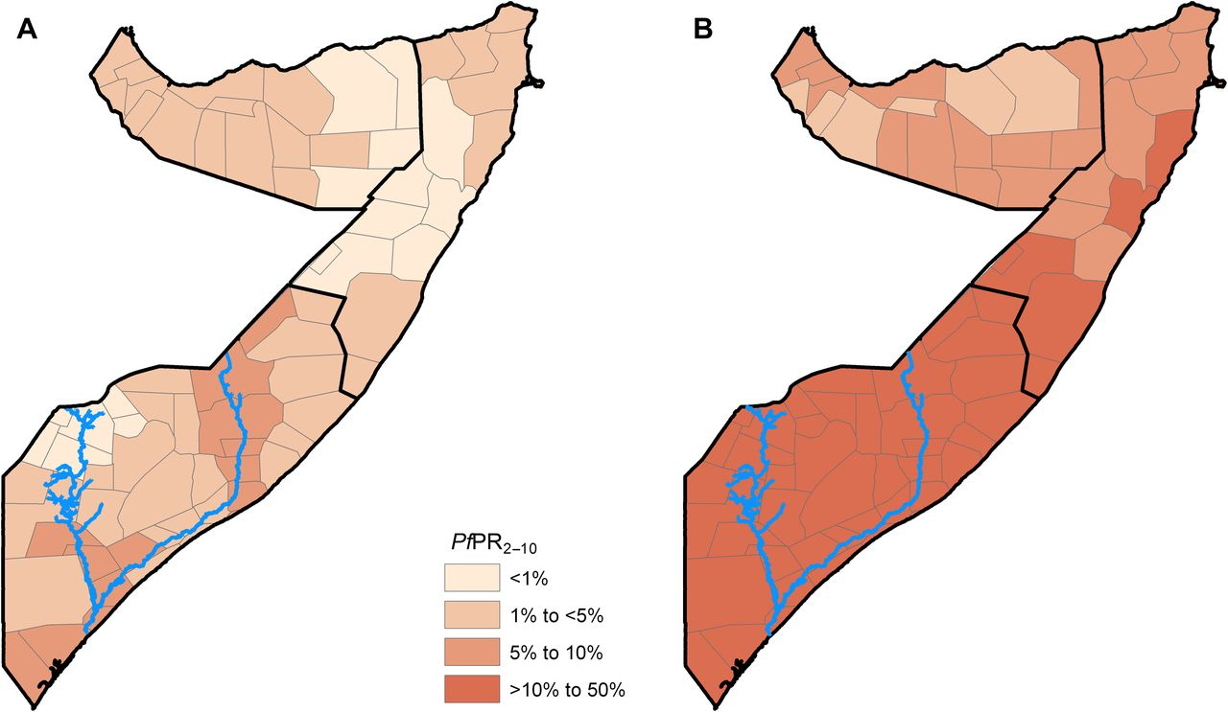
Contemporary use of malaria risk mapping
Risk map used in 2011-15 National Malaria Strategy
2010 malaria risk map used in MPR 2014
Maximal PfPR map used in MPR 2014
Notes:
Malaria risk mapping 2005-2010
The 2005-2010 National Malaria Strategic (NMS) Plan did not provide any epidemiological risk maps but did recognise the diversity of malaria risk, leading to different levels of epidemic/stability risk and affecting different age groups across the country: the strategy divided the country up into three Zones: Zone 1 hypoendemic unstable (Awdal, W. Galbeed, Togdheer, Sanaag, Sool, Bari, Nugaal, Mudug, Galgaduug), Zone 2 hypo-mesoendemic unstable (Gedo, Bay, Bakool and Hiraan), and Zone 3 hyperendemic stable (Middle & Lower Shabelle, Middle Juba and Lower Juba) [NMCP & SACB, 2005]
The KEMRI-Wellcome Trust programme has worked with partners and the NMCP in Somalia since 2006 to provide assemblies of data and modelled predictions of risk to plan malaria control and guide strategic development. Several of these early products were used in National planning around the plan for 2010-2015, where a 2007 map based on parasite prevalence was developed using model based geo-statistical methods to interpolate 500 empirical surveys of parasite prevalence (2005-2007) showing regions of <5% PfPR₂₋₁₀, 5-9% and >= 10% (Left hand map above) [Noor et al., 2008; NMCP, 2009]. Tabulated regional summaries of all the raw data from those supported by Global Fund to FSANU were also shown. The strategy still worked around a mix of epidemiological strata and administrative strata resulting in four target zones (driven by political divisions within the country more than the finer resolution epidemiology) – Somaliland, Puntland, Central South and South. The NMS specifically stated a reduction of malaria prevalence in many districts to <1% and the NMS showed a map of what this might look like by 2015. Despite an aspiration use of maps, and a tangible means of monitoring progress through parasite prevalence surveys, the NMS 2010-2015 was vague on how 2007 risk estimates would guide the selection of intervention combinations by region.
Note the 2007 regional PfPR2-10 map was also used in the national malaria prevention and control monitoring and evaluation plan 2011-2015.
During the Malaria Programme Review (MPR) undertaken between 2013 and 2014, other maps were used that had been developed by the KEMRI-Wellcome Trust programme, based in Nairobi. These were developed using Model Based Geo-Statistical (MBG) methods and based upon 1558 age-corrected surveys of P. falciparum prevalence collected between 2007 and 2011. The final products of the time-series MBG models were published in 2012 with the NMCP and WHO [Noor eta l., 2012]. The district level, population weighted maps of malaria risk for the years 2005 (Figure a above) and the maximal prediction between 2007 and 2010 (Figure b above) were shown in the MPR [NMCP, 2014].
References
National Malaria Control Programmes (NMCP) (2009). Somalia National Strategic Plan for Malaria 2011-2015. Nairobi, Kenya; October 2009
National Malaria Control Programme (2014). Somalia Malaria Performance Review. Ministries of Health of the Federal Government of Somalia, Puntland and Somaliland, March 2014
Noor AM, Clements ACA, Gething PW, Moloney G, Borle M, Shewshuk T, Hay SI, Snow RW (2008). Spatial prediction of Plasmodium falciparum prevalence in Somalia. Malaria Journal, 7: 159
Noor AM, Alegana VA, Patil AP, Moloney G, Borle M, Ahmed F, Yousef F, Amran J, Snow RW (2012). Mapping the receptivity of malaria risk to plan the future of control in Somalia. British Medical Journal Open Access, 2: e001160

Slide 25
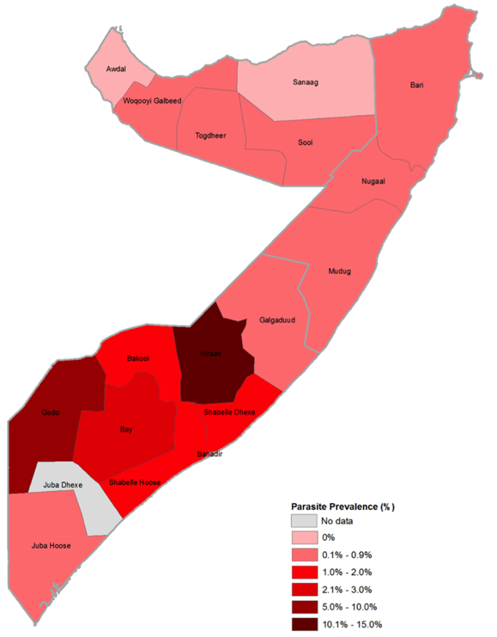
Contemporary use of malaria risk mapping
Summary data of MIS 2014 PR data by region
Modelled intrinsic P. falciparum prevalence by district
Notes:
Current, Global Fund driven, malaria risk mapping in Somalia
By 2013, the Global Fund had become more demanding of countries for the provision of sub-national tailored intervention packages based upon an understanding of the epidemiological variation within national borders. As part of the 2014 submission to the Global Fund, the NMCPs in each of the three zones requested the INFORM project to construct a national risk profile based on much more malaria data than had previously been used and also to meet the needs of the programmes to define epidemic risks and a stratified epidemiological data-driven map to support their application, notably including the 2014 national malaria indicator survey data.
For the Global Fund application, and in subsequent epidemic response guidelines and LLIN strategy documents, data from the national malaria indicator survey data for 2014 were simply summarised and shown as a regional map (right hand map above).
Given that the NMCPs required an immediate product of other risk maps to prepare for the Global Fund application, a rapid modelling method was used involving small area estimation (SAE) methods (see slides on LLIN coverage later) with the inclusion of TSI, EVI and precipitation to help with predictions. These are imperfect model based geo-statistical techniques, but can be run within a few days to complete. So SAE methods were employed in 2014 to provide risk estimates for 2005, 2010 and 2014 and selections made for each of the 109 districts where the highest intrinsic P. falciparum prevalence by district [INFORM et al., 2014]. It was decided to provide a maximal receptive risk estimate given the large inter-annual variation in risks based on rainfall and the fact that should intervention coverage cease it would be better to define a level of risk in the theoretical absence of intervention (left hand map above).
References
INFORM, NMCP & WHO-EMRO & UNICEF (2014). Defining the risk of and vulnerability to malaria epidemics in Somalia. October, 2014

Slide 26
Linking malaria risk to intervention selection - Global fund concept note 2014/15
Notes:
The map shown on right hand side of previous slide was then used to propose a mix of control interventions: Case management and surveillance were recommended everywhere, however targeted IRS was proposed in areas with an intrinsic potential for PfPR <1% and epidemic prone (green), but not those areas where PfPR was less than 1% but not epidemic prone (Blue). LLIN were recommended only were intrinsic PfPR was in excess of 1%, prioritising the CSZ (orange).
This map was then used in both the revised Global Fund concept note submitted in 2014, the epidemic preparedness and response strategy (next slide) [NMCP, 2015a], the national LLIN distribution strategy designed in 2015 [NMCP, 2015b].
References
National Malaria Control Programme (NMCP) (2015a). Somalia National Malaria Epidemic Detection, Preparedness and Response Strategy 2015-2020. June, 2015
National Malaria Control Programme (NMCP) (2015b). Long Lasting Insecticidal Net Distribution Strategy Somalia.

Slide 27
Modelling epidemic risks
Notes:
Context
Epidemics have been a characteristic feature of epidemiology of malaria in Somalia since the earliest ministry of health documentation in the 1920s (see timelines). Historically, these epidemics occurred after the rains that followed periods of prolonged drought. A national malaria epidemic preparedness strategy document for Somalia was prepared in 2006 [Guintran, 2006], but no EPR implementation guidelines were undertaken.
In 2010, an epidemic preparedness and response (EPR) strategy was developed as part of the updated national malaria strategic plan (NMSP). However, due to the prolonged insecurity in the country and slow to implement revised universal HMIS information for epidemic planning remains weak. The Malaria Programme Review in 2014, noted that of the three zones, only Somaliland has developed draft malaria EPR plans. Sentinel surveillance sites (N=222; slide x) have been used to provide malaria outbreak alerts; however, they remain few, their selection has not been based on empirical data on risk of epidemics and their reporting frequency remains sub-optimal.
In the National Malaria Strategy 2011-2015 the following objectives and targets were defined for Epidemic Preparedness and Response (EPR) [NMCP, 2009]:
90% of epidemic prone districts have epidemic preparedness plans and detection/rapid response systems for local malaria epidemics
80% of malaria epidemics are detected within two weeks of onset
70% of confirmed epidemics are effectively contained through selective interventions including effective case management, ITNs and/or IRS, community mobilization
EPR activities were scheduled for implementation from 2014 with funding from the Global Fund. The key activities for implementation included training of health workers on EPR and strengthening surveillance for early detection of epidemics. Plans for implementation of EPR activities are developed in collaboration with the NMCP, WHO and UNICEF and implementing NGOs.
The Malaria Performance Review in 2014, recommended, among other systems and resource issues, the following: “Develop and finalise a Somali national EPR policy, implementation guidelines and standard operating procedures linked to the surveillance system” and “Implement nationwide surveillance and map epidemic hotspots using geographical information systems to guide proper planning and estimation of required commodities” [NMCP, 2014]. To provide the epidemiological framework for an EPR policy the KEMRI-Wellcome Trust programme we asked to assemble climate vulnerability and malaria risk data to stratify each of the 109 districts [INFORM et al., 2014]. This finally resulted in the EPR strategic plan [NMCP, 2015].
Modelling epidemic risk
Four steps were used to define the risk of malaria epidemics [INFORM et al., 2014]. In brief, the limits of epidemic risk was defined using a combination of climatic ecozones [Muchiri, 2007] and malaria transmission [Slide 25]. Those areas which were under hypoendemic transmission of 1% to 10% parasite prevalence and in semi-arid, arid or desert ecologies were defined the limits of epidemicity.
Within these limits the relationship between rainfall anomaly and malaria cases by month and year from 2005 were defined for a few hospitals with carefully assembled data. A three month period of anomalous rain preceded most epidemics and the median level of anomaly for these three months was about 40% of average rainfall.
Villages were defined on the basis of number of 3 blocks of months with 40% or more rainfall compared to average expected rainfall. Most villages had a set of such blocks of three months and these were ranked into quintiles of epidemic risk as shown on the map.
This map shows that most districts in northern Somalia and a few in the south have moderate to high risk of epidemics. The focus of vector control interventions, in a situation of limited resources, should be on those in the high to highest risk of epidemics.
References
INFORM, NMCP & WHO-EMRO & UNICEF (2014). Defining the risk of and vulnerability to malaria epidemics in Somalia. October, 2014
Guintran J-O (2006). Control of malaria epidemics in Somalia: 2006-2007 strategic framework. Report of Short Term Consultancy for WHO/EMRO, March 2006
Muchiri PW (2007), Climate of Somalia. Technical Report No W-01, FAO-SWALIM, Nairobi, Kenya http://data.fao.org/map?entryId=bcaf00e0-88fd-11da-a88f-000d939bc5d8&tab=metadata]
National Malaria Control Programmes (NMCP) (2009). Somalia National Strategic Plan for Malaria 2011-2015. Nairobi, Kenya; October 2009
National Malaria Control Programme (2014). Somalia Malaria Performance Review. Ministries of Health of the Federal Government of Somalia, Puntland and Somaliland, March 2014
National Malaria Control Programme (NMCP) (2015). Somalia National Malaria Epidemic Detection, Preparedness and Response Strategy 2015-2020. June, 2015

Slide 28
Modified endemicity classification of Somalia & current (2014) risks

Slide 29
The limits of malaria risk
Temperature Suitability Index, shown red where TSI = zero
Aridity index
Combined TSI and Aridity malaria exclusion areas
Notes:
Context
The first steps in most vector borne risk mapping is to exclude the likelihood of transmission based on the biology of pathogen and vector. Two important biological determinants of whether malaria can be transmitted in a given area are temperature, when too cold for too long sporozoites cannot develop within the mosquito within a time frame necessary for human to human transmission; and aridity, where there is too little surface water for larval development or survival [Shililu et al., 2004] or adults become desiccated [Gray & Bradley, 2005].
Temperature Suitability Index (TSI): As a metric for the effect of temperature on malaria transmission, a temperature suitability index (TSI) has been developed at a spatial resolution of 1×1 km [Gething et al., 2011], see Slide 15. On a scale of increasing transmission suitability, TSI ranges from 0 (unsuitable) to 1 (most suitable). In Somalia, TSI values of zero, i.e. unsuitable for transmission, are located along the high altitude areas of Ceerigaabo and Yufle within the Shimbiris Mountain range.
Ardity: The Global mean Aridity Index has been developed as a composite of data from 1950-2000 at 30’ spatial resolution [Trabucco et al,. 2009]. Aridity Index (AI) = Mean Annual Precipitation / Mean Annual Potential Evapo-Transpiration. The Aridity index values increase for more humid conditions, and decrease with more arid conditions. Mean annual precipitation (MAP) values were obtained from the WorldClim Global Climate Data [Hijmans et al. 2005], for years 1950-2000. The Global Potential Evapo-Transpiration (PET) layers estimated on a monthly average basis were used to generate/aggregate mean annual values (MAE). PET is a measure of the ability of the atmosphere to remove water through Evapo-Transpiration process. PET is calculated as PET = 0.0023 • RA • (Tmean + 17.8) • TD0.5 (mm / day) where Tmean is mean monthly temperature, TD is mean monthly temperature range and RA is the mean monthly extra-terrestrial radiation. The Hargreaves method has been used, monthly average temperature has been sourced from WorldClim database, and monthly extra-terrestrial radiation, calculated using a methodology presented by Allen et al. (1998). Temperature range (TD) is a proxy to describe the effect of cloud cover on the quantity of extra-terrestrial radiation reaching the land surface.
Hyper-aridity is represented by an index of <0.03 [UNEP] and here it is assumed represents areas unable to sustain malaria transmission; all areas with an aridity index > 0.03 are shown as orange. These hyper-arid areas, along the northern coastlines of Somalia. Previous authors commenting on the absence of malaria in Somaliland, Puntland and South central have all alluded to the fact that malaria is virtually absent from these coastal areas (slides 17 & 18). What is harder to reconcile is the notion that there is no malaria risk along the long Indian Ocean coastline
References
Allen RG, Pereira LS, Raes D, Smith M (1998). Crop evapotranspiration: Guidelines for computing crop requirements. Irrigation and Drainage Paper No. 56, FAO, Rome, Italy.
Hijmans RJ, Cameron SE, Parra JL, Jones PG, Jarvis A (2005). Very high resolution interpolated climate surfaces for global land areas. International journal of climatology, 25:1965-78.
Gething PW, Van Boeckel, Smith DL, Guerra CA, Patil AP, Snow RW, Hay SI (2011). Modelling the global constraints of temperature on transmission of Plasmodium falciparum and P. vivax. Parasites & Vectors, 4: 92
Gray EM & Bradley TJ (2005). Physiology of desiccation resistance in Anopheles gambiae and Anopheles arabiensis. American Journal of Tropical Medicine & Hygiene, 73: 553-559
Shililu JI, Grueber WB, Mbogo CM, Githure JI, Riddiford LM, Beier JC (2004). Development and survival of Anopheles gambiae eggs in drying soil: influence of the rate of drying, egg age, and soil type. Journal of the American Mosquito Control Association, 20: 243-247
Trabucco A & Zomer RJ (2009). Global potential evapo-transpiration (Global-PET) and global aridity index (Global-Aridity) geo-database. CGIAR Consortium for Spatial Information. Available online from the CGIAR-CSI GeoPortal at: http://www. csi. cgiar. Org
UNEP (United Nations Environment Programme), 1997. World atlas of desertification 2ED. UNEP, London

Slide 30
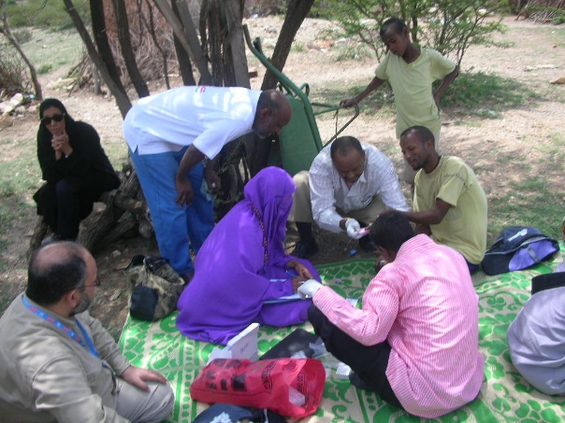
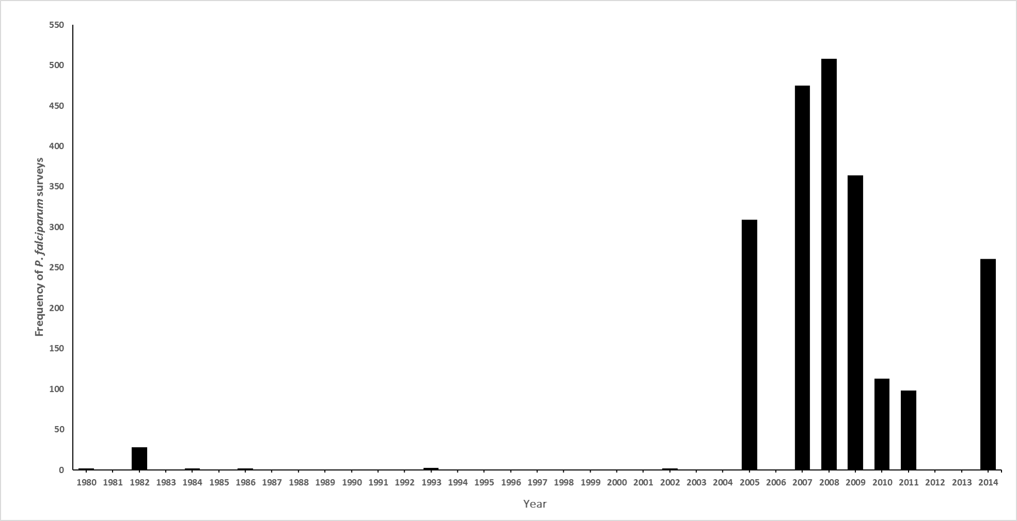
Malaria parasite prevalence surveys by year 1980 - 2014
Notes:
Given the lack of reliable HMIS data on malaria case incidence across much of the country the use of parasite prevalence data is the default measure of risk (however we return to this later under next steps). Parasite prevalence, and categories of prevalence, have been used for decades to define the appropriateness of interventions, pre-elimination states and a means by which to track impact of control [Snow & Noor, 2015]. Surveys are often undertaken among complete or random samples of communities of all ages, school children, or among selected age groups within villages.
Community-based surveys of malaria parasite prevalence have been assembled from a variety of sources including peer-reviewed journals, international and national ministry of health and academic archives, personal correspondence and more recent national household sample surveys. Methods used to identify, extract and geo-code survey reports are presented elsewhere [Snow et al., 2015; Noor et al., 2008; Noor et al., 2012].
Of the assembled data, we restricted inclusion of all surveys undertaken from 1980, 88 survey sites could not be geo-located and 2 had sample sizes less than 10 individuals. The earliest two surveys were undertaken in two villages in Togadeer in July 1980. The dataset included national household sample surveys from 2005 malaria surveys undertaken in each of three zones by WHO and partners covering 275 clusters and the 2014 Malaria Indicator Survey [NMCP, 2014] that effectively sampled 216 with a minimal sample size of 10 people.
Importantly, with funding via UNICEF as the Principal Recipients of the Global Fund support, the Food and Agriculture Organization Food Security and Nutrition Analysis Unit (FAO-FSNAU) added in RDT testing to their monthly random community nutritional surveys resulting in 1522 independent estimates of malaria prevalence between 2007 and 2011. These stopped from 2012 despite being included in the national malaria M&E plan and strongly supported by the Malaria Programme Review in 2012.
The final database included 2169 unique survey data points from 1607 locations. The vast majority 2125 were sampled using RDTs (Paracheck, ParaHit and SD Bioline). Since 2005 there have been 2128 survey data points assembled at 1595 unique locations (see next slide).
All data assembled is provided to the NMCP accompanying this report, for future use and updating
Action Points
FSNAU should be encouraged to resurrect inclusion of RDTs into nutritional surveys in the CSZ. These are done monthly in different locations and provide a unique opportunity to track changing malaria prevalence as specified as one of the main targets in the NMS 2011-2015.
References
National Malaria Control Programme (2014). The first malaria indicator survey in Somalia, 2014. Ministries of Health of the Federal Government of Somalia, Puntland and Somaliland, August 2014
Noor AM, Clements ACA, Gething PW, Moloney G, Borle M, Shewshuk T, Hay SI, Snow RW (2008). Spatial prediction of Plasmodium falciparum prevalence in Somalia. Malaria Journal, 7: 159
Noor AM, Alegana VA, Patil AP, Moloney G, Borle M, Ahmed F, Yousef F, Amran J, Snow RW (2012). Mapping the receptivity of malaria risk to plan the future of control in Somalia. British Medical Journal Open Access, 2: e001160
Snow RW & Noor AM (2015). Malaria risk mapping in Africa: The historical context to the Information for Malaria (INFORM) project. Working Paper in support of the INFORM Project funded by the Department for International Development and the Wellcome Trust, Nairobi, Kenya June 2015; http://www.inform-malaria.org/wp-content/uploads/2015/07/History-of-Malaria-Risk-Mapping-Version-1.pdf
Snow RW, Amratia P, Mundia CW, Alegana VA, Kirui VC, Kabaria CW, Noor AM (2015). Assembling a geo-coded repository of malaria infection prevalence survey data in Africa 1900-2014. INFORM Working Paper, developed with support from the Department of International Development and Wellcome Trust, UK, June 2015; http://www.inform-malaria.org/wp-content/uploads/2015/07/Assembly-of-Parasite-Rate-Data-Version-1.pdf

Slide 31
Location of 2128 P. falciparum parasite prevalence surveys 2005-2014: shown as age-corrected PfPR highest values on top (left); lowest values on top (right)
Notes:
To make meaningful comparisons in time and space, a single standardized age range is required. Correction to a standard age for P. falciparum was done using adapted catalytic conversion Muench models, into static equations in R-script that uses the lower and upper range of the sample and the overall prevalence to transform into a predicted estimate in children aged 2-10 years, PfPR₂₋₁₀ [Smith et al., 2007]
References
Smith DL, Guerra CA, Snow RW, Hay SI (2007). Standardizing estimates of malaria prevalence. Malaria Journal, 6: 131

Slide 32
Space-time Kriging P. falciparum data in Bayesian framework
Time
Latitude
Longitude
Notes:
Geo statistical methods were developed to interpolate from data at sampled locations in space and time to provide predictions of quantities at locations and times where data do not exist. These statistical methods operate under Tobler’s First Law of Geography, which states that things that are closer in space and time are more similar than those more spatially and temporally distal [Tobler, 1970]. When applied within a Bayesian inference framework, these methods are referred to as model-based geostatistical (MBG) methods. Bayesian inference allows for better use of sparse data and through the application of prior knowledge of an outcome in an iterative process and also allows for robust estimation of uncertainties around the estimates of the outcome.
Ecological and climatic heterogeneity affect the development and survival of the Plasmodium parasite and the malaria-transmitting Anopheles vectors. Environmental covariates are therefore commonly used to improve the precision of malaria risk modelling and traditionally include measures of aridity, vegetation, rainfall, temperature, proximity to water bodies and urbanization (See earlier slides). These covariates were used within a total sets analysis based on a generalized linear regression model and implemented in bestglm package in R [Miller, 2002; Lumley, 2010] with PfPR₂₋₁₀ as the dependent variable. The best combination of covariates, those with the lowest value of the Bayesian Information Criteria (BIC) statistic, were selected, and proved to be three: Enhanced Vegetation Index (P= 0.00307) (slide 15), Temperature Suitability Index (P = 0.00055) (slide 15) and urbanization (P= 0.027) (see Slide 8) .
The procedures used to model and validate the transformation of empirical P. falciparum parasite prevalence data to continuous predictions of age-corrected mean prevalence in children aged 2-10 years (PfPR₂₋₁₀) are provided elsewhere [Noor et al., 2014]. In brief, we have used information from available age-corrected survey data (sample size and numbers positive) at known locations (longitude and latitude) and times (year) all data assembled 2005-2014 (see previous slide) with the minimal set of conservative, long-term covariates (TSI, EVI and urbanisation) within a Bayesian hierarchical space-time model, implemented through an adapted Stochastic Partial Differential Equations (SPDE) approach using Integrated Nested Laplace Approximations (INLA) for inference [R-INLA, 2013; Rue et al., 2009] to produce continuous maps of PfPR₂₋₁₀ for where the peaks in national PfPR sampling were done, 2005, 2007, 2008, 2009, 2010, 2011 and 2014 (see Slide 30) at 1 x 1 spatial resolutions. For more detailed equations and model descriptions a word file accompanies this PPT.
References
Lumley T (2010). Leaps: regression subset selection (R package) Version 2.7.
Miller A (2002). Subset Selection in Regression. Boca Raton, FL: Chapman & Hall
Noor AM, Kinyoki DK, Mundia CW, Kabaria CW, Wambua JM, Alegana VA, Fall IS, Snow RW (2014). The changing risk of Plasmodium falciparum malaria infection in Africa: 2000 to 2010. Lancet, 383: 1739-1747
R-INLA project. http://www.r-inla.org/. Accessed 10 April 2012
Rue H, Martino S, Chopin N (2009). Approximate Bayesian inference for latent Gaussian models by using integrated nested Laplace approximations. Journal of the Royal Statistical Society Series B, 71: 319–392
Tobler W (1970). A computer movie simulating urban growth in the Detroit region. Economic Geography, 46: 234-240

Slide 33
Model categorical predictions of PfPR₂₋₁₀ at 1x1km resolutions
Notes:
For each year shown in panels above a posterior prediction was made with a distribution around the mean at 1x1km resolutions. These were then grouped into categories of risk as shown in the bottom right panel. The grey areas are the areas masked because of unsuitability for malaria transmission as described in slide 29. the peak year, of those where predictions made, was 2007, 2008 through to 2011 saw a steady decline in infection prevalence. The lowest predicted PfPR₂₋₁₀ was 2014 across the entire series.

Slide 34
Population weighted PfPR₂₋₁₀ per district
Notes:
Population distributions at 1 x 1 km spatial resolution for Somalia, as shown and described in Slide 8 were used to adjust estimates of malaria risk per population for each district shown above. Given the clear over-dispersed nature of settlement in Somalia and small area variation in malaria risk this is important. The distributions of 1x1 km pixel predictions of PfPR₂₋₁₀ (Slide 8) were matched to year-specific population counts at the same resolution for each year 2005, 2007, 2008, 2009, 2010, 2011 and 2014. These combinations were used to compute a Population Adjusted PfPR₂₋₁₀ (PAPfPR₂₋₁₀) that reflects both the underlying diversity of human settlement and malaria risk within a district. These maps highlight that at some point over last decade every district has at one point been above 1% infection risk and at no point has malaria endemicity exceeded 50%. However, the current risk profile is one characterized by almost universally low infection prevalence nationwide (<5%) with the exception of Balanbale & Guriel districts (Galgadud region) and Belet Weyne & Mataban districts (Hiran region), in CSZ since 2010.
Predicted PAPfPR values for each district and each year are provided in accompanying excel.
Action Points
This should be repeated as and when we have a better population distribution surface from Catherine Linard of WorldPop

Slide 35
Population weighted PfPR₂₋₁₀ per region
Notes:
The same approach was taken as in previous slide to provide population weighted estimates of PfPR per region per year. This representation of risk has in some ways a greater degree of precision, aggregating wider area pixel level risks, but importantly national household sample surveys, such as the one undertaken in 2014, are powered around regional estimation. Therefore, future measurements of progress, based on parasite prevalence, as indicated in the national malaria strategic plan 2010-2015 that states that the goal is to achieve near zero (<1% parasite prevalence) malaria transmission within areas of historically low transmission (Somaliland, Puntland and Central parts of CSZ); and reduce by 50% the parasite prevalence in endemic districts of CSZ, can be measured and tracked more efficiently. The next slide shows the actual percentage reductions from 2005 to 2014 by region.

Slide 36
Percentage reduction in Population weighted PfPR₂₋₁₀ per region from 2005 to 2014
Notes:
Taking mean predicted values of PAPfPR₂₋₁₀ in 2005 and 2014 the percentage reduction between these years was computed for each region. While the 2010-15 strategy has a start date in 2010 there was probably too few sampling data points to reliably make a prediction over this interval and also as can be seen in previous slide little change. However, the changes since 2005 have been substantial as shown in above slide. At this stage it is hard to make any direct attribution of causality. Both prolonged periods of drought since 2008 and scaled intervention coverage have occurred simultaneously.

Slide 37
Model precision
Notes:
To assess the predictive performance of the model, the predicted prevalence of malaria in the surveyed locations was extracted and matched with the actual prevalence in surveyed data at the corresponding locations and time in a randomly sampled 10% holdout validation dataset using a sampling algorithm which declusters over space and time. Four performance indices were chosen to evaluate predictive performance and model fit: root-mean-square error (RMSE), mean prediction error (MPE), mean absolute prediction error (MAPE), and the correlation coefficient between the predicted and the observed values. The RMSE is simply the square-root of the mean of the squared difference between the posterior predicted mean and observed value and it is used to measure the accuracy of the model. The MPE provides a measure of the bias of the predictor, the MAPE provides a measure of the mean accuracy of individual predictions, and the correlation coefficient provides a measure of association between the observed data and prediction sets [Magalhaes & Clements, 2011]. The correlation between the observed and predicted data was visualized in a scatter plot with a least-squares best fitting line and histograms (see above left hand image). Overall there is a tendency for the model to over-predict very low prevalence but under predict higher prevalence. Overall the validation statistics were the RMSE was 0.176; MPE 0.034; MAPE 0.095 and the correlation coefficient 0.843
Despite a good overall model fit as per the testing of observed and predicted hold-out data, the model does not perform equally well everywhere and is largely a combined result of data paucity in space or large variance in data within small geographical areas, notably when prevalence declines to very low levels
The coefficient of variation (CV) is defined as the ratio of the standard deviation to the mean [Kirkwood, 1979]. It is has no measurement units and is an indicator of the magnitude of variability in relation to the mean or dispersion in data or estimates of a variable. One disadvantage of the CV is that where the mean is equal to zero, it approaches infinity and therefore sensitive to small changes in the mean. In such a case, the standard deviation should be used to describe the uncertainty of the model predictions. Generally, low CV values suggest that the standard deviations around the mean are relatively small and high values may indicate increasing model uncertainty [Noor et al., 2012].
The figure shows the coefficient of variation (CV) where a higher value (blue) indicates increasing model uncertainty for the 2014 prediction (images for all other years also available). In Somalia, most locality CV values are less than 0.5 for each prediction year, indicating that in most locality predictions of PAPfPR₂₋₁₀ are a result of good model precision. The highest prediction uncertainty, however, is in CSZ in 2007, but in the North and North East of the country when prevalence declined to very low levels between 2010-2014 (above right hand panel). To improve the precision of estimates for these counties, future surveys should consider over-sampling of survey clusters in the North, or because prevalence is so low migrate to other metrics, see later slides.
Action Points
Given the big difference in the SAE approach used previously by Noor for the epidemic report, and the over-predictions of zero. Two further models will be developed a) the probability that an area is less than 1% and b) a zero-inflated model. Noting that a binomial model has been used previously in Somalia (note MPR imagery shown in slide 24 which is the same as that used here – slides 33-37. However, with an excess of zero’s both outputs might be improved with a different modelling approach. The SAE approach is definitely wrong and only used as an expedient approach given time constraints (AM Noor, personal communication, July 2016).
New modelling code structure is being developed and will be tested this will take several weeks to finalize and run the models. This series of experiments will have added value for re-modelling infection risks in other EMRO Countries of low transmission intensity.
References
Kirkwood BL (1979). Geometric means and measures of dispersion. Biometrics, 35: 908–909
Magalhaes RJS & Clements ACA (2011). Mapping the risk of anaemia in preschool-age children: The contribution of malnutrition, malaria, and helminth infections in West Africa. PLoS Medicine, 8: e1000438
Noor AM, Alegana VA, Patil AP, Moloney G, Borle M, Ahmed F, Yousef F, Amran J, Snow RW (2012). Mapping the receptivity of malaria risk to plan the future of control in Somalia. British Medical Journal Open Access, 2: e001160

Slide 38
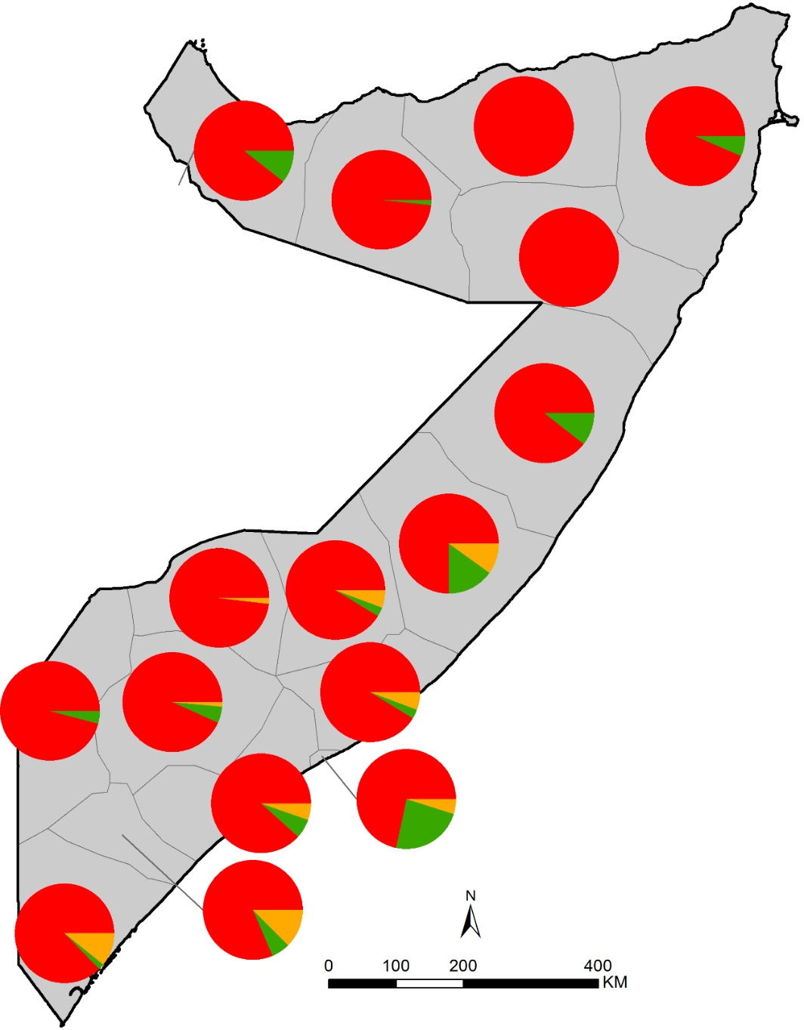
Other Plasmodium species
Community samples 1950
Clinical samples 1979
Notes:
Background
The prevalence and epidemiology of Plasmodium vivax is poorly described in Somalia [Howes et al., 2011]. It is likely that large fractions of the population are susceptible to P. vivax infection as they constitute populations who have duffy positive antigens (Fya and Fyb) on the red cell surface. The prevalence of duffy-negativity varies between reports from frequencies similar to the Bantu populations of sub-Saharan Africa [Sistonen et al., 1987], to frequencies similar to those on Arabian peninsular [Goldsmith, 1959]
Community based parasitological surveys undertaken during the 1950s, in the present day CSZ, by Italian malariologists, at eight sites were summarised by Moise (1951), and showed that the relative proportion of P. vivax to all infections detected was significant at most sites sampled (Left hand figure), more prevalent than P. malariae. P. malariae was also highly prevalent in the intensively studied Villabruzzi area of CSZ during the 1930s-1950s [Moise, 1953]
During the 1970s, malaria stations across the country screened febrile patients and summarised their data monthly by parasite species to the National Malaria Service headquarters in Mogadishu. Among the clinical fever infections detected in 1979, P. vivax was detected in each of the three Zones, most notably in Mogadishu.
According to National Antimalarial Service report in 1988 only 1 case of P. ovale has ever been reported in 1981; although this cannot be confirmed as original source not provided.
For many years during the 1990s and early 2000’s P. vivax was a neglected parasite among the epidemiological descriptions and clinical guidelines, with a general sense that this parasite was not present in Somalia. However, during the US deployment of troops in the late 1990s as part of Operation Restore Hope, there is published evidence of P. vivax transmission among military servicemen stationed in Jilib and Bandar Salaam along the Jubba and Shabelle Rivers [Newton et al., 1994; Smoak et al., 1997; Peragallo et al., 1997; Wallace et al., 1996].
Serological studies of antibodies to P. vivax antigens have also confirmed on-going exposure of populations (n=1044) in three villages in Somaliland in 2008 with a 19.3% seropositivity [Bousema et al., 2010].
National treatment guidelines were until recently, based only on P. falciparum, with no provisions or recommendations for P. vivax. This contrasts recommendations made during the 1970s and 1980s that did include 14 day primaquine treatment recommendations for vivax malaria. The launch of the revised 2016 national standard treatment guidelines does include provisions for a 14 day treatment using primaquine for vivax cases [NMCP, 2016]. It should be noted that in 1997, 26 US military personnel serving in Somalia experienced attacks of P. vivax after terminal prophylaxis with primaquine [Ajdukiewicz & Ong, 2007], therefore this does need constant monitoring.
Action Points
The recent national malaria surveys have taken thick blood slides and filter papers for species identification. However, these have not been reliably analysed for parasite species. At sentinel sites it should be possible to mount a short term investigation of the prevalence of P. vivax among clinical samples taken from febrile patients to re-examine the contribution of this parasite to the malaria burden in Somalia.
References
Ajdukiewicz KM & Ong EL (2007). Management of vivax malaria with low sensitivity to primaquine. Journal of Infection, 54: 209-211
Anon (1980). A brief description of the progress of the malaria work of the Somali Democratic Republic for the year 1979. unpublished report EMRO-WHO archives, Cairo
Bousema T, Youssef RM, Cook J, Cox J, Alegana VA, Amran J, Noor AM, Snow RW, Drakeley C (2010). Serological markers can detect heterogeneity in malaria exposure in an area of very low transmission intensity in Somaliland. Emerging Infectious Diseases, 16: 392-399.
Goldsmith KGL (1959). The blood groups of Somali tribes, with special reference to anthropology. Thesis submitted in fulfillment for the degree of doctor of philosophy, University of London
Howes RE, Patil AP, Piel FB, Nyangiri OA, Kabaria CW, Gething PW, Zimmerman PA, Barnadas C, Beall CM, Gebremedhin A, Ménard D, Williams TN, Weatherall DJ, Hay SI (2011). The global distribution of the Duffy blood group. Nature Communications, 2: 266
Moise R (1951). Il problema della malaria in Somalia e l'impostazione di una campagna di lotta. Rivista di Malariologia, 30: 229-256
Moise R (1953). L'incidenza dell'infezione da Plasmodium malariae nell'endemia malarica della Somalia. Inchiesta e studio epidemiologico. Rivista di Malariologia, 32: 11-39
National Malaria Control Programme (NMCP) (2016). Guidelines for the diagnosis and treatment of malaria in Somalia.
Newton JA, Schnepf GA, Wallace MR, Lobel HO, Kennedy CA, Oldfield EC (1994). Malaria in US Marines returning from Somalia. Journal of American Medical Association, 272: 397-399
Peragallo MS, Sabatinelli G, Majori G, Cali G, Sarnicola G (1997). Prevention and morbidity of malaria in non-immune subjects; a case-control study among Italian troops in Somalia and Mozambique, 1992-1994. Transactions of Royal Society of Tropical Medicine & Hygiene, 91: 343-346
Sistonen P, Koistinen J, Aden Abdulle O (1987). Distribution of blood groups in the East African Somali population. Human Heredity, 37: 300-313
Smoak BL, DeFraites RF, Magill AJ, Kain KC, Wellde BT (1997). Plasmodium vivax infections in U.S. Army troops: failure of primaquine to prevent relapse in studies from Somalia. American Journal of Tropical Medicine & Hygiene, 56: 231-234
Wallace MR, Sharp TW, Smoak B, Iriye C, Rozmajzl P, Thornton SA, Batchelor R, Magill AJ, Lobel HO, Longer CF, Burans JP (1996). Malaria among United States troops in Somalia. American Journal of Medicine, 100: 49-55

Slide 39
Nouger (1967): comments on data needs
If the system of blood collection from fever cases in the Health Institutions could be properly developed, the epidemiologist would be able to draw yearly transmission curves for every District and even perhaps Municipalities. The knowledge of the levels of endemicity and the stratification of the country in homogeneous malarious areas will call for the planning and organization of blood malariometric surveys.
Notes:
Nouger A (1967). Assignment report Malaria pre-eradication programme in Somalia. EM/MAL/58, Somalia 0002/R, UNDP, UNICEF August 1967

Slide 40
Malaria Programme review 2013-2014
In this situation [where parasite prevalence is low], the routine health information system is essential for supporting control activities and the transition to malaria elimination. The health management information system (HMIS) and communicable disease surveillance system (CSR) are facing challenges with coverage, incompleteness and timeliness of reporting for malaria data and are for the time being, providing inadequate support for malaria control activities.
Notes:
The Malaria Programme Review (MPR, 2014) made some very specific recommendations: including to “Strengthen the reporting of malaria information from all levels of the health care system through the HMIS and including the private and NGO sector in order to understand disease burden and trends” and “The declining malaria burden will expand the risk of malaria epidemics to all three zones. In order to mitigate this, establish comprehensive malaria surveillance activities integrated within national disease surveillance and response system (CSR) for epidemic detection”
Health Management Information System
The national HMIS collapsed with the war in Somalia. Restoration of the current HMIS commenced in 2009 using health systems strengthening grant from the Global Fund and became functional in 2011. It is the source of routine morbidity and mortality data for malaria and common communicable diseases.
Other information systems exist for Tuberculosis, HIV and nutrition and for which linkages are being established with the HMIS. The information system is not yet fully functional in the CSZ due to insecurity. Reporting to the HMIS is mainly from MCH/OPD health centres, hospitals and a small proportion of health posts. Private sector facilities and health centres wholly owned by NGOs do not report to the national HMIS. The reporting rates fluctuate by season and zone and can be high in some zones and low in others. For example in Puntland in 2013, 68 out of 72 facilities consistently sent reports through the HMIS while in the SCZ reporting rates were as low as 40% and about 60% in Somaliland.
An assessment of the HMIS in 2013 found that the system faced issues with data quality and reliability stemming from lack of standard case definitions, standard operating procedures, insufficient daily tally sheets and monthly reporting tools. Also there are no HMIS reports produced. This “survey” and “analysis” of the HMIS system appeared not to have been exhaustive or comprehensive, for example the consultants recommended that the health sector be geo-located to form a master health facility database, this exists (slide 12), albeit in need of updating [Manion Daniels Inc, 2014]. A detailed audit of data flows, quality and fidelity was not undertaken. The consultants proposed a revised data capture system, but there is no evidence that this has yet been adopted.
In addition to low reporting rates, there remain issues with malaria data quality and validity for example, reporting of both suspected and confirmed cases when testing is not feasible and double reporting of cases tested using both microscopy and RDT
Communicable Disease Surveillance Systems
The CSR is the weekly equivalent of the IDSR system in Somalia, set up by WHO and implemented within the HMIS. The CSR collects data on 9 priority diseases including malaria, vaccine preventable diseases, Cholera and injuries. A total of 222 sentinel health facilities report weekly through this system, 123 from CSZ and 45 from Puntland and 54 from Somaliland. CSR is integrated in the HMIS and uses the similar reporting channels, through regions to the zonal MoHs. The participating facilities provide weekly reporting using a standardised formats, using email with rollout of mobile phone reporting underway in Puntland and parts of Somaliland
The timeliness of CSR reporting by region ranges from 58-75% while completeness of reporting ranges from 42-100%. From 2003-2012 WHO Somalia and the MoHs published a weekly surveillance bulletin under the title Somalia Emergency Weekly Health Update. In 2013, the bulletin became a bi-weekly publication called the Somalia Emergency Weekly Health Update. Both bulletins provided data on completeness, timeliness and trends of 9 conditions under surveillance.
An MoH surveillance task force in each zone meets every week to review the surveillance information received and to determine if any actions are required. In Somaliland, the CSR also provides a report published daily called the Good Morning Report. It is compiled from data on nine priority diseases for surveillance from all MCH/OPD health centres and hospitals in the zone in the previous 24 hours. This report is shared with the Minister and vice Minister for Health every weekday morning.
In November 2013, WHO and the MoH launched a pilot electronic disease early warning and response system (eDEWS) in 25 facilities in Puntland. The objective of the project was to improve timeliness and accuracy of reported surveillance data this enabling faster response to emergencies. Weekly surveillance reported are submitted to the eDEWS platform through mobile or desktop Internet. SMS alerts are automatically generated and sent to surveillance teams for immediate action.
Action Points
A careful review of information process is required, copies of data forms reviewed and perhaps a repeat of a data audit, using tools developed for Djibouti, is necessary within a mix of CSR and non-CSR facilities
The geo-coded list of CSR sentinel facilities is needed
References
Manion Daniels Inc (2014). Support for an Improved Health Management Information System in Somalia, Final Report. Institutional Consultancy Services for Health Management Information Systems (HMIS) Strengthening under the GF 10 Grant for Malaria
Ministries of Health of the Federal Government of Somalia, Puntland and Somaliland (2014). Somalia malaria performance review. March, 2014

Slide 41
Recommendation for future risk mapping
Given costs, uncertainty of data availability and low prevalence it is critical to carefully assemble routine and sentinel, geo-coded facility-level test-positivity data
Notes:
In line with recommendations since 1967, Somalia has a variable, low level of endemic risk and therefore should consider migrating to use of routine, strengthened facility level data. This will overcome problems of single, snap-shot estimations of malaria prevalence, which given the intensity of transmission, demand large sample sizes per cluster and large numbers of clusters to provide reliable precision of risk. Furthermore, in Somaliland and Puntland, areas of traditionally very low transmission, the National Malaria Strategic Plan 2010-2015 indicated that these areas will be prepared for elimination. An elimination pathway demands significant resources in preparing for case identification, linked to active community-based surveillance and all tied to targeted foci control.
Action Points
As described in previous slide notes, there is a need to review the HMIS systems in place able to support reliable case-detection, reporting and action, Quality of Data (QoD) surveys.
In addition, data from routine reporting have been assembled by the WHO team in Somalia for the period 2011-2014 for 396 facilities (from a possible universe of 884 – slide 12) (sent by Jamal Amran in March 2016). However, the databases are not geo-coded, the monthly reports per facility have large gaps, none of the monthly reports include the numbers of individuals tested (only those reported as positive, so when recorded as 0 its not clear if this represents zero tested on zero positives among an unknown number tested). To be able to clean the entire database may be beyond the scope of the present NMCP staff in country. It might, however, be possible to examine in much more detail the notional 220 sentinel facilities, where one presumes much higher quality data is available, over a more continuous period and that RDTs have been supplied on a regular basis.
These next steps need further discussion with the NMCP and Jamal of WHO.

Slide 42
Malaria Vectors

Slide 43
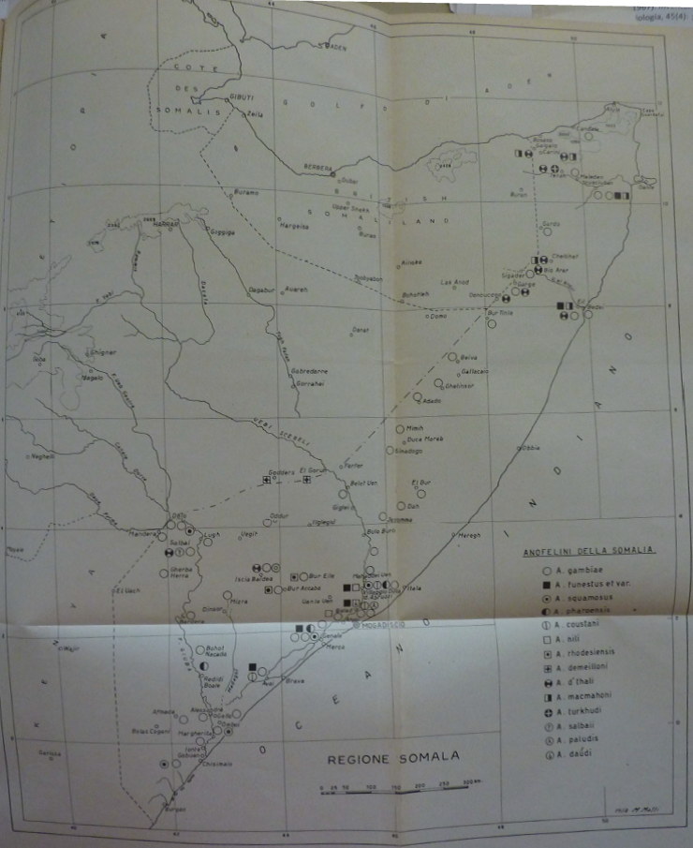
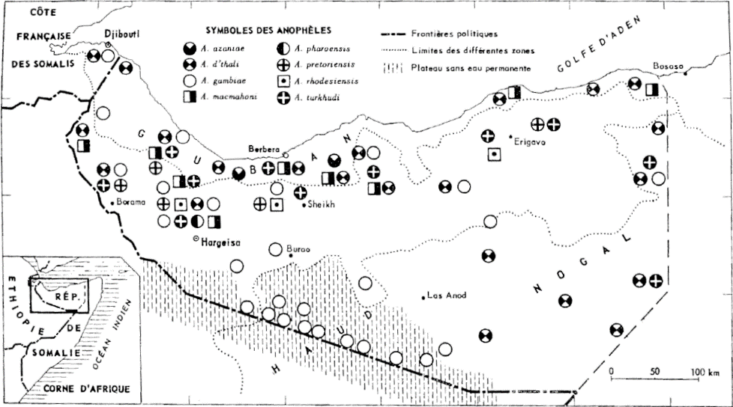
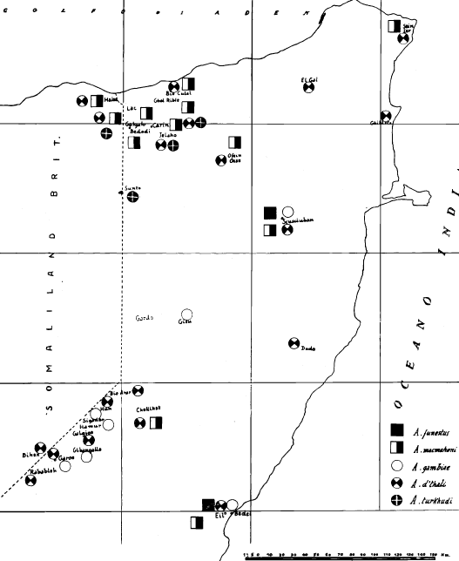
Historical vector distribution maps
Choumara, 1961
Maffi, 1961
Maffi, 1958
Notes:
Maps of Anopheline distributions were developed during the pre-eradication period in Somalia and were used in preparation of an epidemiological understanding of malaria in Italian administered Puntland/South Somalia [Maffi, 1959; Maffi, 1961] and Somaliland [Choumara, 1961]. See maps above.
References
Choumara R (1961). Notes on Malaria in Somaliland. Rivista Malariologica, 40: 9-34
Maffi M (1958). Contribution to the knowledge of the Anopheline fauna of Somalia; National Anti-Malaria Service in Somalia. Journal of Malariology, 73-76
Maffi M (1960). Malaria in the Regions of Mudugh and Migiurtinia, Somalia. Journal of Malariology, 39: 21-118

Slide 44
Location of mosquito sampling sites for 559 surveys undertaken between 1935 and 2014
Blue dots show searches at 86 sites where no Anophelines were found
Notes:
We have used historical archives and published sources, increased the documentation of potential secondary vectors and sourced more recent unpublished data from scientists and control agencies working in Somalia. Full details of the data assembly, geo-coding methods and classifications of species according to their role in malaria transmission are provided elsewhere [Snow et al., 2015]. The database has been arranged as a site-specific, referenced inventory to capture details of species identification recorded since the earliest surveys in 1935 through to the latest records in 2014. The full digital PDF library, database is available with this report.
From each identified report, data extraction included whether a species was identified at a given site, methods used to capture adults or larvae and methods used to speciate each anopheline collection. “Y” was recorded if species was identified and “N” was only recorded when the true absence of the species was reported. The database is therefore one of species presence, not absence and nor proportional presence of various vectors.
The final database contained 559 site/time specific reports of anopheline vectors in Somalia occurrence between 1935 and 2014 for which we were able to geo-locate the survey site. We were unable to geo-locate 25 (4.3%) of the survey sites.
During investigators searches at 86 survey sites no anophelines were found (blue dots).
The database includes site specific records of some of then earliest malaria vector maps developed in Somalia by Van Someren (1943), Wilson & Thomas (1949), Maffi (1958, 1960) and Choumara (1961) and recent national larval surveys undertaken by the WHO country programme between 2005 and 2007
References
Maffi M (1958). Contribution to the knowledge of the Anopheline fauna of Somalia; National Anti-Malaria Service in Somalia. Journal of Malariology, 73-76
Maffi M (1960). Malaria in the Regions of Mudugh and Migiurtinia, Somalia. Journal of Malariology, 39: 21-118
Choumara R (1961). Notes on Malaria in Somaliland. Rivista Malariologica, 40: 9-34
Snow RW, Kyalo D, Amratia P, Kabaria CW, Noor AM. Developing a geo-coded repository of malaria vector species occurrence for Africa: methods and data summaries 1900-2014. Working Paper 2: Report prepared in support of the INFORM Project funded by the Department for International Development and the Wellcome Trust, April 2015; http://www.inform-malaria.org/wp-content/uploads/2015/07/Assembly-of-Vector-Data-Version-1.pdf
Van Someren G (1943). Notes on the mosquitoes of British Somaliland. Bulletin of Entomological Research, 34: 325-328
Wilson DB & Thomas WRG (1949). Malaria in British Somaliland. East African Medical Journal, 26: 284-291

Slide 45
Location of mosquito sampling sites for 178 surveys undertaken since 2005
Blue dots show searches at 4 sites where no Anophelines were found
Notes:
The blue dots represent (4) sites where no anophelines were recorded.
Action Points
The Malaria Programme Review (2014) reports that there are sentinel sites in each of the main zones where routine entomological data is maintained: Puntland (34), Somaliland (8) and South Central Zone (17). What is not clear is whether these data have been included in the final vectors database. This requires checking and ensuring the maximal data possible is included in the species distribution reviews below.

Slide 46
Species distributions
Notes:
Entomological evidence shows that Anopheles arabiensis is the main and often, the only vector in the country [Diallo et al., 2014]. Where An. gambiae ss has been recorded the M form (An. colluzzi)) was described. An. merus, the salt water breeding sibling species, has been found at Buscbusc in South-Central [Maffi, 1960b; Davidson, 1966], however it is not prolific and further confirmation of its relative existence and contribution to transmission is required.
An. funestus and An. nili have also been reported [Maffi, 1958]. Members of the An. funestus group have been recorded in South-Central and Puntland, more commonly in South Central. In Somaliland only 2 identifications of An. funestus have been made in the Sool Region. An. nili has only been described in the Shabelle regions.
There have been no records of An. moucheti group or An. hancocki in Somalia.
In the North East An. pharoensis and An. d’thali have been described [Choumara, 1961]. An d'thali has been identified with sporozoites in Somalia and may be a secondary vector in Somalia within its ecological range. In June 1960, in Somaliland, An. d’thali was found resting indoors and a sporozoite infected female was identified [Rishikesh, 1961]. There is no empirical evidence that An. pharoensis contributes to transmission in Somalia, however it has been identified as a secondary vector in the Red Sea region. Both An. d’thali and An. pharoensis are cosmopolitan across the country, however likely to be more prevalent in the northern areas.
References
Choumara R (1961). Notes on Malaria in Somaliland. Rivista Malariologica, 40: 9-34
Diallo M, Amran J, Ali SD, Yasin AH, Mio JD (2014). Study of Malaria vectors behaviour in Somalia. February – March, 31st 2014. Unpublished report to WHO-EMRO, dated 26th August 2014
Davidson G (1966). Distribution records of member species of the Anopheles gambiae complex (identifications Up to May 1966). WHO/Mal/66.570
Maffi M (1958). Contribution to the knowledge of the Anopheline fauna of Somalia; National Anti-Malaria Service in Somalia. Journal of Malariology, 73-76
Maffi M (1960a). Malaria in the Regions of Mudugh and Migiurtinia, Somalia. Excerpt from Journal of Malariology, 39: 21-118
Maffi M (1960b). Larval breeding places of Anopheles gambiae and An. squamosus in collections of salt water in Busc Busc, Somalia. Rivista di Malariologia, 39: 131-133
Rishikesh N (1961). Anopheles d'thali Patton as a possible secondary vector of malaria in the northern region of Somali Republic. Geneva, WHO, 1961 (mimeographed document WHO/MAL/308)

Slide 47
Records of other anopheline species, either non-vectors or considered incidental vectors of malaria since 1935
An. austeni, An. azaniae, An. cinereus, An. concolor, An. coustani, An. culicifacies, An. daudi, An. garnhami, An. gibbinsi, An. implexus, An. longipalpis, An. macmahoni, An. paludis, An. pretoriensis, An. rhodesiensis, An. ruarinus, An. seydeli, An. squamosus, An. turkhudi, An. vanhoofi

Slide 48
Vector control
Notes:
Vector control strategies have been documented in Somali strategic plans since 2006 focusing primarily on distribution and use of LLIN and IRS. The Somali Malaria Indicator Survey (MIS) 2014 results indicate the percentage of households with at least one LLIN per 1.8 persons: 4.3 % in Puntland, to 15.5% in Somaliland, with similar rates observed when comparing urban to rural rates. The percentage of household members who slept under a LLIN ranged from 8.1% in Puntland to 28.9% in Somaliland. MIS 2014 reports national LLIN coverage at 19.1% with Central South Zone (CSZ) at 17.8%. Between 2006 and 2012, over 2 million ITNs and LLINs have been distributed across all three zones, with 1.5m LLINs delivered during this time. In 2013, 2.135 million LLINs were distributed.

Slide 49
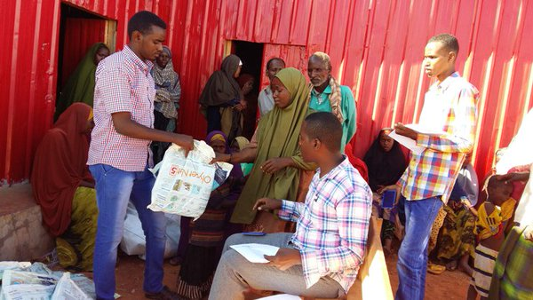
Per capita 2011-2014 LLIN summed distribution per 2014 population
Notes:
Context
The first mention of the promotion of insecticide treated nets (ITN) within a policy framework was made in 2000, by the WHO RBM consultant to Somalia, during a proposed plan of action, where universal coverage was suggested in the CSZ but limited or pilot use in Somaliland and Puntland [Some, 2000].
Between 2001 and 2005, very few mosquito nets had been distributed (circa 150,000), some were available on the commercial market or sold at MCH clinics. A KAP survey reported that people preferred double conical nets of a dark colour but were likely to only use them during the Gu rains [Graham, 2005].
The 2005-2010 National Malaria Strategy proposed that a market segmentation approach consisting of: a) sustained targeted subsidies for vulnerable groups; b) market priming to introduce affordable nets through the commercial sector to the general population; and c) commercial sector distribution. Where ITNs would be distributed according to endemicity with priorities to children under 5 children and pregnant women in hyper-endemic and meso-endemic areas and to the general population in hypoendemic and epidemic prone areas. However, it stated explicitly that first preferred areas of distribution would be stable endemic areas. For distribution, it was suggested that ITN would be provided by the Expanded Program on Immunization (EPI) including at health facility level (MCHs, OPDs and HPs), during EPI acceleration campaigns and during mass vaccination campaigns such as polio and measles for rapid coverage, Community Health Worker networks to reach rural and nomadic communities and to IDPs in camps and during emergencies using relief agencies [NMCP, 2005].
As part of the National Strategic Plan 2011-2015, it was stated that over the last five-year plan “challenges facing scale up of LLIN coverage in the past remain, these include the potential diversion of LLINs to the private sector, lack of security, difficulties in supply and logistics, and potential issues with durability of LLINs in the Somali setting, but particularly among IDPs and pastoralists” [NMCP, 2009]. The aim of the new strategy was to ensure universal coverage where all households (100%) own and use at least 2 LLINs, in target areas (although this time less explicit about epidemiological strata). An emphasis was this time on “free” with proposed distribution channels including Mass distribution of nets at community level (at-no-cost to beneficiaries (catch-up)); where possible pre-registration of households and issuance of vouchers should be used to minimize leakage to private sector; replacement of old ineffective nets with free new LLINs through CHWs, ANCs, health posts, Village health Committees (keep-up campaigns); and the free distribution of nets in IDP camps post-emergency (i.e. when IDPs have been forced to move) [NMCP, 2009].
Data were obtained from Ms Muna Shalita and Ms Alice Macharia (UNICEF) related to summaries of LLINS distributed between 2011 and 2014; here we have summed LLIN distributions by district for the four years leading up to 2014 (2011-14) and expressed per person distribution (from 2014 census data). The above figure highlights how few nets had been distributed to areas located in CSZ, largely as a result of insecurity in the area. The comparatively higher and more complete distribution in Somaliland may highlight a more stable area of MoH operations (?)
The national Malaria Indicator Survey of 2014, showed that LLIN use among children aged less than five years was 17.3%, 14.4% and 36.5% in South Central Zone, Puntland and Somaliland respectively, despite very low malaria prevalence in both Puntland and Somaliland. This suggested that there had been an imbalanced distribution of LLIN contrary to epidemiological need [NMCP, 2014]. Less than 10% of households in CSZ, where universal coverage of LLIN is the national strategy, had 1 LLIN for every 1.8 persons. In Bakool region in CSZ, none of the households reported owning an LLIN despite reports from the NMCP that close to 100,000 LLINs were distributed in this region in the period 2011-2013. Although most LLINs used in Somalia were acquired within the last three years, the level of coverage clearly remains well below the target for universal coverage particularly in the Central South and rapid scale up is required in this zone.
In 2015, a more detailing LLIN distribution strategy was developed [NMCP, 2015]. Here is was emphasized that mass campaigns of free distribution would be targeted to areas where PfPR was >= 5% (as per global fund and interim strategic plan documentation); including IDP camps located in these areas. In districts where PfPR was above 1% routine ANC/MCH distributions were proposed. It was estimated that there would be a need for 4.53 million LLIN to achieve universal coverage in these districts using these two delivery systems.
Action Points
More data for 2015 and 2016 is pending assembly by UNICEF (Alice Macharia) and WHO (Jamal/Fahrim), data should be ready on 22nd July – last contact 8th July. Slide above useful to contextualize SAE modelling of 2014 MIS in subsequent slides.
References
Graham K (2005). ITN Situation Analysis and Working Paper for the scaling-up of ITN coverage and use: Somalia. Working paper developed by Malaria Consortium for UNICEF, February 2005.
Ministries of Health of the Federal Government of Somalia, Puntland and Somaliland (2014). Somalia malaria performance review. March, 2014
National Malaria Control Programmes (NMCP) (2005). Somalia National Malaria Strategy 2005-2010.
National Malaria Control Programmes (NMCP) (2009). Somalia National Strategic Plan for Malaria 2011-2015. Nairobi, Kenya; October 2009
National Malaria Control Programme (NMCP) (2014). The first malaria indicator survey in Somalia, 2014. Ministries of Health of the Federal Government of Somalia, Puntland and Somaliland, August 2014
National Malaria Control Programme (NMCP) (2015). Long Lasting Insecticidal Net Distribution Strategy.
Some ES (2000). Assignment report on Roll Back Malaria in Somalia 29th June to 28th July 2000. EMRO, World Health Organisation, unpublished report, EM/MAL/276/E/R/12.01/20, September 2000

Slide 50
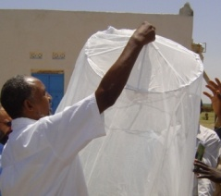
LLIN coverage from survey data in 2014 by district
Proportion of total population under a
LLIN in 2014
Proportion of households with 2 or people per
LLIN in 2014
Notes:
Typically, national household surveys are designed to be precise at national and regional levels and rarely at lower levels such as districts. Therefore, simply aggregating survey data to provide district level estimates of an outcome of interest will lead to values of low precision. SAE methods handle the problem of making reliable estimates of a variable at these areal units under conditions where the information available for the variable, on its own, is not sufficient to make valid estimates [Rao et al., 2003; BIAS 2007]. We have used the geo-coded household data from the 2014 national MIS sample survey to provide information coverage and reported LLIN use for each of the 109 districts using Small Area Estimation (SAE) methods. Here we have used hierarchical Bayesian spatial and temporal SAE techniques using a geo-additive regression approach [Banerjee et al., 2004; Best et al., 2005]. This method uses survey data from a district and neighborhood information from adjacent districts to smooth values at the health district. Importantly we have elected to predict quantities among all age groups, as this now represents the important indicator for universal coverage and necessary when computing likely impacts on malaria transmission [Smith et al., 2009; Griffin et al. 2010]. In addition, WHO recommended targets for universal coverage have been defined as at least 2 people per LLIN per household and shown for each national survey year (above left).
Note modelling for 2014 MIS based on 261 clusters, 5,220 households and 16,442 respondents.
References
Banerjee S, Carlin BP, Gelfand AE (2004). Hierarchical Modeling and Analysis for Spatial Data. Chapman & Hall, New York.
Best N, Richardson S, Thomson A (2005). A comparison of Bayesian spatial models for disease mapping. Statistical Methods in Medical Research, 14: 35-59
BIAS (2007). Introduction to Bayesian Small Area Estimation, January 2007. http://www.bias-project.org.uk/software/SAE.pdf
Griffin JT, Hollingsworth D, Okell LC et al. (2010). Reducing Plasmodium falciparum malaria transmission in Africa: a model based evaluation of intervention strategies. PLoS Medicine, 7: e1000324
Rao JNK (2003). Small Area Estimation. John Wiley & Sons, Inc., Hoboken, New Jersey, 2003
Smith DL, Noor AM, Hay SI, Snow RW (2009). Predicting changing malaria risk following expanded insecticide treated net coverage in Africa. Trends in Parasitology, 25: 511-516

Slide 51
LLIN coverage from survey data in 2014 by region
Proportion of total population under a
LLIN in 2014
Proportion of households with 2 or people per
LLIN in 2014
Notes:
Same as above by SAE undertaken to provide estimates by region

Slide 52
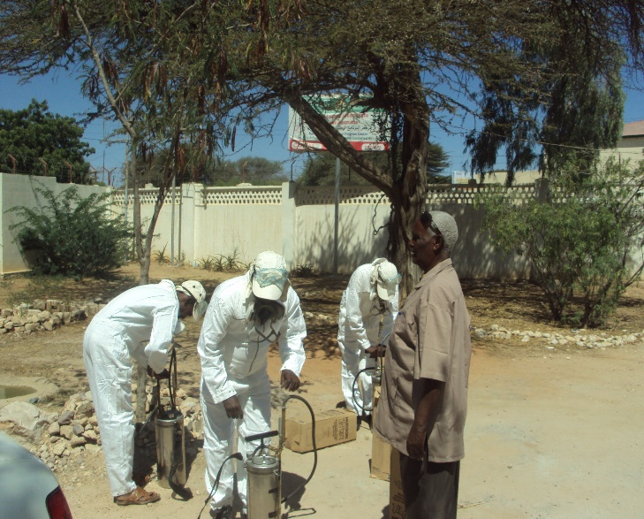
Indoor residual house spraying operations
2011-2015
Notes:
History of IRS (see also timeline document)
Indoor Residual House Spraying (IRS) with DDT was first attempted at “Villabruzzi” in Jowhar region in 1945. Thereafter eradication demonstration projects using DDT IRS were initiated in the early 1950s under the joint sponsorship of WHO and UNCIEF in the Haud region (SOM03) of Somaliland and the Afgoye Region (SOM02) in the south. Neither were sustained but in the south up to 200,000 people were protected by 1957. By 1961 these projects were merged and during the early 1960s, revised efforts at a controlled experiment of elimination was attempted in two areas between the Juba and Shabelle rivers using DDT. Dieldrin had also been used variously in the Haud and Southern areas, Gammexene was used with DDT, poorly, to control increased bed bug activity. Most IRS activity between 1950 and 1966 was with DDT, after 1966 DDT IRS was used only in known foci and to control epidemics through to the end of the 1970s. During the 1980s the only major vector control activities centered on biological control of larvae.
Current use of IRS
The National Malaria Strategic plan 2005-2010, suggested that IRS should be reserved for epidemics and that DDT was not recommended [NMCP, 2005]. Greater emphasis was given to larval control. The National Malaria Strategic plan NMS 2011-2015 was more explicit about the use of IRS compared to the previous five year strategic plan and planned to increase the use of IRS in specific settings where malaria transmission is highly focal. It further suggested that “water sources in Somalia have been well-defined through SWALIM, and cross-referencing this with increased geographical reconnaissance and reinforced surveillance will allow for identification of a limited number of areas where IRS will have significant impact” [NMCP, 2009]. More detail is provided on the SWALIM resources in next slide. The objective of the IRS intervention was to spray at least 85% of targeted households in target villages. IRS using lamdacyhalothrin, has since 2011, been conducted annually just before the rainy season beginning in October [MoFSPS, 2014]. IRS activities in the northern zones are financed by the Global Fund grant and implemented with the technical assistance of WHO and aim to cover over 300,000 people in Puntland and Somaliland. IRS in the SCZ is targeted at IDP camps and is implemented as part of the humanitarian emergency response [MoFGSPS, 2014]
Data provided by Jamal Amran on areas and numbers of households sprayed between 2011 and 2015; not all villages/households sprayed each year so presented as average numbers of households per annum that received IRS
References:
Ministries of Health of the Federal Government of Somalia, Puntland and Somaliland (2014). Somalia malaria performance review. March, 2014
National Malaria Control Programmes (NMCP) (2005). Somalia National Malaria Strategy 2005-2010.
National Malaria Control Programmes (NMCP) (2009). Somalia National Strategic Plan for Malaria 2011-2015. Nairobi, Kenya; October 2009

Slide 53
Dr R Choumara’s visit to Somaliland in 1959 as WHO consultant; Quarterly Field Report Somaliland project SOM3
In 1959, one spraying cycle (DDT) has been completed, in Haud…, and a further cycle planned for the latter part of October. But it is not felt this is the most practicable, or economic, method of eradication of malaria, since a complete coverage is not feasible, due to boundary restrictions [with Ethiopia] and nomadism and in any case it is not, generally speaking, efficient… Then only reliable methods seem to be detection, treatment and follow-up of patients and the development of a comprehensive health education

Slide 54

Larval control, GIS and water sources
Berkads
Hand dug wells
Ponds
Notes:
Larval control
Larvivorous fish were introduced in the 1950s to control Aedes mosquito populations in Mogadishu, DDT soaked briquettes were deployed in Somaliland in 1956, local species of Tilapia Oreochromis spilurus spilurus, were used in Burao district (1971-75), further trials conducted in Toghadeer region during the early 1980s and again in Kalabeydh, Puntland during the early 2000s. Some of these trials achieved dramatic reductions in vector numbers and during the1980s trial reduced infection prevalence in local communities to zero [Alio et al., 1985].
The National Malaria Strategic plan 2005-2010, placed more emphasis on larval control than IRS, recommending that this should be deployed in a) Villages with large cement lined man-made reservoirs (birkets); b) earthen ponds (wars or bulleys); and c) villages along streams often with shallow sunlit wells used for irrigation and occasionally with wars and urban areas with waters storage practices including rainwater harvesting tanks, wars, wells, and some pools [NMCP, 2005]. This was repeated in the National Malaria Strategic plan for 2011-1015 [NMCP, 2009]. However, there was little suggestion that larval control had been scaled up during either strategic plan [MoFGSPS, 2014].
Sources of water locations and a GIS framework
The predominant hydrological features of Somalia are the downstream stretches of these two perennial rivers of the Horn of Africa, both of which flow from the highlands of Ethiopia towards the Indian ocean: The Juba which flows in Somalia for more than 1,000 km of its length and The Shabelle which extends for more than 1,200 km from the Somali-Ethiopian border to its confluence with the Juba. Both of these rivers are most affected by rainfall from neighbouring countries.
Seasonal streams dominate throughout the rest of the country but in large remain dry apart from following heavy rains occurring in the wet seasons. There are however, natural springs and several short streams in the mountainous areas of the north which flow all year round in some stretches. Rainwater harvesting is also prevalent in the north in the form of berkads or wars.
Berkads are a simple water supply option that is extensively used in Somalia since the 1950’s. A berkad is an artificial catchment that collects surface runoff that results from intense rainfall episodes. They are usually lined with masonry and/or concrete, and often include on one side a catch-pool that traps the coarse sediment. Berkads are generally constructed in gently sloping areas, where low barriers are sometimes present to direct runoff towards the catch-pool and then to the cistern. During the intense rainfall episodes, berkads may fill up within several hours and last for months throughout a dry period. They are the main water source for both the human and livestock water needs and have been the subject of larval malaria control approaches for several decades (see later)
Hand dug wells are excavated wells and are the traditional method of obtaining groundwater in rural areas of the developing world, and still the most common, is by means of hand‑dug wells
Data source: FAO SWALIM (2016). Somalia water sources. Accessed at [http://systems.faoso.net/imms/fmt/maps/website/227]; given the significance to livlihoods in Somalia SWALIM have invested in assembling these data using GPS methods and varied descriptions of different types of water source. The above image is an example of these data displays.
References
Alio AY, Isaq A, Delfini LF (1985). Field trial on the impact of Oreochromis spilurus spilurus on malaria transmission in Northern Somalia. WHO/MAL/85.1017. World Health Organization EMRO Archives, Cairo
Ministries of Health of the Federal Government of Somalia, Puntland and Somaliland (2014). Somalia malaria performance review. March, 2014
National Malaria Control Programmes (NMCP) (2005). Somalia National Malaria Strategy 2005-2010.
National Malaria Control Programmes (NMCP) (2009). Somalia National Strategic Plan for Malaria 2011-2015. Nairobi, Kenya; October 2009
Action Points
SWALIM has been working on expanding the capacity of Somali government line ministries and partner agencies on the use of Geographic Information Systems (GIS) by conducting an intensive training course on “Basic GIS, Google Earth and Global Positioning System (GPS)” in Mogadishu in 2016, courses are also planned in Hargeisa and Nairobi. If there was a renewed interest in the NMCP’s commitment to larval control this should, as stated in the National Malaria Strategic Plan for 2011-2015 be accompanied by better reconnaissance data on locations of potential breeding sites, for which SWALIM would be a perfect partner.
In addition, the SWALIM web portal provides updates on flooding and flood alerts for Somalia, useful for epidemic preparedness
http://www.faoswalim.org/

Slide 55
Future outlook and recommendations

Slide 56
Noguer (1967): Predictions for the future
For the time being the only expectations could be the settling of the basis for such development and the gathering of the data and of the malaria information necessary for the preparation of a Malaria Eradication Programme
Too much depends on the economical development of the country and henceforth of the development of the health infrastructure to be able to make predictions at this time. If by 1968, as expected, the country has developed its sources of income it will them be possible to think that five years later, i.e. by 1973, the rural infrastructure would be ready to support a country-wide Malaria Eradication Programme.
Notes:
Noguer A (1967). Assignment report Malaria pre-eradication programme in Somalia. EM/MAL/58, Somalia 0002/R, UNDP, UNICEF August 1967

Slide 57
Operational research questions
Malaria risks and service needs among nomadic pastroalists
Marginalization of IDPs from routine malaria services
Drug resistance studies
Prevalence of G6PD
Prevalence of P. vivax among clinical cases presenting to health facilities
Quality of Data (QoD), routine data audit
Quality of Care (QoC), public facility practice of TTT around new drug policy
Quality of Care (QoC) in hospitals for management of severe malaria; and referral practices
Quality of Care (QoC) among private sector providers
Malaria prevalence, access and use of treatment services among IDPs and Nomadic Pastoralists
Vector resistance studies

Slide 58
Acknowledgements
We acknowledge all those who have generously provided unpublished parasite and vectors data, helped locate information or the geo-coordinates of data necessary to complete the analysis of malaria risk across Somalia:
National Malaria Control Programmes, Somalia: Abdiqani S Omar, Abdi Abdullahi, Abdikarim H Hassan. Jeilani Mio, Said Dahir Ali, Abdulhafidh Yassin
Jamal Amran, Imanol Berakoetxea, Mohammed Borle, Matthew Burns, Waqar Butt, Ahmed Jama, Craig Von Hagen, Said Abdikadir, Abdullahi M Hassan, Ali Hassan, Abdi Hersi, Alice Macharia, Grainne Moloney, Abdikarim Musa, Abdisalaam Mohamed Noor, Abdi Noor, Abdulhamid Osman, Ismail Rage, Muna Shalita, Tanya Shewchuk, Annie Sparrow, Randa Youssef, Fahmi Essa Yusuf

