Slide 1





Sierra Leone: A Profile of Malaria Control and Epidemiology
December 2017

Slide 2
Sierra Leone: Major city/town extents, elevation and rivers
Notes:
Population distribution predictions for the year 2015 were derived from the population products shown in Slide 5. The population distribution provided at 100m spatial resolution was resampled in ArcGIS (ver10.1 ESRI, USA) to obtain population density per km². A population density threshold of greater than 1000 persons per km² was used to identify urban settlements, a threshold found to significantly influence malaria prevalence [C Kabaria, personal communication]. Polygons covering an area greater than 5km² with population density across the polygon of >= 1000 people per km² were selected. These were then matched to a place name gazetteer of Sierra Leone (www.geonames.nga.mil/gns/) to identify 43 major urban settlements shown in slide. These are: Aberdeen, Blama, Bo, Boajibu, Buedu, Bumbuna, Daru, Falaba, Freetown, Gerihun, Hastings, Kabala, Kamakwie, Kayima, Kenema, Kilahun, Koidu, Koribondo, Lungi, Lunsar, Magburaka, Makeni, Mambolo, Mange, Mano, Mateboi, Matru, Mile 91, Moyamba, Panguma, Pendembu, Pepel, Port, Loko, Pujehun, Rokupr, Songo, Sumbuya, Taiama, Wellington, Yele, Yengema, Yonibana, Zimmi.
Digital elevation from sea level (light brown) to maximal elevation of 1931 metres above sea level (dark brown).
References:
30m ASTER DEM: www.asterweb.jpl.nasa.gov/gdem
Rivers from Global Lakes and Wetlands Database: GLWD; www.worldwildlife.org/ GLWD

Slide 3
Sierra Leone: Health administration units
Notes:
Sierra Leone has four regions (Western, Southern, Eastern and Northern) and 19 local councils (14 district councils and 5 city councils). The district councils are responsible for managing the delivery of both primary and secondary health care services in the decentralised structure of health system [Ministry of health and sanitation, 2012; Government of Sierra Leone, 2004]. To reconstruct the decision making units, we obtained second level shapefile from global administrative units (GADM), this contained some 14 district councils. We then aligned the external boundaries to match national boundaries from global administrative unit layers (GAUL).
References
Global Administrative Areas (GADM) (2012). GADM database of Global Administrative Areas, version 2.0. Accessed June 11, 2014 at [www.gadm.org]
Government of Sierra Leone (2004). The local government act: Supplement to the Sierra Leone Gazette Extraordinary Vol. CXXXV, No. 14. Accessed July 24, 2014 at [http://www.sierra-leone.org/Laws/2004-1p.pdf]
Ministry of Health and Sanitation MoHS (2012). National Health Sector Strategic Plan 2010-2015: Joint Programme of Work and Funding (JPWF)

Slide 4
Code | District
Eastern Region
1 | Kailahun
2 | Kenema
3 | Kono
Northern Region
4 | Bombali
5 | Kambia
6 | Koinadugu
7 | Port Loko
8 | Tonkolili
Southern Region
9 | Bo
10 | Bonthe
11 | Moyamba
12 | Pujehun
 | Western Region
13 | Western Rural
14 | Western Urban/Freetown

Slide 5
Sierra Leone: Population distribution at 1 × 1 km² in 2010
Notes:
Modelling techniques for the spatial reallocation of populations within census units have been developed in an attempt to (i) disaggregate population count data to a finer spatial detail and (ii) convert population count data from irregular administrative units to regular raster layers [Linard et al., 2010; 2012]. Population census size estimates, corresponding within chiefdoms used during the 2004 national census were acquired for Sierra Leone. Typical regional per-land cover class population densities were estimated from African countries for which very fine resolution population data were available, following approaches previously outlined [Linard et al., 2012]. These typical population densities were then applied as weightings to redistribute census counts according to the land cover and to map human population distributions at a finer spatial resolution using dasymetric modelling techniques [Mennis, 2009]. The modelling method distinguishes urban and rural populations in the redistribution of populations. The population distribution datasets were projected to 2010 using United Nations (UN) national rural and urban growth rates and made to match the total national population estimates provided by the UN Population Division.
References
Linard C et al. (2010). GeoJournal, 76: 525–538; Linard C et al. (2012).PLoS One, 7: e31743; Mennis J (2009). Geography Compass, 3: 727-745

Slide 6
Sierra Leone: Distribution of available public health facilities hospitals (red), Health centers (blue) and Health Posts (green)
Notes:
Health System
Sierra Leone’s health care delivery is organized in a three tier system. The first tier includes the Peripheral Health Units (PHU); the second, District Hospitals; and the third, the Referral Hospitals [MoH 2012]. Core functions of MoHS are policy formulation; standards setting and quality assurance; resource mobilization; capacity development and technical support; provision of nationally coordinated services; coordination of health services; monitoring and evaluation of the overall sector performance and trainings; and management of referral hospitals.
The responsibilities of districts are implementation of the national health policies; planning and management of district health services; health education; ensuring provision of safe water and environmental sanitation; health data collection, management, interpretation, dissemination and utilization. The 19 local councils (14 district councils and 5 city councils) are responsible for managing the delivery of both primary and secondary health care services.
Health Service Delivery
The Primary Health Units (PHUs) are the first line health services, and are further sub-classified into three levels. The maternal and child health posts (MCHPs) are situated at village level for populations of less than 5000. They are staffed by MCH Aides who are trained to provide numerous services: antenatal care, supervised deliveries, postnatal care, family planning, growth monitoring and promotion for under-five children, immunization, health education, management of minor ailments, and referral of cases to the next higher level. The MCH Aides are supported by community health workers (TBAs, Community volunteers etc). Community Health Posts (CHPs) are located in small towns with population between 5,000 and 10,000 and are staffed by State Enrolled Community Health Nurses (SECHNs) and MCH Aides. They provide the same types of services that are provided at the MCHPs but they also include prevention and control of communicable diseases and rehabilitation.
Health Posts refer more complicated cases to the Community Health Centres (CHCs) which are located at the Chiefdom level, usually covering a population of 10,000 to 20,000 and staffed with a community health officer (CHO), SECHN, MCH Aides, an epidemiological disease control assistant and an environmental health assistants. They provide all the services provided at the CHP level in addition to environmental sanitation and supervise the CHPs and MCHPs within the Chiefdom.
Hospitals are located in district and regional headquarters and provide tertiary services as well as outpatient services.
Health facility mapping
Geo-coded Health facility list assembled in 2010 by the Ministry of Health and Sanitation was provided by Dr. Edward Magbity, Principal Monitoring and Evaluation Officer, on August 17, 2012. The database contained 1097 records with information on facility name, type (hospital, community health centre, community health post, maternal child posts), ownership (government, parastatal, private-for-profit, faith-based, and NGO), and location (district, chiefdom). Anomalies in the file included duplicated coordinates (n=8), fields with only facility type but no name, misspelt facility types and initialized names. These were systematically corrected by re-positioning duplicated coordinates, assigning chiefdom names to facilities without names, correcting for spellings and complete names to initials. Facilities providing specialized care such as leprosy clinics, eye clinics, mental centers, military and police clinics were excluded from the map (n=107) as these do not often provide routine curative care. The remaining 990 facilities, all with coordinates were mapped, per facility type.
References:
Ministry of Health and Sanitation MoHS (2012). National Health Sector Strategic Plan 2010-2015: Joint Programme of Work and Funding (JPWF)

Slide 7
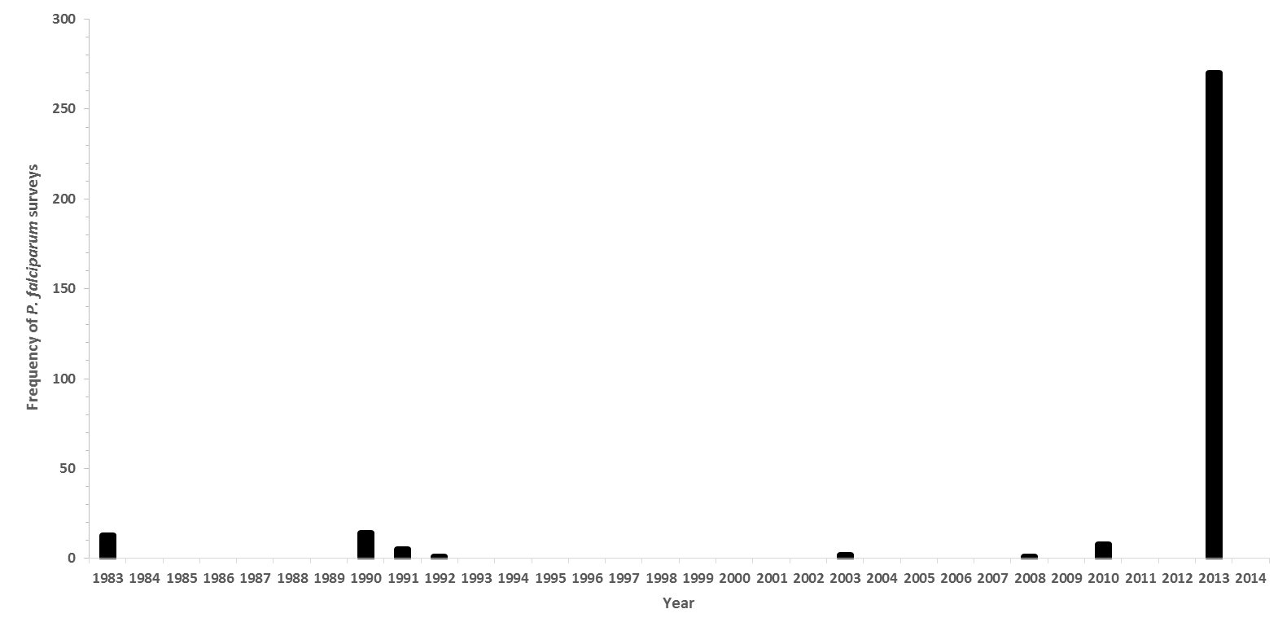
Sierra Leone: Malaria parasite prevalence 321 surveys by year 1983-2013
Notes:
Community-based surveys of malaria parasite prevalence have been assembled from a variety of sources including peer-reviewed journals, international and national ministry of health and academic archives, personal correspondence and more recent national household sample surveys. Methods used to identify, extract and geo-code survey reports are presented elsewhere [Snow et al., 2015; Noor et al., 2014].
A total of 321 time-space surveys undertaken since 1983 were identified through the data search process. The earliest survey was undertaken in 1983 and the most recent survey undertaken in 2013. Six surveys were excluded because their sample sizes were less than 10 individuals. Of the remaining surveys, 270 were undertaken in 2013 during the Malaria Indicator Survey (MIS) and were used in the final analysis. Parasiteamia results were based on rapid diagnostic tests.
A complete excel database of all geo-coded surveys is provided for the NMCP as part of the support under the INFORM-LINK project; date provided xxxxxxxx
References
Noor AM, Kinyoki DK, Mundia CW, Kabaria CW, Wambua JM, Alegana VA, Fall IS, Snow RW (2014). The changing risk of Plasmodium falciparum malaria infection in Africa: 2000—10: a spatial and temporal analysis of transmission intensity. Lancet, 383: 1739-1747
Snow RW, Amratia P, Mundia CW, Alegana VA, Kirui VC, Kabaria CW, Noor AM (2015). Assembling a geo-coded repository of malaria infection prevalence survey data in Africa 1900-2014. INFORM Working Paper, developed with support from the Department of International Development and Wellcome Trust, UK, June 2015; http://www.inform-malaria.org/wp-content/uploads/2015/07/Assembly-of-Parasite-Rate-Data-Version-1.pdf
MEASURE DHS: http://www.dhsprogram.com/what-we-do/survey/survey-display-448.cfm

Slide 8
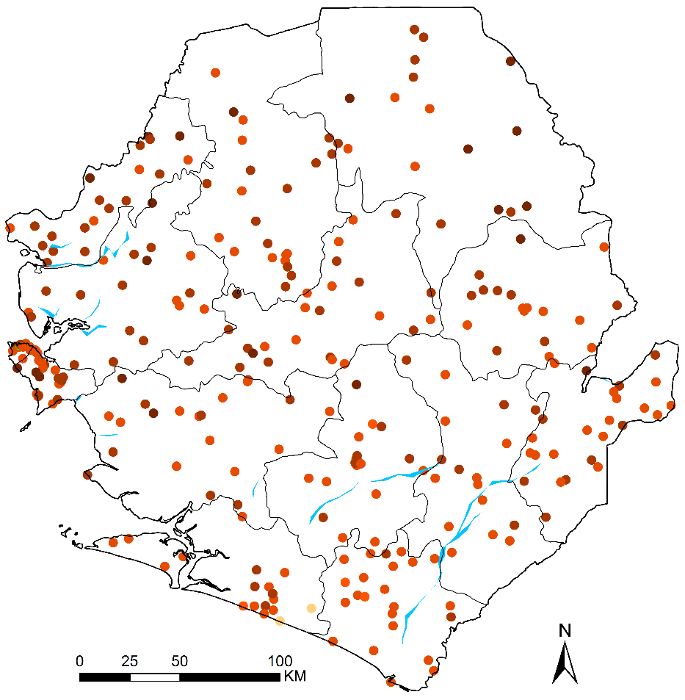
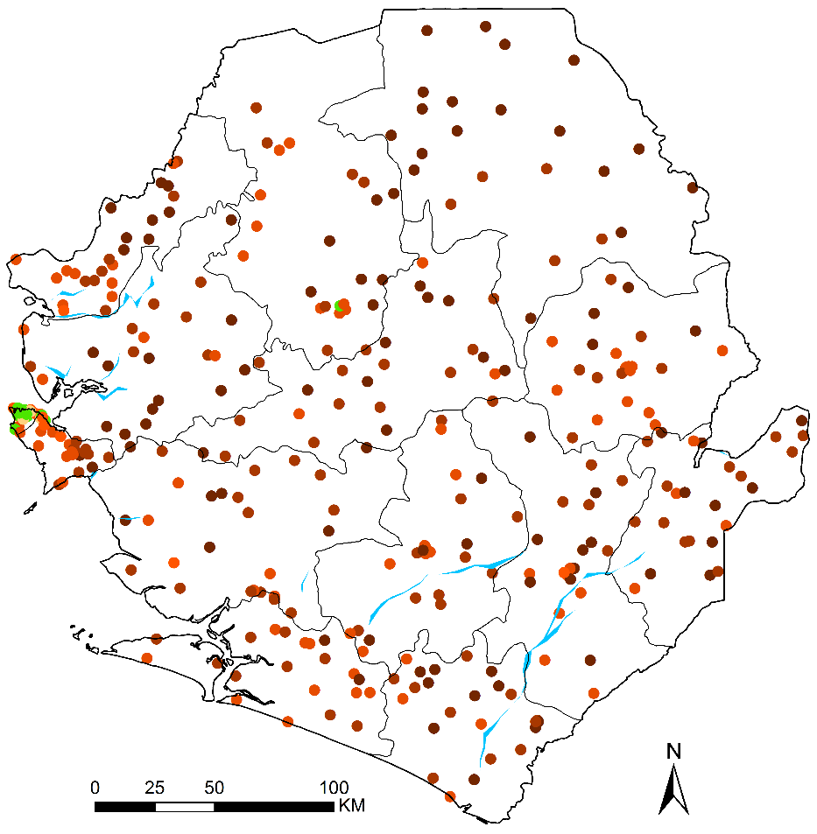
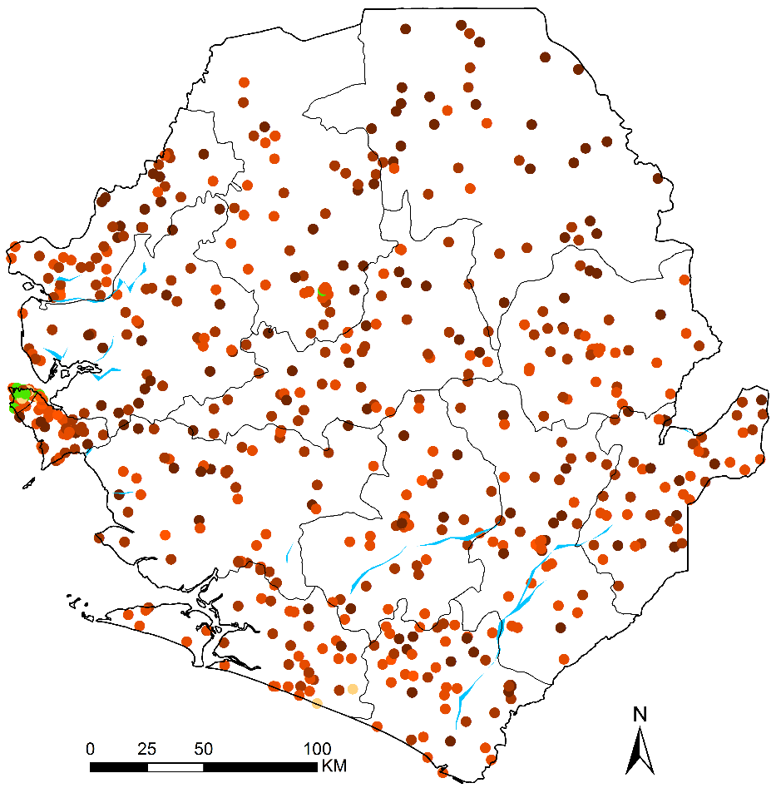
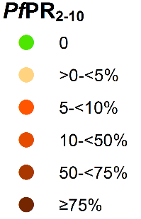
Sierra Leone: Location of 270 age-corrected parasite prevalence data (PfPR2-10) in 2013 and 2016
Location of 336 age-corrected parasite prevalence data (PfPR_{2–10}) for Sierra Leone MIS 2016
Location of 612 age-corrected parasite prevalence data (PfPR_{2–10}) for Sierra Leone for MIS 2013 and MIS 2016 combined
Location of 276 age-corrected parasite prevalence data (PfPR_{2–10}) for Sierra Leone MIS 2013
Location of 276 age-corrected parasite prevalence data (PfPR_{2–10}) for Sierra Leone MIS 2013

Slide 9
Space-time geostatistical models of P. falciparum transmission intensity
Time
Latitude
Longitude
Notes:
Geo-statistical methods were developed to interpolate from data at sampled locations in space and time to provide predictions of quantities at locations and times where data do not exist. All MBG methods operate under Tobler’s First Law of Geography, which states that things that are closer in space and time are more similar than those more spatially and temporally distal [Tobler 1970]. When applied with a Bayesian inference framework, these methods are referred to as model-based geostatistical (MBG) methods. Bayesian inference allows for better use of sparse data and through the application of prior knowledge of an outcome in an iterative process and also allows for robust estimation of uncertainties around the estimates of the outcome.
The procedures used to assemble, geo-code, archive, model and validate the transformation of empirical P. falciparum parasite prevalence data to continuous predictions of age-corrected mean prevalence in children aged 2-10 years (PfPR₂₋₁₀) are provided in Noor et al 2014 and Snow et al 2015. In brief, we have used information from available age-corrected survey data (sample size and numbers positive) at known locations (longitude and latitude) and times (year) with a minimal set of conservative, long-term covariates traditionally used in vector-borne disease mapping within a Bayesian hierarchical space-time model, implemented through an adapted Stochastic Partial Differential Equations (SPDE) approach using Integrated Nested Laplace Approximations (INLA) for inference [R-INLA 2013; Rue et al 2009] to produce continuous maps of PfPR₂₋₁₀ for 2000 and 2010 at 1 x 1 spatial resolutions [Noor et al., 2014]. A spatially and temporally de-clustered 10% of the PfPR₂₋₁₀ data was held out per country for model validation. Model accuracy was estimated by computing the linear correlation, the mean prediction error (MPE) and mean absolute prediction error (MAPE) of the observations and predictions of the holdout dataset. MPE is a measure of the bias of predictions (the overall tendency to over or under predict) whilst the MAPE is a measure of overall precision (the average magnitude of error in individual predictions.
References:
Tobler W (1970). A computer movie simulating urban growth in the Detroit region. Economic Geography, 46: 234-240
Rue H, Martino S, Chopin N (2009). Approximate Bayesian inference for latent Gaussian models by using integrated nested Laplace approximations. Journal of the Royal Statistical Society Series B, 71: 319–392
R-INLA project. http://www.r-inla.org/. Accessed 10 April 2012.
Noor AM, Kinyoki DK, Mundia CW, Kabaria CW, Wambua JM, Alegana VA, Fall IS, Snow RW (2014). The changing risk of Plasmodium falciparum malaria infection in Africa: 2000 to 2010. Lancet, 383: 1739-1747.
Snow RW & Noor AM (2015). Malaria risk mapping in Africa: The historical context to the Information for Malaria (INFORM) project. Working Paper in support of the INFORM Project funded by the Department for International Development and the Wellcome Trust, Nairobi, Kenya June 2015; http://www.inform-malaria.org/wp-content/uploads/2015/07/History-of-Malaria-Risk-Mapping-Version-1.pdf
Snow RW, Amratia P, Mundia CW, Alegana VA, Kirui VC, Kabaria CW, Noor AM (2015). Assembling a geo-coded repository of malaria infection prevalence survey data in Africa 1900-2014. INFORM Working Paper, developed with support from the Department of International Development and Wellcome Trust, UK, June 2015; http://www.inform-malaria.org/wp-content/uploads/2015/07/Assembly-of-Parasite-Rate-Data-Version-1.pdf

Slide 10
Selection of covariates for incorporation in the SAE model
The flowing covariates were investigated for inclusion in the SAE model based on their association with the PfPR2-10 using univariate and multivariable (confidence level of 0.05.). A best GLM was also used.
    Enhanced Vegetation Index (EVI)
    Precipitation
    Temperature Suitability Index (TSI)
    Urbanization
Notes:
Covariates considered for selection
The development and survival of the Plasmodium falciparum parasite and the malaria-transmitting Anopheles vector is affected by a several ecological and climatic factors [Molineaux, 1988]. The factors included for investigation were, Enhanced Vegetation Index (EVI), Precipitation, Temperature Suitability Index(TSI) and urbanization.
EVI is an index of intensity of photosynthetic activity and ranges from 0 (no vegetation) to 1 (complete vegetation). This index is used in malaria risk mapping as a proxy of rainfall (Noor et al., 2009) and a measure of aridity that limits larval growth and vector survival (Guerra et al.,2008). EVI ranges from 0 (no vegetation) to 1 (complete vegetation). Monthly Fourier–processed EVI derived from the MODerate‐resolution Imaging Spectroradiometer (MODIS) sensor imagery and available at approximately 1×1 km spatial resolution [Scharlemann et al., 2008] was used to develop a long term annual mean EVI surface.
Precipitation and suitable ambient temperatures provide potential breeding settings for Anopheles vectors. Monthly mean precipitation raster surfaces at 1×1 km resolution were downloaded from the WorldClim website (http://www.worldclim.org/download.html) was used as a proxy for rainfall. A long term average annual precipitation surface was generated from monthly means.
Urbanization: Urban environments limit the availability of optimum environments for the development of the anopheline vectors. As a consequence, there is reduced vector density, biting rates and transmission intensity. The urbanization surface was obtained from WorldPop [Linard et al., 2010]
TSI: Too high temperatures lead to larval mortality while lower temperatures results to the larvae to produce viable adults .The mortality increases sharply at ambient temperatures approaching 40 while temperatures 25°C- 30°C are optimum for Pf sporogony. TSI surface is developed on this, on a scale of increasing transmission suitability, from 0 (unsuitable) to 1 (suitable)
References
Molineaux L (1988) The epidemiology of human malaria as an explanation of its distribution, including some implications for its control. Malaria: Principles and Practice of Malariology. Volume 2. Edited by: Wernsdorfer W, McGregor I. London, Churchill Livingstone 913-998.
Scharlemann JPW, Benz D, Hay SI, Purse BV, Tatem AJ, Wint GR, Rogers DJ (2008). Global data for ecology and epidemiology: A novel algorithm for Temporal Fourier Processing MODIS data. PLoS One, 1: e1408
Guerra CA, Gikandi PW, Tatem AJ, Noor AM, Smith DL, Hay SI, Snow RW. (2008). The limits and intensity of Plasmodium falciparum transmission: implications for malaria control and elimination worldwide. PLoS Medicine, 5: e38.
Noor AM, Gething PW, Alegana VA, Patil AP, Hay SI, Muchiri E, Juma E, Snow RW (2009). The risks of Plasmodium falciparum infection in Kenya in 2009. BMC Infectious Diseases, 9: e180
Linard C, Gilbert M, Snow RW, Noor AM, Tatem AJ. Population distribution, settlement patterns and accessibility across Africa in 2010. PloS one. 2012;7(2):e31743.

Slide 11
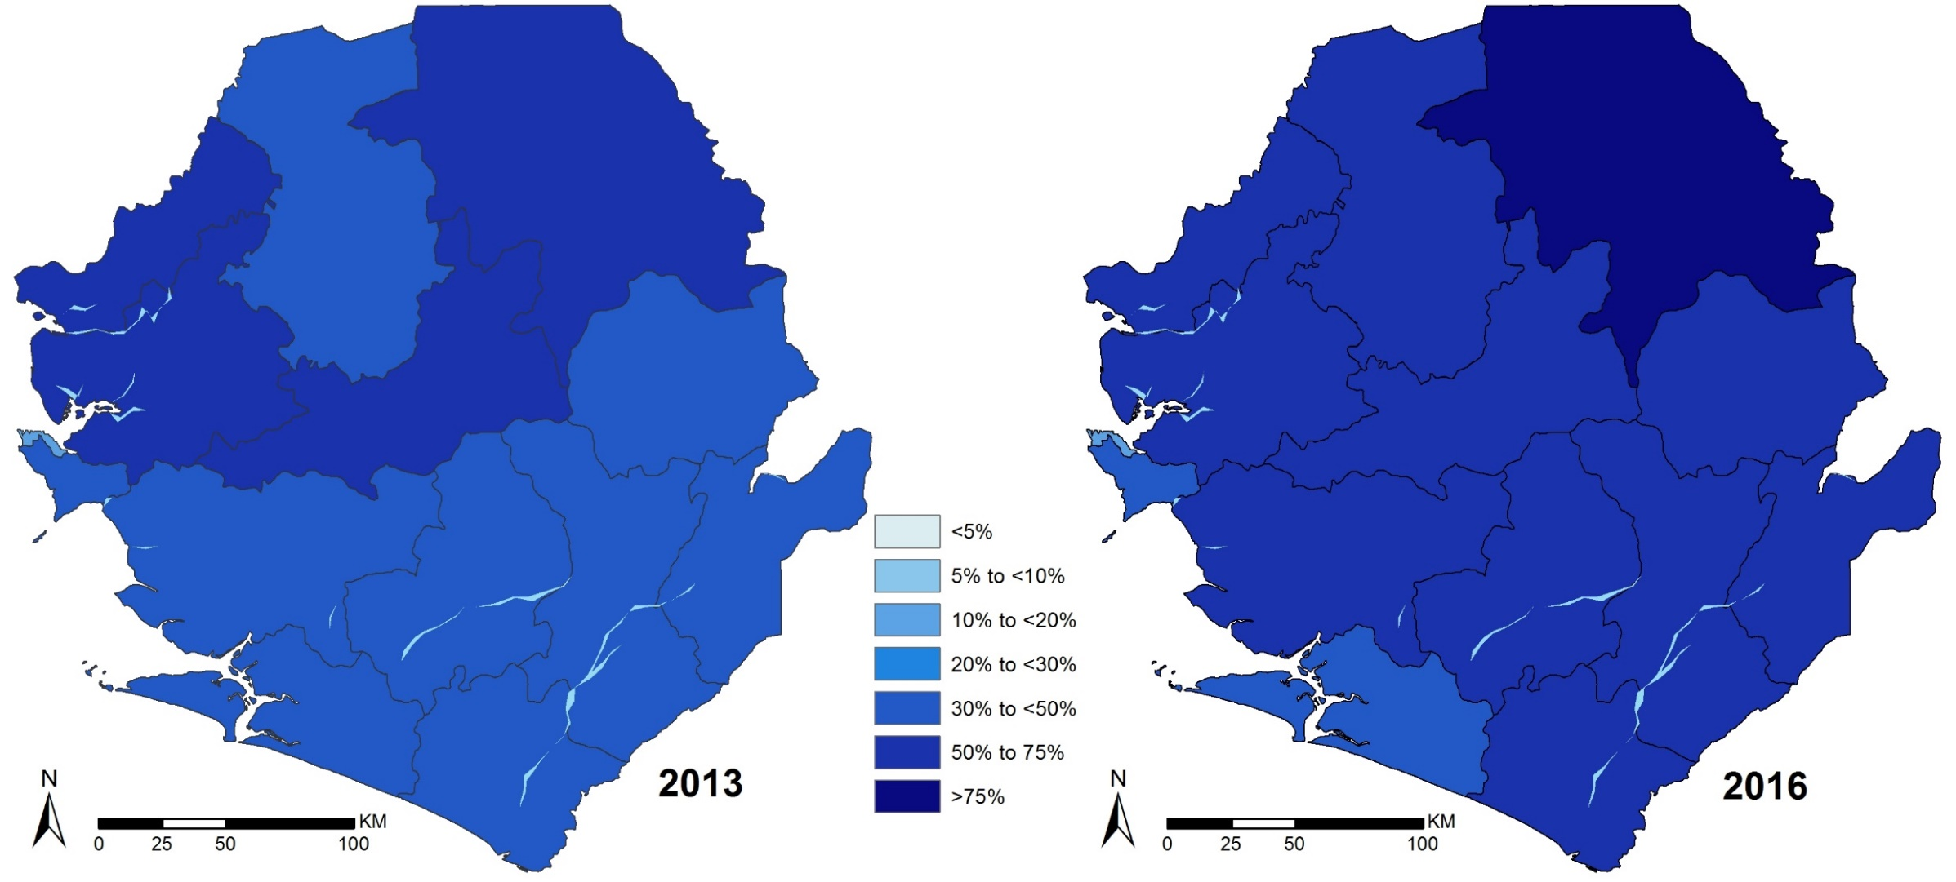
Mean prevalence in children aged 2-10 years (PfPR₂₋₁₀)
Notes:
Small area estimations at district levels of the mean prevalence in children aged 2-10 years (PfPR₂₋₁₀).
This is a cross section at two points in time (the estimates are matched to the availability of the MIS surveys)
Why model MIS data?
MIS data is a cross section of data, it assumes each area is independent, and the power and precision is at the regional level.
We model the data to understand the relatedness of each district to the others.
The inclusion of co-variates improves the properties of the unit (district)
This is not population weighted
Main take-aways:
Most districts have prevalance above 30 or 50%
We cannot say if prevalance has gotten worse in the north. The model generates a median value from all data points in a given area; in the north (pan up) there are not as many data points in this region. This is a signal to interrogate other sources of data.
Meso-hyper-holo enemic across the country

Slide 12
Mean prevalence in children aged 2-10 years (PfPR₂₋₁₀)

Slide 13
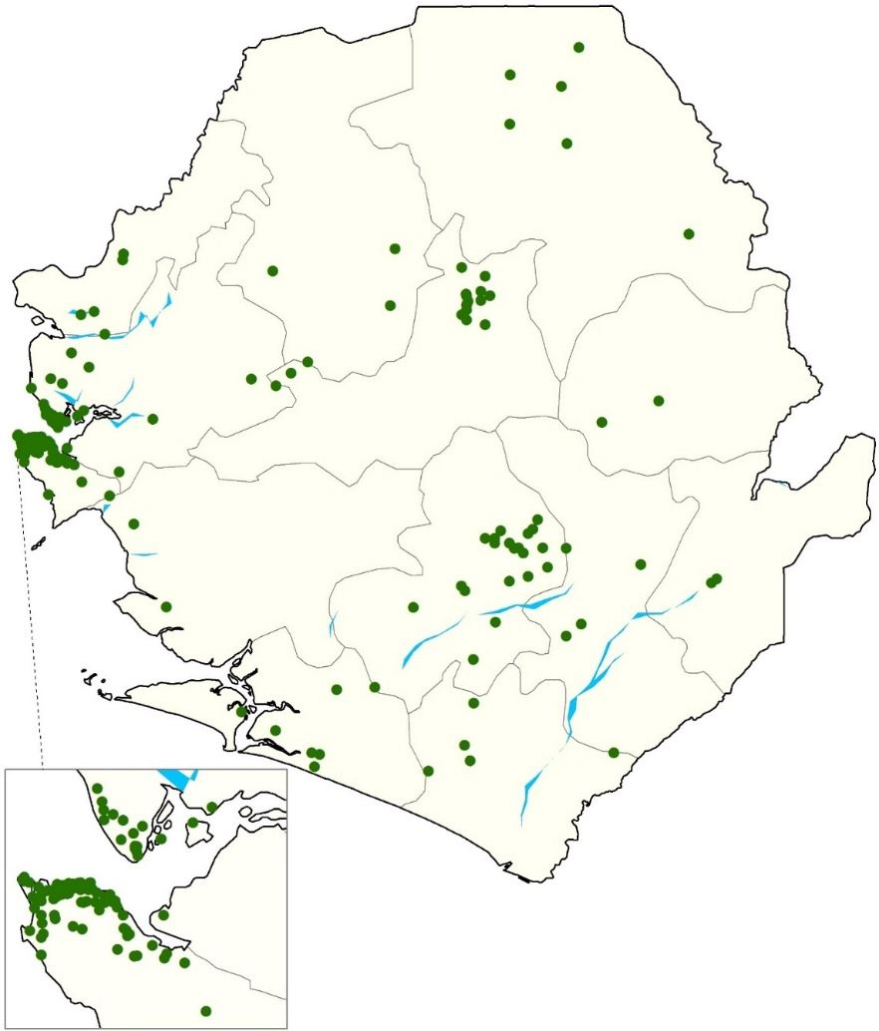

Sierra Leone: location of mosquito sampling sites for 189 surveys undertaken between 1898 and 2012
Notes:
We have used historical archives and published sources, increased the documentation of potential secondary vectors and sourced more recent unpublished data from scientists and control agencies working in Sierra Leone. Full details of the data assembly, geo-coding methods and classifications of species according to their role in malaria transmission are provided elsewhere [Snow et al., 2015]. The database has been arranged as a site-specific, referenced inventory to capture details of species identification recorded since the earliest surveys in 1898 through to the latest records in 2012. The full digital PDF library, database and bibliography accompanies this report.
From each identified report, data extraction included whether a species was identified at a given site, methods used to capture adults or larvae and methods used to speciate each anopheline collection. “Y” was recorded if species was identified and “N” was only recorded when the true absence of the species was reported. The database is therefore one of species presence, not absence and nor proportional presence of various vectors.
The final database contained 189 site/time specific reports of anopheline vectors in Sierra Leone occurrence between 1898 and 2012 for which we were able to geo-locate the survey site. We were unable to geo-locate only 1 (0.5%) of the survey sites.
The database includes site specific records of some of then earliest malaria vector maps developed by Christophers & Stevens (1900) and reported vectors at different sites during Sir Ronald Ross’s visit in 1902 [Ross, 1901]
We have not assembled, geo-coded information related to vector resistance, these data have been carefully curated, validated and mapped by the IRBase initiative [IRBase; Knox et al., 2014] and described in the malaria milestone narrative section.
References
Christophers SR & Stephens JWW (1900). Further reports to the Malaria Committee of the Royal Society. London, Harrison & Sons, pp. 22
IRBase: http://www.irmapper.com
Knox TB, Juma EO, Ochomo EO, Pates Jamet H, Ndungo L, Chege P, Bayoh NM, N’Guessan R, Christian RN, Hunt RH, Coetzee M (2014). An online tool for mapping insecticide resistance in major Anopheles vectors of human malaria parasites and review of resistance status for the Afrotropical region. Parasites & Vectors, 7: 76
Ross R (1901). First progress report of the campaign against mosquitoes in Sierra Leone. Liverpool School of Tropical Medicine, Memoir 5, part 1, pp. 22
Snow RW, Kyalo D, Amratia P, Noor AM, Coetzee M (2015). Assembling a geo-coded inventory of Anopheline (Diptera: Culicidae) species occurrence in Africa. INFORM Working Paper, developed with support from the Department of International Development and Wellcome Trust, UK, June 2015; http://www.inform-malaria.org/wp-content/uploads/2015/07/Assembly-of-Vector-Data-Version-1.pdf

Slide 14
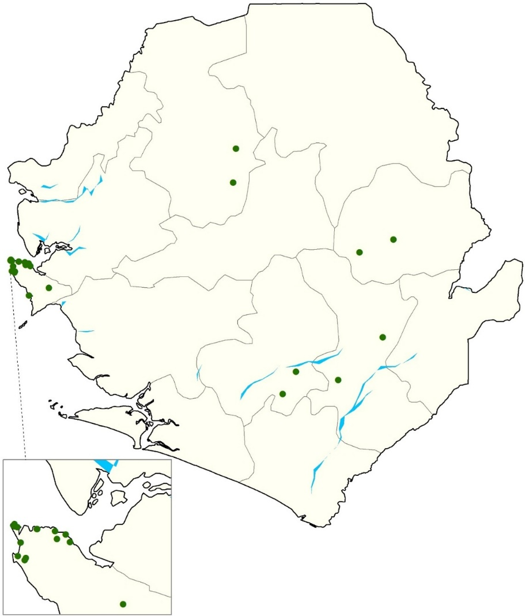
Sierra Leone: location of mosquito sampling sites for 25 surveys undertaken since 2005
Notes:
Only 25 survey locations have been sampled during a period that is inclusive of 2005-2014 . It is important to note the data gap between 1993 and 2009 where no anopheline survey was carried out. This is attributed to the Sierra Leone Civil War which lasted about a decade and half.

Slide 15
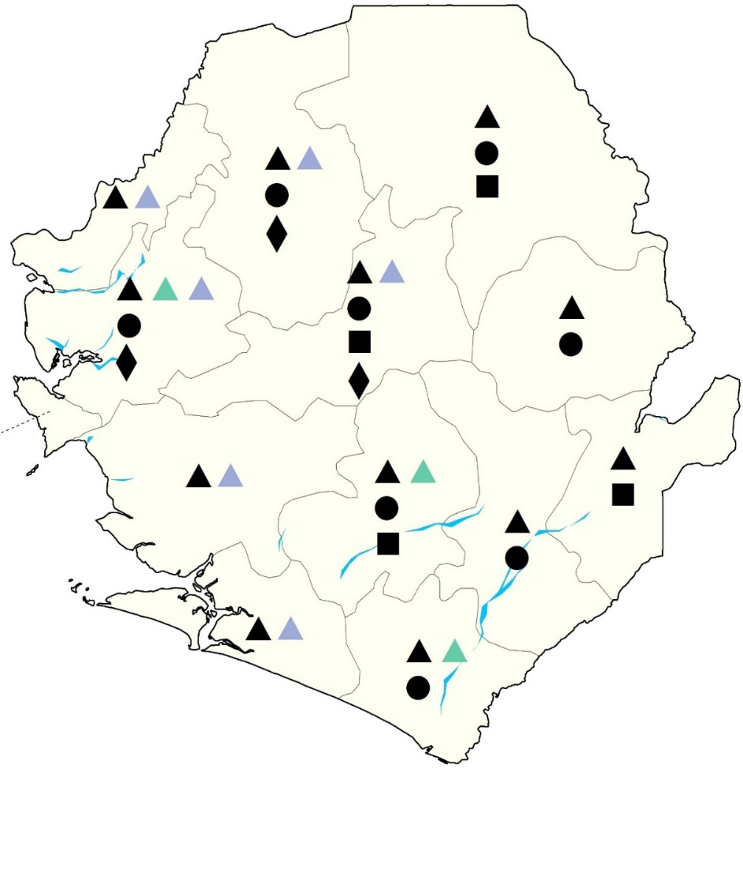

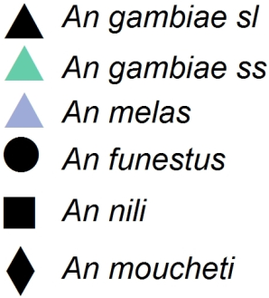
Recorded species identifications across all surveys by district
Notes:
The presence of the An. gambiae complex is ubiquitous across the entire county. Members of the An. funestus group have been recorded among the eastern and central districts of the country, with the exception of Port Loko district in the east.
Among the An. gambiae complex, only An. gambiae ss (both M (An. colluzzi) and S forms) and An. melas have been recorded in Sierra Leone. There have been no records of An. Arabiensis in the country.
The furthest inland An. Melas has been reported is along the Rokel river [Thomson, 1946].
An. nili group, An. moucheti group, An. hancocki have also been described in Sierra Leone, but only in few numbers.
References
Thomson RCM (1946). Studies on the Breeding Places and Control of Anopheles gambiae and A. gambiae var. melas in Coastal Districts of Sierra Leone. Bulletin of Entomological Research, 36: 185-252

Slide 16
Sierra Leone: Records of other anopheline species, either non-vectors or considered incidental vectors of malaria since 1898
An. barberellus, An. cinctus, An. coustani, An. domicolus, An. freetownensis, An. hargreavesi, An. marshalli, An. mauritianus, An. obscurus, An. paludis, An. quadriannulatus (of the An. gambaie complex), An. rhodesiensis, An. rufipes, An. smithii, An. squamosus, An. tenebrosus, An. theilleri and An. ziemanni

Slide 17
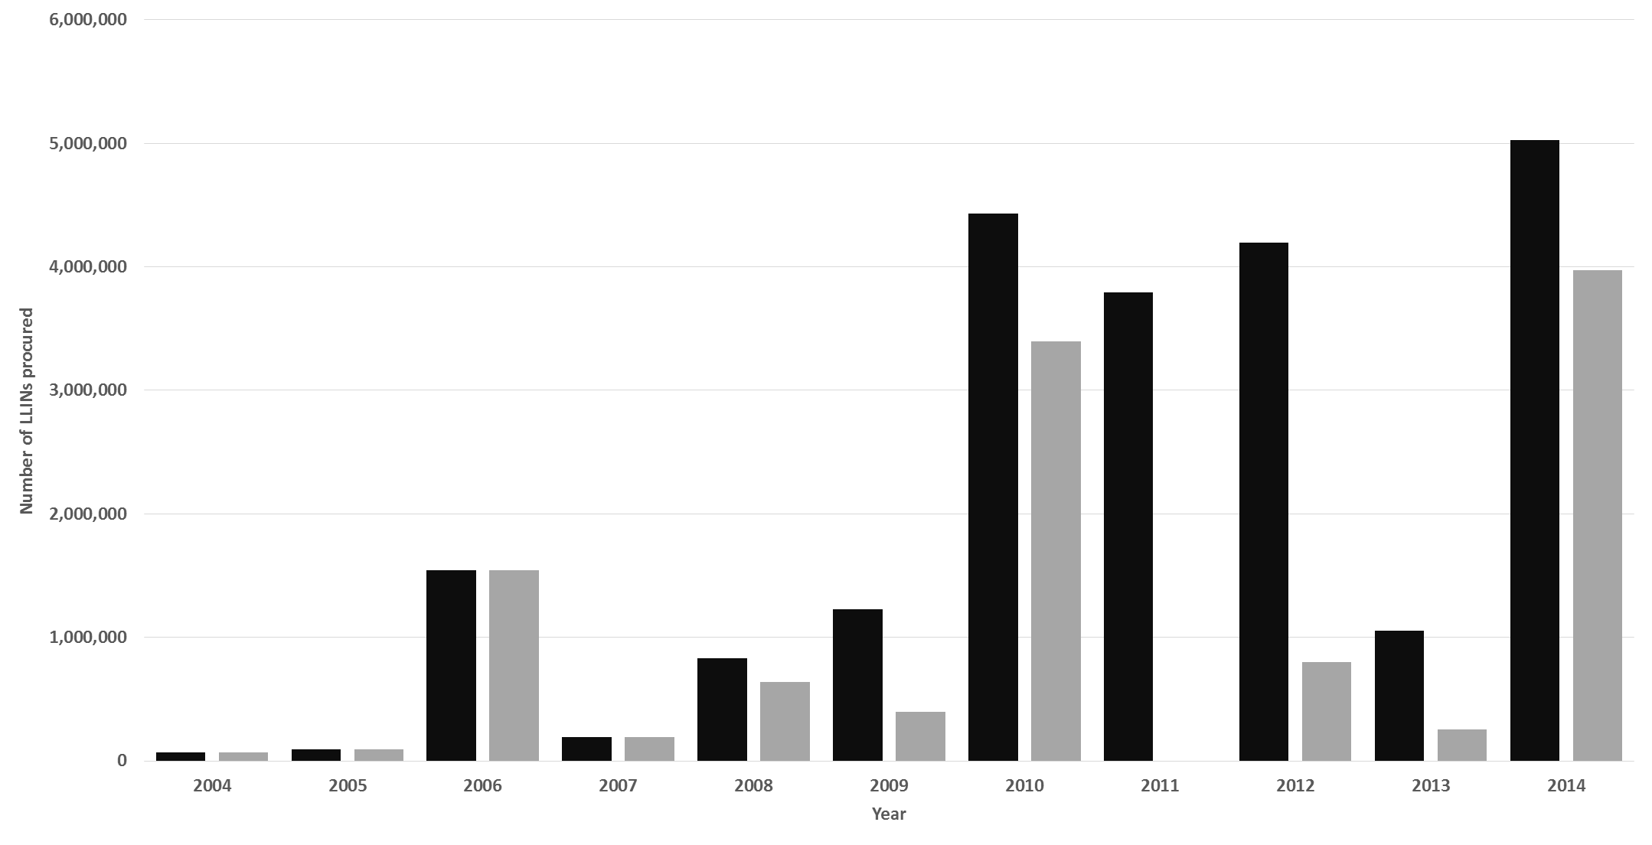
Sierra Leone: Annual national (grey) and effective cumulative (black) procurement of ITNs/LLINs
Notes:
Data on national procurement of ITN (up to 2006) and LLIN 2006 onwards were provided by the ALMA-RBM harmonization working group that maintain careful data on years and numbers of nets delivered to each country [Melanie Renshaw, personal communication, 2015]
Data have been arranged as follows, nets delivered in 2004 and 2005 (assumed to be ITN only) would have lasted for one year in absence of re-treatment. LLIN we have assumed would remain effective in year delivered and for three years afterwards when they would have lost efficacy. The graph shows therefore a cumulative “in-country” net availability. This is not usage or coverage which are modelled from household surveys in subsequent slides.

Slide 18
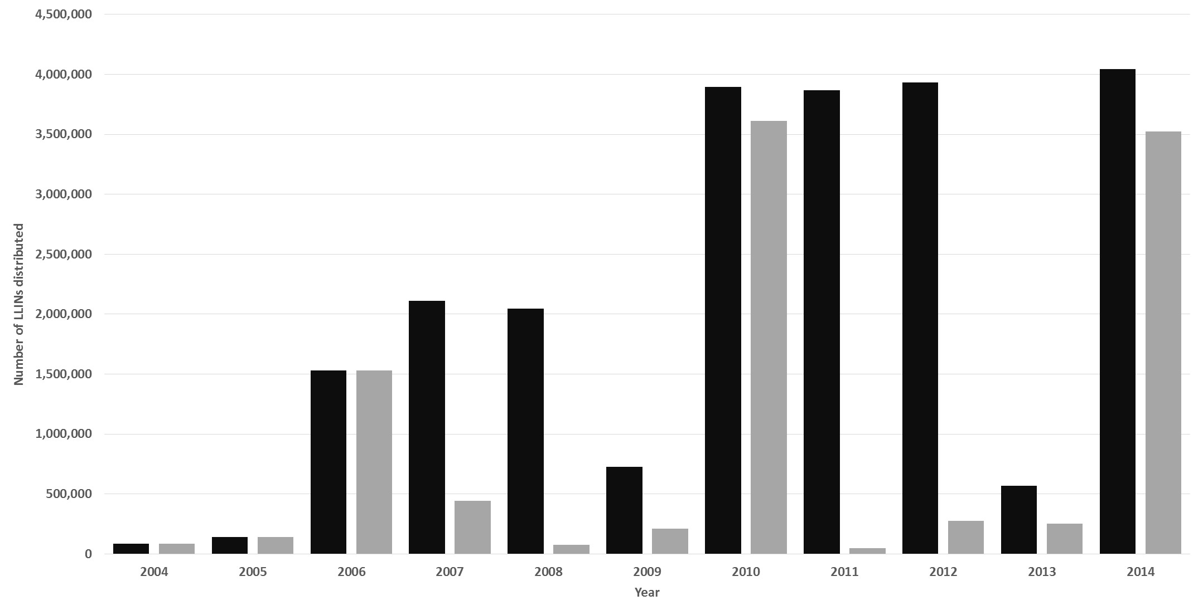
Sierra Leone: Annual national (grey) and effective cumulative (black) distributions of ITNs/LLINs
Notes:
Data on distribution of ITNs for the period 2004-2014 was obtained from the NMCP. Cumulative ITN/LLIN distribution were computed by assuming an effective ITN lifespan of 1 year (up to 2006) and 3 years (2007-2014) after which they were assumed lose efficacy. This graph shows distribution in country and does not reflect actual use of the nets or their ownership by households.

Slide 19
Sierra Leone: Districts (yellow) targeted for Indoor Residual Spraying (IRS) since 2011
Notes:
A pilot indoor Residual Spraying (IRS) was conducted in selected Chiefdoms in Bo, Bombali, Kono and Western Rural districts in 2011 and 2012 [NMCP 2012]. Districts were selected on the basis on the availability of reliable malaria morbidity and incidence rate data; human resource and logistical capacity to manage IRS; infrastructure; stakeholder participation; economic activity and availability of sentinel sites for monitoring insecticide efficacy. Objective of the pilot IRS program was to assess the feasibility, acceptability by communities, and effectiveness of IRS under the local circumstances and scale up the intervention for impact to reduce malaria burden in the country.
Reference:
National Malaria Control Programme (2012). The implementation of IRS in Sierra Leone in 2010-2012. Ministry of Health and Sanitation, Government of Sierra Leone, Draft Report, 2012.
Follow up:
Report indicates efficacy of various insecticides was undertaken but not clear which ones were used for household spraying.
Inquire if a final clean database of efficacy trials is available and we could map this.

Slide 20
Sierra Leone: Indoor Residual Spraying (IRS) in 2010-2012
Rooms sprayed
Coverage
% rooms sprayed
Rooms sprayed
<2730
0%
>89 % to 90%
273 - 4289
> 90 to 96 %
4290 - 6234
> 96 to 97 %
6235 - 11704
>97 to 98 %
11705 -
>98 to 99 %
Notes:
The IRS Data was presented at Chiefdom level for the year 2010-2012 [NMCP 2012]. Selected number of Chiefdoms were targeted in each IRS district: Bo (Badjia, Gbo, Bagbwa); Kono (Nyawa Lenga, Selenga, Fiama, Gbaneh, Nimikoro, Kamara, Gorama); Bombali (Safroko Limba; M/ Ndohahun, Makari Gbanti, Paki Masabong); Western Area Rural (Malambay, Lumpa(Partial), Macdonald, Crossing, Masorie, Newton, Kent, York, John Thorpe, Songo, Waterloo(Partial), Kissy town)
The last district Western Area Rural had 12 Chiefdoms which had to be merged to the existing chiefdoms for mapping. Freetown5 (Crossing, Kissy town, Masorie, Newton and Songo), Freetown3(John Thorpe Lumpa(Partial) Macdonald Malambay and Waterloo(Partial) ) and Freetown(Kent and York). For each Chiefdom data on rooms sprayed and coverage achieved based on planned targeted was computed.
Reference:
National Malaria Control Programme (2012). The implementation of IRS in Sierra Leone in 2010-2012. Ministry of Health and Sanitation, Government of Sierra Leone, Draft Report, 2012.

Slide 21
Sierra Leone: Mass Drug Administration (MDA) for malaria districts (dark grey)
Notes:
Sierra Leone experienced the first outbreak of Ebola virus disease (EVD) on the 25th of May, 2014 in the Eastern part of the country [NMCP 2015]. In May 2014, Sierra Leone experienced the first outbreak of Ebola virus disease (EVD). This outbreak has since resulted in 13785 cases of which 3955 died [CDC 2015]. The epidemic was concentrated in the Bombali and Port Loko districts in the Northern province and rural and urban zones of the Western Area province.
The EVD outbreak has disrupted malaria case management significantly partly because of its impact on the health system and work force, but also due to common initial symptoms between malaria and EVD, potential malaria patients in Sierra Leone are afraid to seek treatment for fear of being diagnosed with EVD. As part of the malaria response to the EVD outbreak, almost 3.5 million LLINs were distributed in June 2014. In addition, a pilot study on the potential effects of MDA during the malaria outbreak, using the first line treatment of artesunate-amodiquine (AS=AQ) was implemented in EVD hotspots. Two cycles of MDA were implemented in 5-8 December 2014 and 16-19 January 2015.
This map shows the districts targeted for MDA [NMCP 2015]. These districts were Bombali, Kambia, Koinadugu, Moyamba, Port Loko, Tonkolili, Western and Rural Western Urban/Freetown ) and are shaded in dark grey.
References:
Centers for Disease control and Prevention. 2014 Ebola Outbreak in West Africa - Case Counts. http://www.cdc.gov/vhf/ebola/outbreaks/2014-west-africa/case-counts.html.
National Malaria Control Programme (2015). Rapid Impact Assessment of Mass Drug Administration ( MDA ) for malaria in response to the Ebola outbreak in Sierra Leone. Ministry of Health and Sanitation, Government of Sierra Leone, Final Report, May 2015.

Slide 22
Sierra Leone: MDA Chiefdoms, Intervention (yellow); Control (brown)
Notes:
Within MDA districts (dark grey) MDA Chiefdoms are shown in yellow color while Non-MDA controls in brown color. In the report the Western Area is divided into Urban and Rural. 10 zones and 20 zones were captured in the Report for Rural and Urban Districts respectively. In mapping these chiefdoms, the two were merged and zones considered to have covered the entire districts. This is because of the lack of an updated zones map for the Western Area.
Reference:
National Malaria Control Programme (2015). Rapid Impact Assessment of Mass Drug Administration ( MDA ) for malaria in response to the Ebola outbreak in Sierra Leone. Ministry of Health and Sanitation, Government of Sierra Leone, Final Report, May 2015.
Follow up:
An updated zones map for Western Area.

Slide 23
Sierra Leone: MDA Chiefdoms - % population covered
Cycle 2
Cycle 1
Notes:
Maps showing Chiefdoms targeted for mass drug administration (MDA) for malaria in cycle 1 (5-8 December 2014) and cycle 2 (16-19 January 2015)

Slide 24
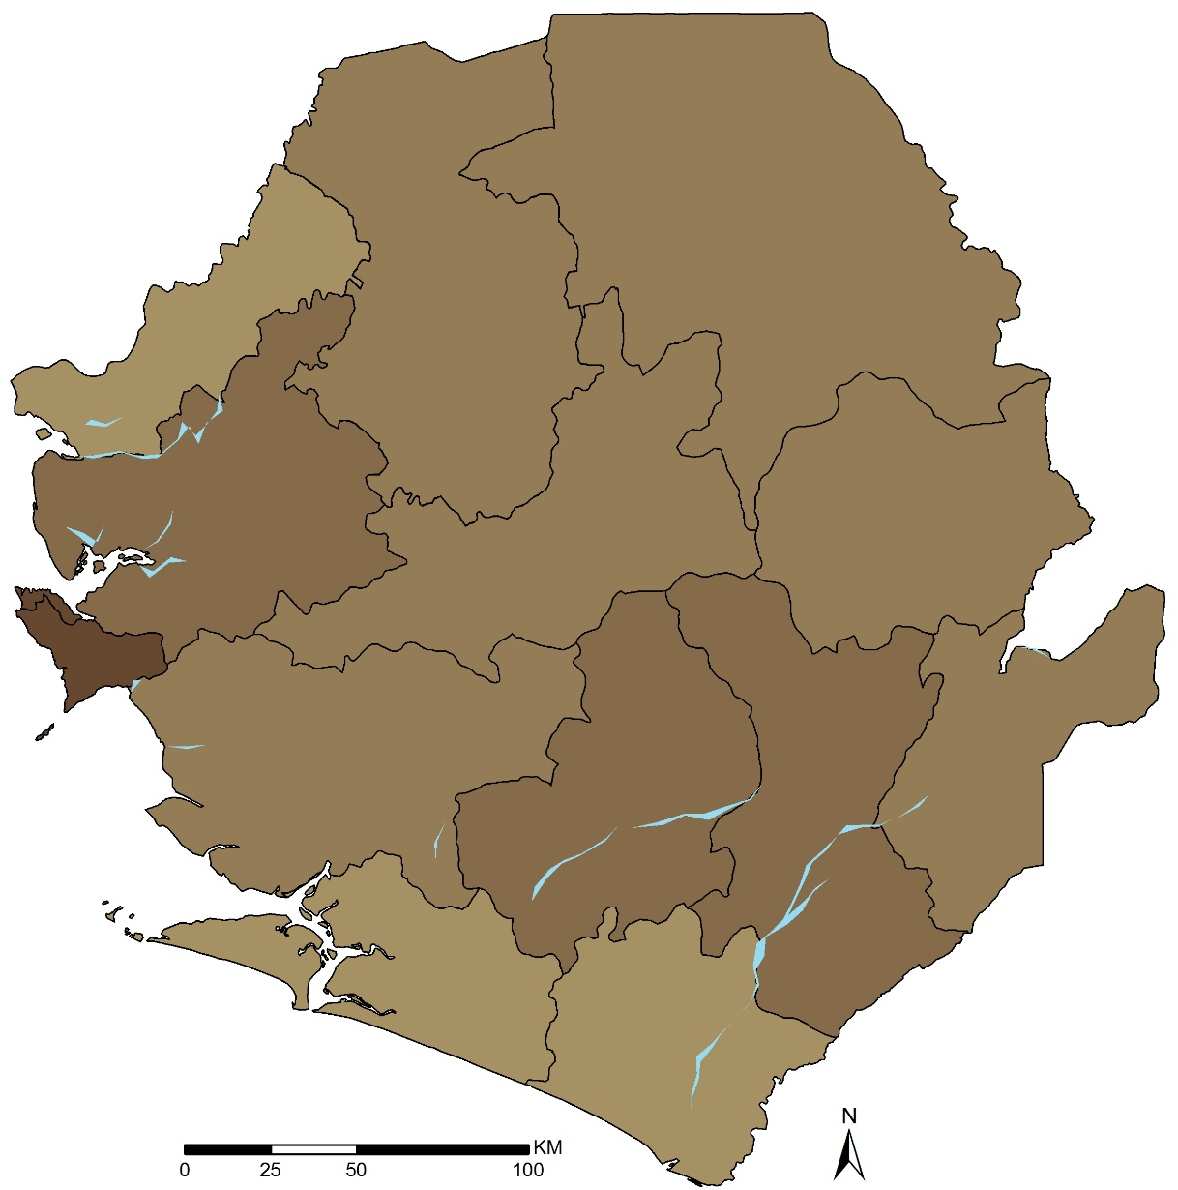
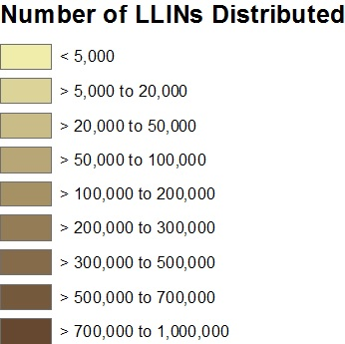
Total LLINs Distributed 2014

Slide 25
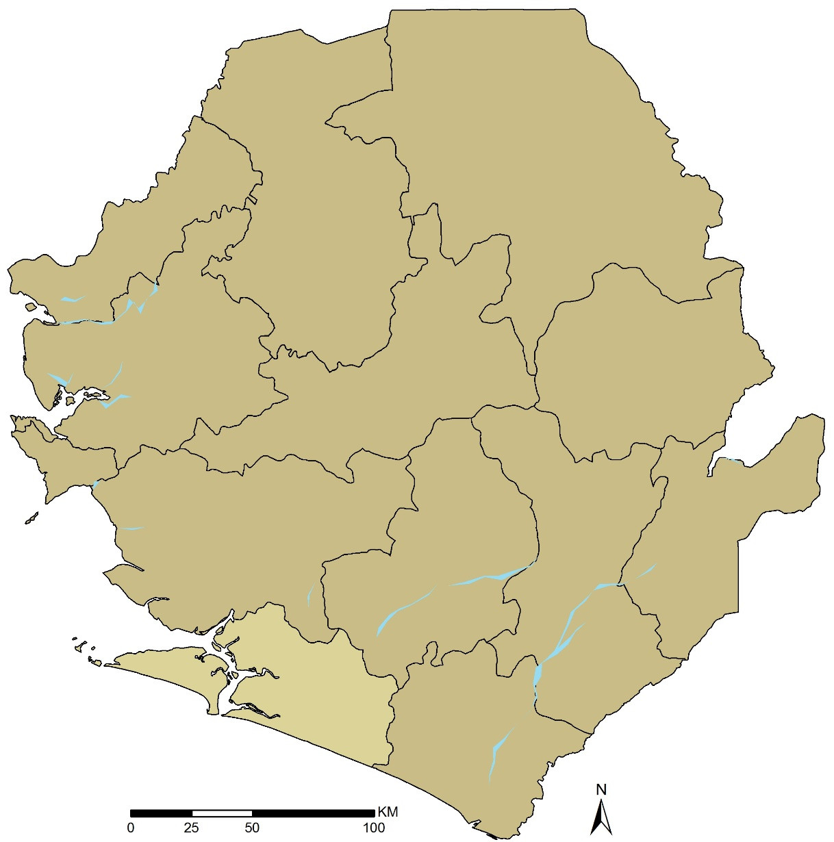
Total LLINs Distributed 2015

Slide 26
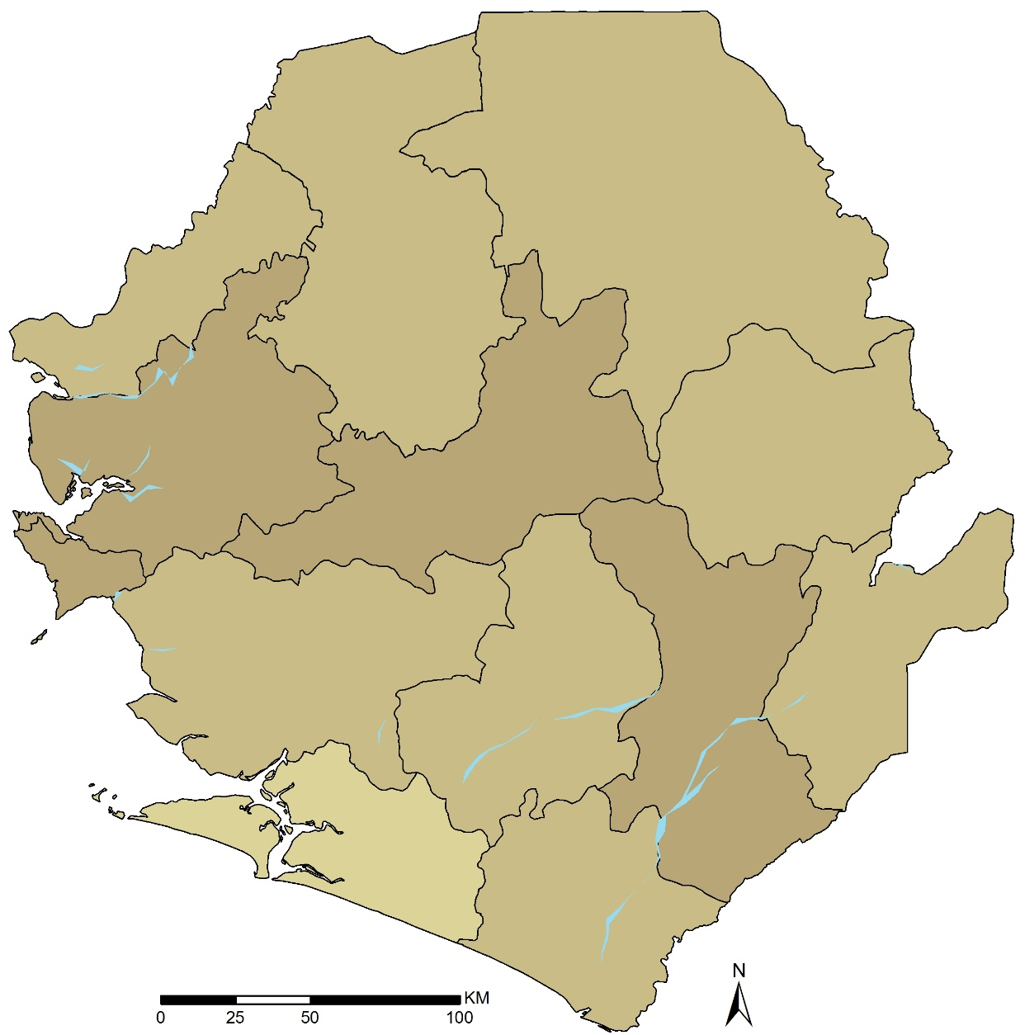
Total LLINs Distributed 2016

Slide 27
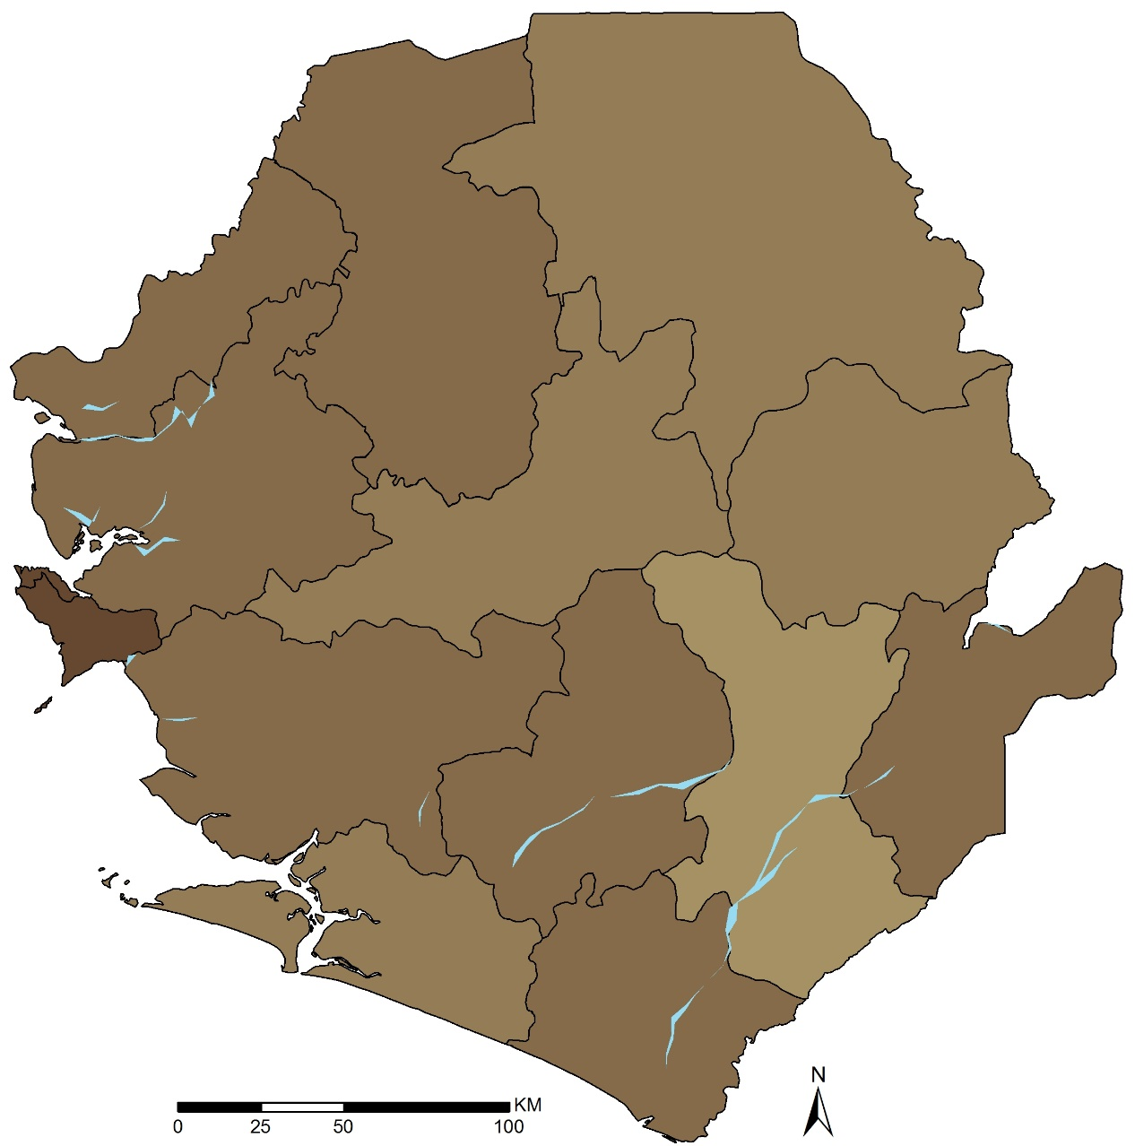
Total LLINs Distributed Jan to June 2017

Slide 28
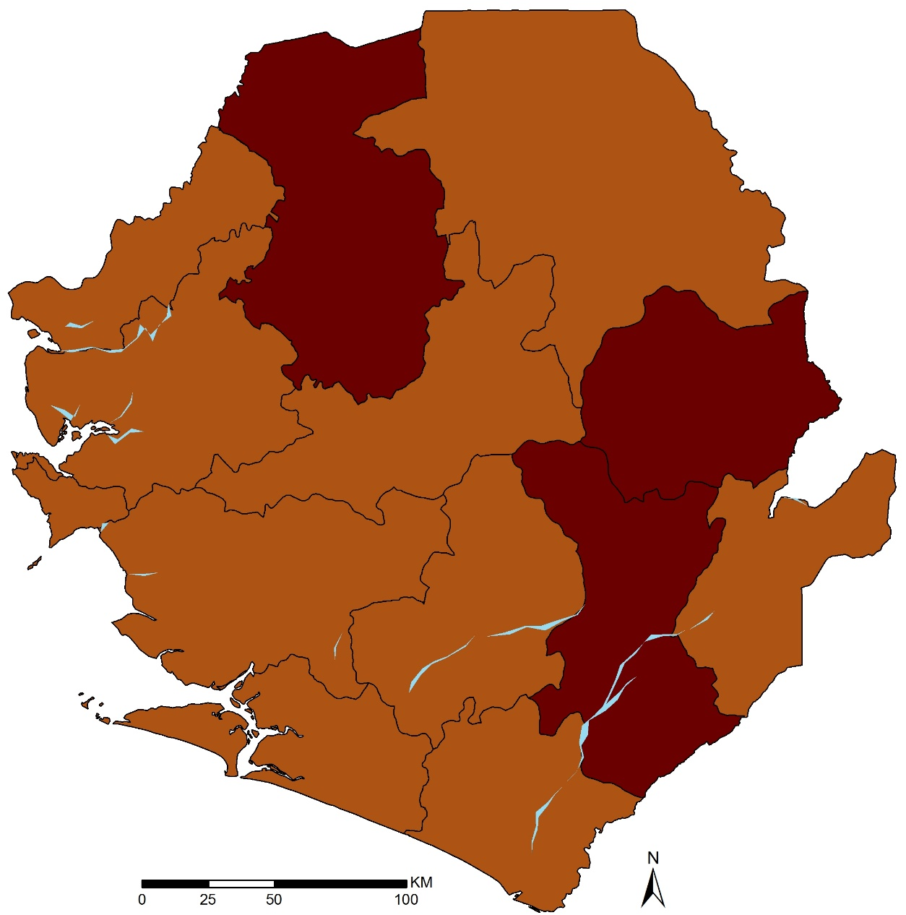
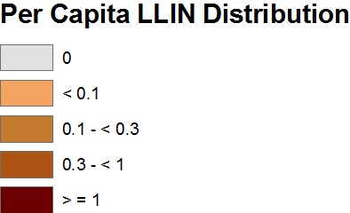
Total LLINs Distributed 2014 to June 2017

Slide 29
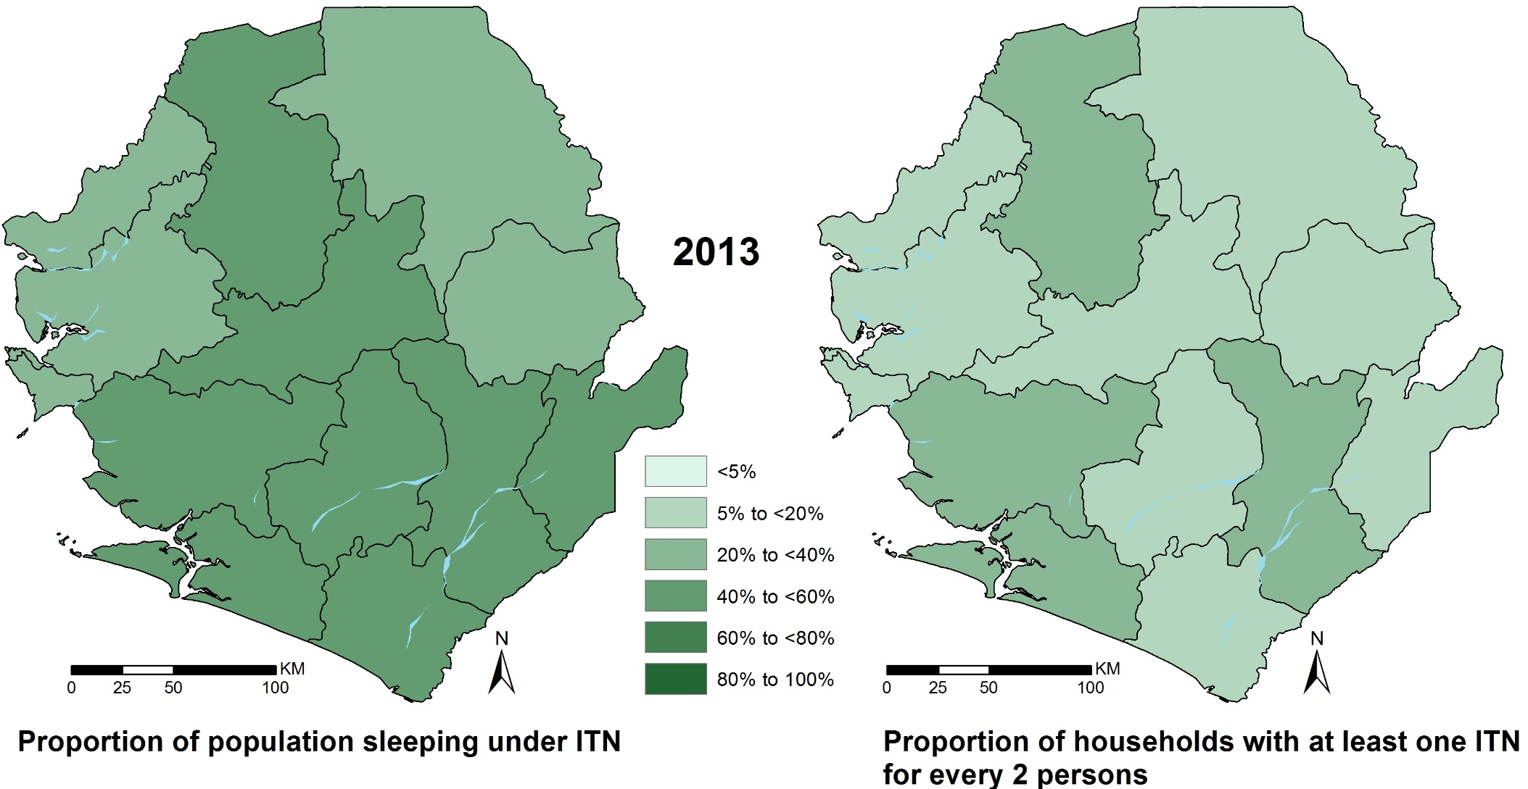
LLIN coverage 2013

Slide 30
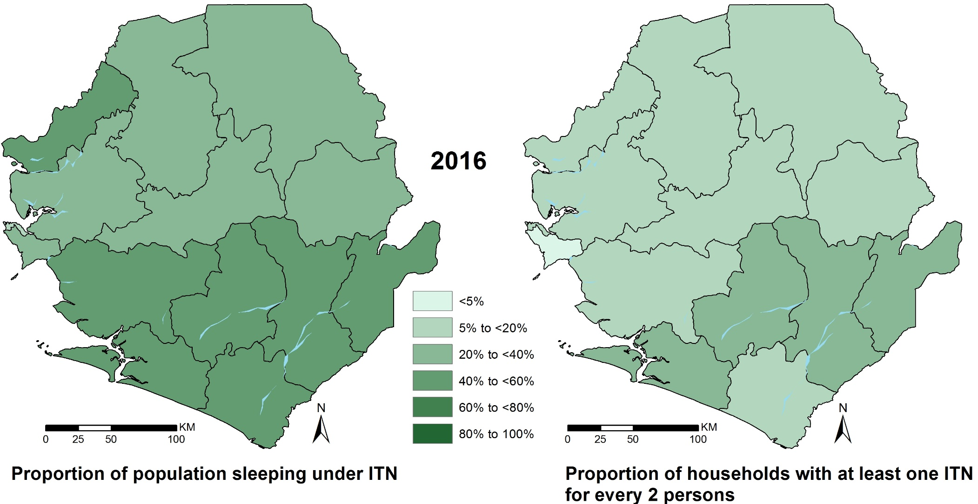
LLIN coverage 2016

Slide 31
Sierra Leone: Indoor Residual Spraying (IRS) in 2010-2012
Rooms sprayed
Coverage
% rooms sprayed
Rooms sprayed
0%
<2730
>89 % to 90%
273 - 4289
> 90 to 96 %
4290 - 6234
> 96 to 97 %
6235 - 11704
>97 to 98 %
11705 -
>98 to 99 %
Notes:
The IRS Data was presented at Chiefdom level for the year 2010-2012 [NMCP 2012]. Selected number of Chiefdoms were targeted in each IRS district: Bo (Badjia, Gbo, Bagbwa); Kono (Nyawa Lenga, Selenga, Fiama, Gbaneh, Nimikoro, Kamara, Gorama); Bombali (Safroko Limba; M/ Ndohahun, Makari Gbanti, Paki Masabong); Western Area Rural (Malambay, Lumpa(Partial), Macdonald, Crossing, Masorie, Newton, Kent, York, John Thorpe, Songo, Waterloo(Partial), Kissy town)
The last district Western Area Rural had 12 Chiefdoms which had to be merged to the existing chiefdoms for mapping. Freetown5 (Crossing, Kissy town, Masorie, Newton and Songo), Freetown3(John Thorpe Lumpa(Partial) Macdonald Malambay and Waterloo(Partial) ) and Freetown(Kent and York). For each Chiefdom data on rooms sprayed and coverage achieved based on planned targeted was computed.
Reference:
National Malaria Control Programme (2012). The implementation of IRS in Sierra Leone in 2010-2012. Ministry of Health and Sanitation, Government of Sierra Leone, Draft Report, 2012.

Slide 32
Sierra Leone: Mass Drug Administration (MDA) for malaria districts (dark grey)
Notes:
Sierra Leone experienced the first outbreak of Ebola virus disease (EVD) on the 25th of May, 2014 in the Eastern part of the country [NMCP 2015]. In May 2014, Sierra Leone experienced the first outbreak of Ebola virus disease (EVD). This outbreak has since resulted in 13785 cases of which 3955 died [CDC 2015]. The epidemic was concentrated in the Bombali and Port Loko districts in the Northern province and rural and urban zones of the Western Area province.
The EVD outbreak has disrupted malaria case management significantly partly because of its impact on the health system and work force, but also due to common initial symptoms between malaria and EVD, potential malaria patients in Sierra Leone are afraid to seek treatment for fear of being diagnosed with EVD. As part of the malaria response to the EVD outbreak, almost 3.5 million LLINs were distributed in June 2014. In addition, a pilot study on the potential effects of MDA during the malaria outbreak, using the first line treatment of artesunate-amodiquine (AS=AQ) was implemented in EVD hotspots. Two cycles of MDA were implemented in 5-8 December 2014 and 16-19 January 2015.
This map shows the districts targeted for MDA [NMCP 2015]. These districts were Bombali, Kambia, Koinadugu, Moyamba, Port Loko, Tonkolili, Western and Rural Western Urban/Freetown ) and are shaded in dark grey.
References:
Centers for Disease control and Prevention. 2014 Ebola Outbreak in West Africa - Case Counts. http://www.cdc.gov/vhf/ebola/outbreaks/2014-west-africa/case-counts.html.
National Malaria Control Programme (2015). Rapid Impact Assessment of Mass Drug Administration ( MDA ) for malaria in response to the Ebola outbreak in Sierra Leone. Ministry of Health and Sanitation, Government of Sierra Leone, Final Report, May 2015.

Slide 33
Sierra Leone: MDA Chiefdoms, Intervention (yellow); Control (brown)
Notes:
Within MDA districts (dark grey) MDA Chiefdoms are shown in yellow color while Non-MDA controls in brown color. In the report the Western Area is divided into Urban and Rural. 10 zones and 20 zones were captured in the Report for Rural and Urban Districts respectively. In mapping these chiefdoms, the two were merged and zones considered to have covered the entire districts. This is because of the lack of an updated zones map for the Western Area.
Reference:
National Malaria Control Programme (2015). Rapid Impact Assessment of Mass Drug Administration ( MDA ) for malaria in response to the Ebola outbreak in Sierra Leone. Ministry of Health and Sanitation, Government of Sierra Leone, Final Report, May 2015.
Follow up:
An updated zones map for Western Area.

Slide 34
Sierra Leone: MDA Chiefdoms - % population covered
Cycle 1
Cycle 2
Notes:
Maps showing Chiefdoms targeted for mass drug administration (MDA) for malaria in cycle 1 (5-8 December 2014) and cycle 2 (16-19 January 2015)

Slide 35
Routine health data

Slide 36
MIS Reported RDT Positivity (actual data)
2016 (June – August)
2013 ( February – March)

Slide 37
MIS Reported Microscopy Positivity (actual data)
2013 ( February – March)
2016 (June –August)

Slide 38
Model Predicted RDT (PfPR_{2–10})
2013 ( February - March)
2016 (June - August)
Notes:
Small area estimation (SAE) techniques are applied to produce reliable estimates for small geographies with few data points since it is impossible to have reliable estimates of small geographical unit directly. The few data points are due to time and resources constraints.
Spatio-temporal SAE models its advantage of information from the neighboring areas when estimating spatially and temporally correlated random effects improving estimates at non sampled points are improved. The area variation not explained by the selected covariates is split in two components, structured and unstructured for each region. Structured effects reflect the likely correlation between neighboring regions while unstructured effects are termed to be independent in each area. Here the SAE models borrowed strength from the neighboring districts and for each year and autocorrelation in time.

Slide 39
2013 SAE modelled RDT vs MIS reported RDT
SAE
Reported

Slide 40
2016 SAE modelled RDT vs MIS reported RDT
SAE
Reported

Slide 41
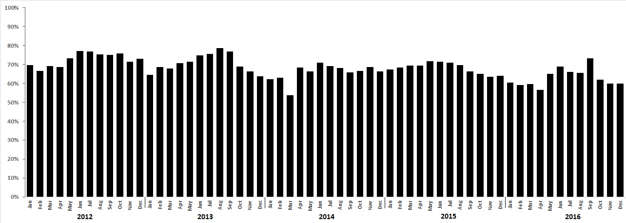
Sierra Leone under 5 years, monthly TPR overall Jan 2012 – Dec 2016

Slide 42
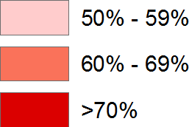
Sierra Leone under 5 years, annual TPR by district 2012 - 2016
2012
2013
2014
2015
2016

Slide 43
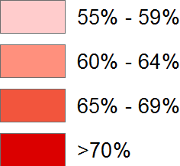
Combined TPR February-March 2013
Combined TPR June-July-August 2016

