Slide 1

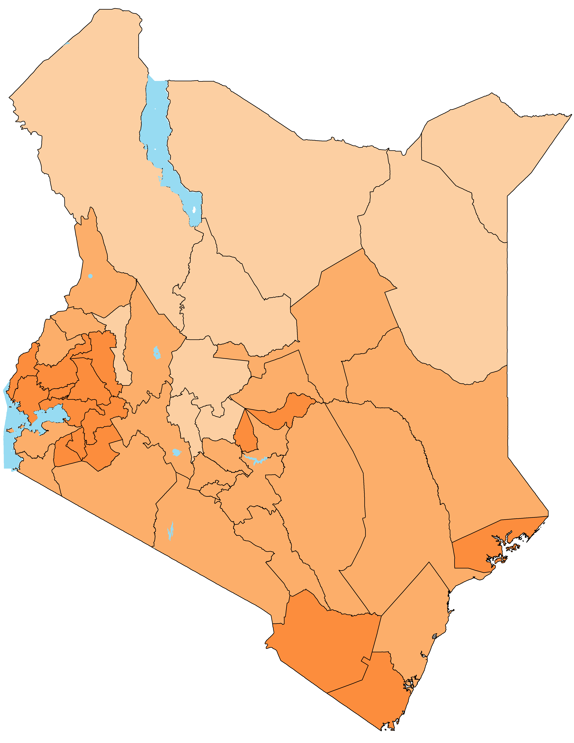



KENYA MALARIA EPIDEMIOLOGY AND CONTROL PROFILE
POPULATION AND ADMINISTRATION
Population by year
Population of counties in 2015
Location of main towns
MALARIA TRANSMISSION AND POPULATION AT RISK
Predicted age-corrected population adjusted P. falciparum parasite rate (PAPfPR₂₋₁₀) by sub-county in 2000 and 2015
Population at risk by different malaria endemicity in 2000 and 2015
PfPR₂₋₁₀ endemicity | 2000 | 2015
Malaria free | 470,373 (1.6%) | 688,618 (1.5%)
<1% | 6,804,174 (23.2%) | 8,993,618 (19.6%)
1% to <5% | 3,051,828 (10.4%) | 19,484,212 (42.5%)
5% to <10% | 3,186,726 (10.9%) | 5,644,731 (12.3%)
10% to <20% | 3,438,631 (11.8%) | 3,524,331 (7.7%)
20% to <50% | 8,032,565 (27.5%) | 7,499,677 (16.4%)
≥50% | 4,266,978 (14.6%) | 0 (0.0%)
VECTOR CONTROL: DISTRIBUTION, COVERAGE AND USE OF INSECTICIDE TREATED NETS (ITNs)
Annual distribution of ITNs since 2004-2015 (graph) and within the last 3 years by county in 2015 (map). RD= routine distribution; FMC= free mass campaign.
% households with universal ITN coverage by survey year (graph) and by county in 2015 (map)
% population sleeping under ITN the night before survey by survey year (graph) and by county in 2015 (map)
MALARIA PREVENTION IN PREGNANT WOMEN
% women receiving at least one dose (IPTp1) or two doses (IPTp2) during pregnancy in the last 2 years by survey year (graph) and by county in 2015 (map)
% pregnant women sleeping under an ITN the night before survey by survey year (graph) and by county in 2015 (map)
MALARIA CASE MANAGEMENT
% of children under the age of five years who had fever in the last two weeks and sought treatment from a health facility, pharmacy or medicine store by survey year (graph) and by county in 2015 (map)
% of children under the age of five years who took the recommended first line antimalarial drug among those who had fever in the last two weeks and took antimalarials, by survey year (graph) and by county in 2015 (map)
Population projections are based on the 1999 and 2009 intercensal growth rates.
Data from the period 1980-2015 were used to estimate PfPR₂₋₁₀ across Kenya using Bayesian spatial-temporal methods and are provided with their uncertainties in the main report.
Data used for intervention analysis and mapping are the DHS of 2003, 2008-9 and 2014-15 and the MIS of 2007, 2010 and 2015
Estimates of ITN universal coverage and use, IPTp coverage, treatment of fever and use of recommended first-line treatment were estimated by county and sub-county using Bayesian small area estimation methods. Estimates for 2015 were generated from a combination of the DHS 2014-15 and the MIS 2015. All modeled estimates are provided with measures of their uncertainty in the main report
Between 2004 and May 2005, conventional ITNs were the main type of net in use in Kenya. Long lasting insecticidal nets (LLINs) were introduced in mid 2005.
In 2003 Sulphadoxine-pyrimethamine (SP) was the recommended first line antimalarial . Artemether lumefantrine (AL) was first line since 2006.

